Slide 1
Solar Power at Landfill
Letter of Intent for RFP
Tony Manzara,
Lake Elmo Economic Development Authority
December 3, 2024

Slide 2
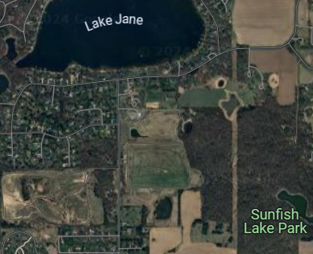
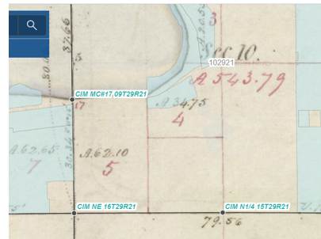
Washington County Landfill (WCL)
Plat of 1848 Aerial view now
Government Lots 4 and 5
Elmo’s Pup Park
WCL

Slide 3
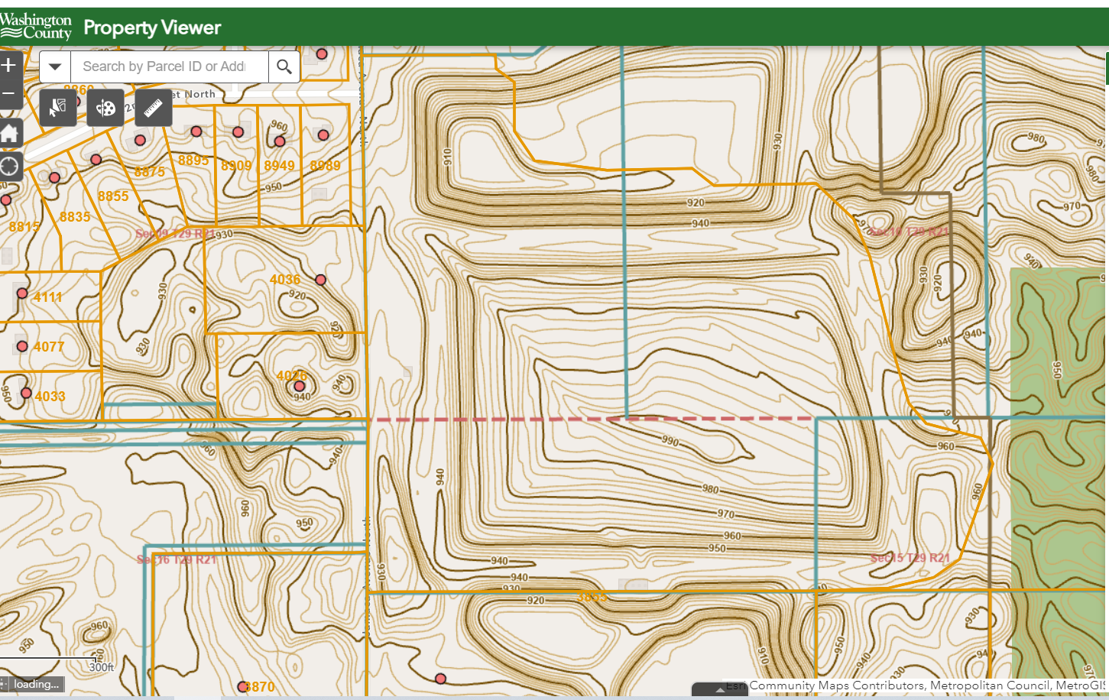
Contour Lines From https://wcmn.maps.arcgis.com/apps/webappviewer/index.html?id=c07b8931249b47be81278a79103bd698

Slide 4
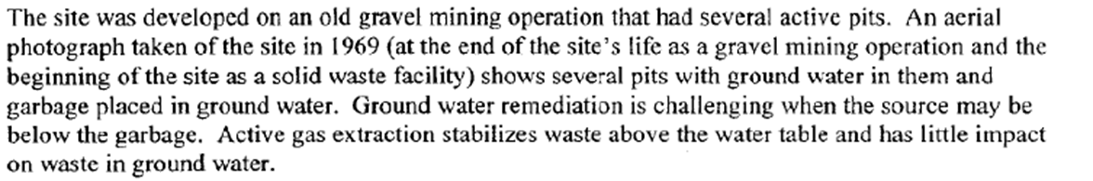
WCL Condensed History - utilization
Public Ownership of Landfill area after use as gravel pit
Landfill had no protective liner or leachate collection system
1969- May 1, 1975 Counties charged “tipping fees”
1969 – $0.20/0.30 per cubic yard, 1970-72 $0.30/0.45 loose/compacted
Total fill 2.75 Million Cu Yd or about $1 - 2 Million revenue
73% Municipal, 26% industrial, 1% demolition
1975 Site was closed

Slide 5
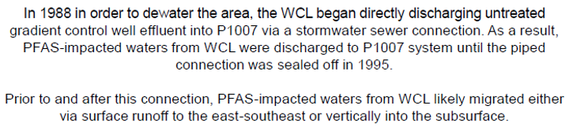
WCL Condensed History – 1975-1996
1981 Volatile Organic Compounds and metals found
1983 Ground water pump out for gradient control / spray irrigation for VOC removal
1984 site added to US and MN Superfund lists
1987-1995 Valley Branch Watershed District Project 1007 – pumped volume 50-80 M gal/yr
1993 methane explosion in valve house – gas extraction system installed
1995 site declared “no threat to public health”
1996 Site removed from Superfund status and control transferred to Minnesota Landfill Cleanup Program
1996 New landfill cover and active gas extraction system with flaring planned

Slide 6
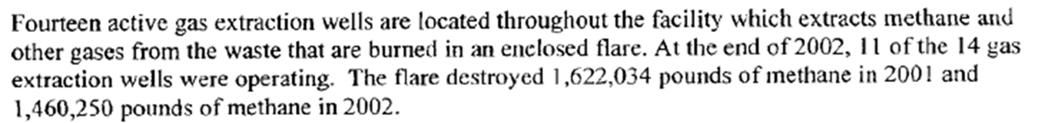
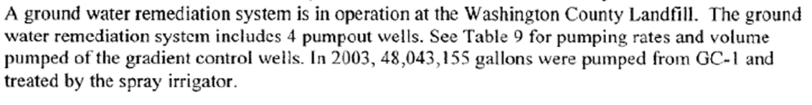
WCL Condensed History 1997-2024
2002
2003
2004 PFAS issue first considered
2006 spray irrigation stopped
2013 Zoned for solar power by City of Lake Elmo
2014 $4.3 million GOB to rearrange & cap waste and build a hill

Slide 7
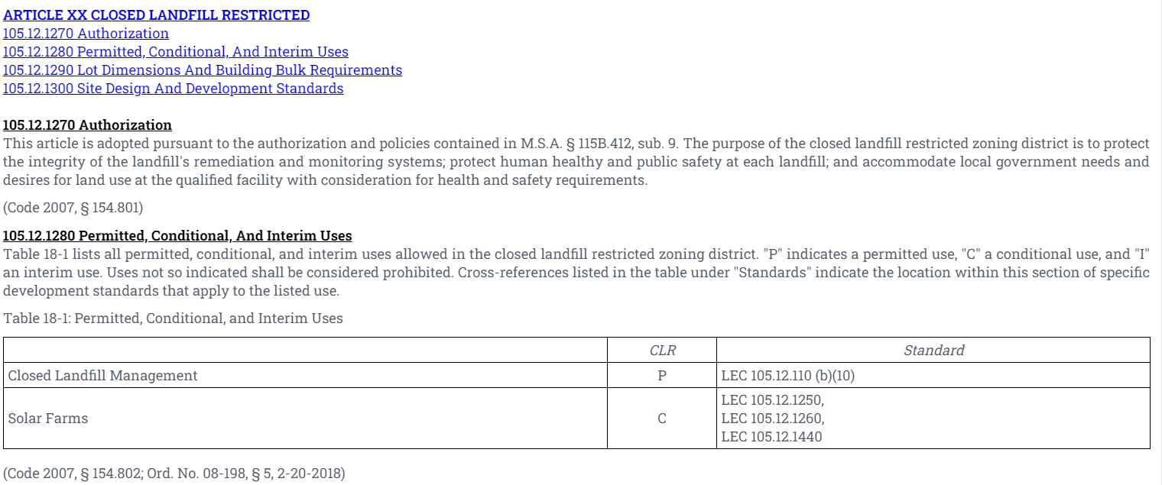
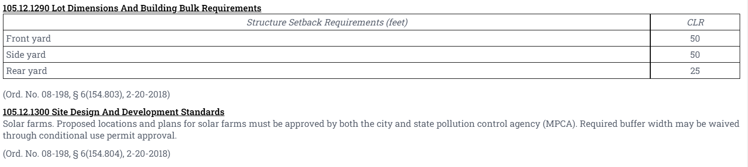
Lake Elmo Zoning

Slide 8
Current status
MN requires retirement of GOB before “beneficial use” occurs.
Spent $4,294,062.52 in 2014, end date is 2054.5, assume 40 year straight line payoff
2024 remaining obligation is 75%, $3,220,546.89
Mn/3M PFAS Settlement Priority 2 funding allotment is $20 M
Priority 2 Goal 1 is to restore habitat
RFP delayed from June 2024 to “late 2024”, process will require LOI (Letter of Intent” to get in the queue, does not create commitment to do a final proposal
Lake Elmo has suffered harm from PFAS (probably most of any locality on a per-capita basis) and can justify compensation
Lake Elmo EDA supports the submission of the LOI.

Slide 9
Due Diligence So Far – by Tony Manzara
Hans Neve – MN Closed Landfills Official – design reviewer
Jennifer Hassemer – MN Bonding Official – requested exact amount
Clark McWilliams – SCS Engineering – site review can be done
Timothy Bradley – Landfill Solar – offered conceptual design
Mary Kay Olson – Cooperative Energy Futures – business models
….. Xcel Energy about availability / cost of connection to grid
No obvious Show Stoppers yet

Slide 10
Looking Forward
RFP published with format, Q&A session, submission deadline
If LOI is accepted, write Proposal (Tony), Review by City Staff , Submit
List of steps needed – Gannt chart
Business Model Choices
– lease land to developer/operator who sells power to make profit
- EDA floats a bond to build it and City sells the power to Xcel
Await Notice of Award

