Slide 1


Lake Elmo Water
April 8th, 2025
Clark Schroeder, Special Projects Manager
cschroeder@lakeelmo.gov

Slide 2
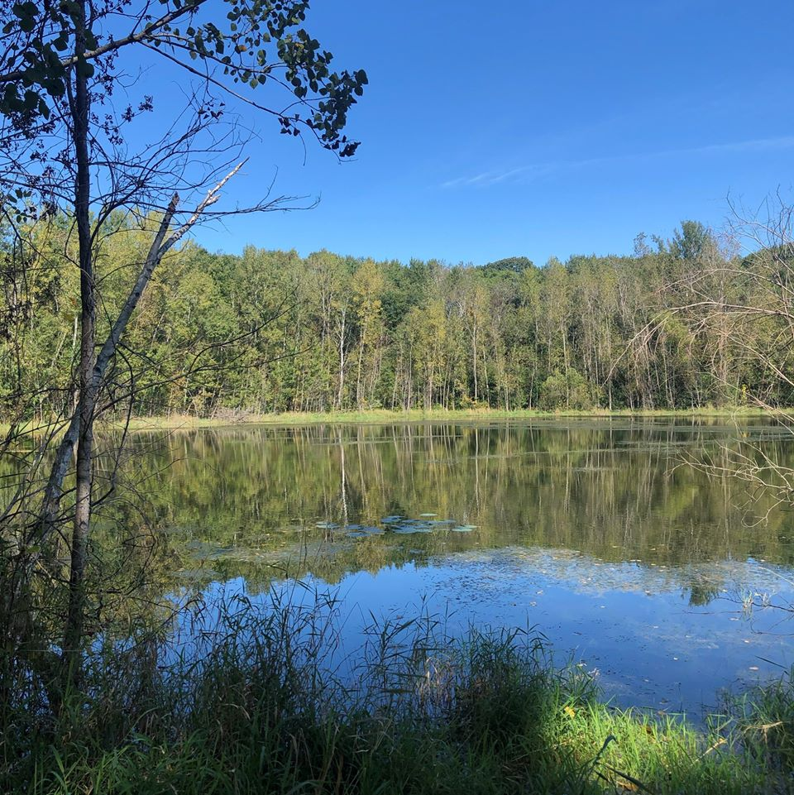
Topics
DNR/WBL Legal Update
White Bear Lake Comprehensive Workgroup
3M Settlement Priority 1 Workgroup
Long Term Funding
Washington County Landfill
01
02
03
04
05

Slide 3
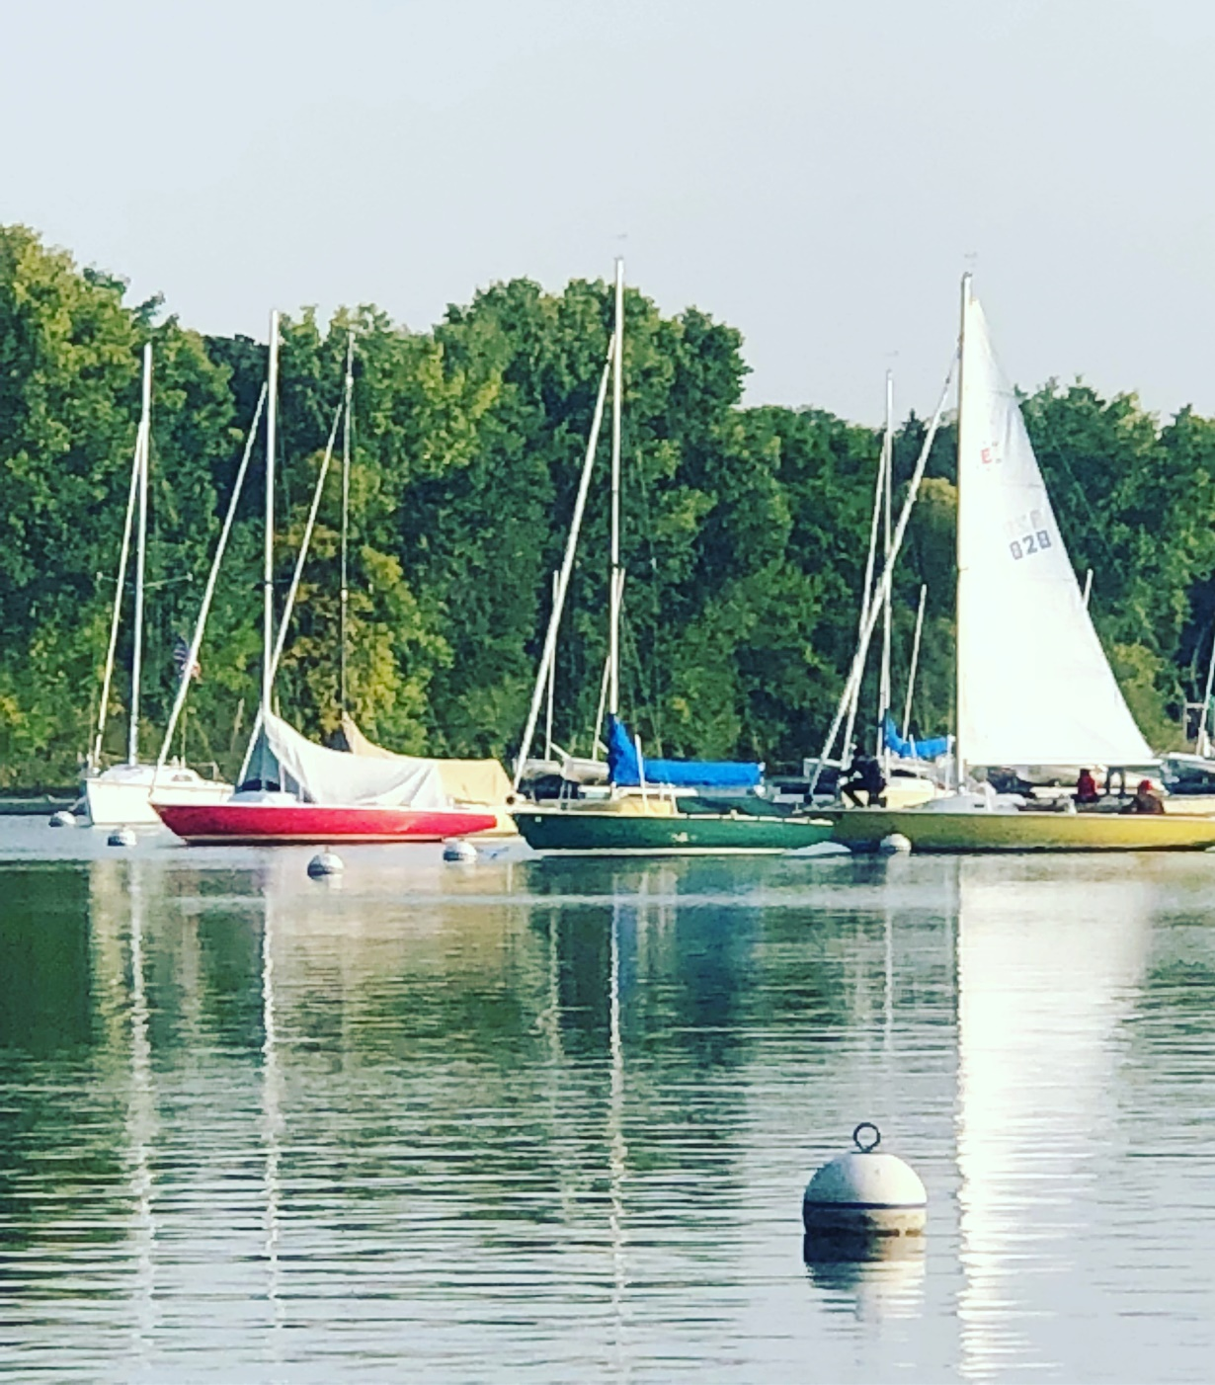
DNR / White Bear Lake Legal Update/Lawsuits
01
In 2012, a lawsuit was filed against the DNR claiming that excess groundwater permits in the east metro led to unacceptably low lake levels.
02
Timeline of court cases that have been going on since 2012 HERE.
03
Short summary HERE.
04
This led to the White Bear Lake Comprehensive workgroup

Slide 4
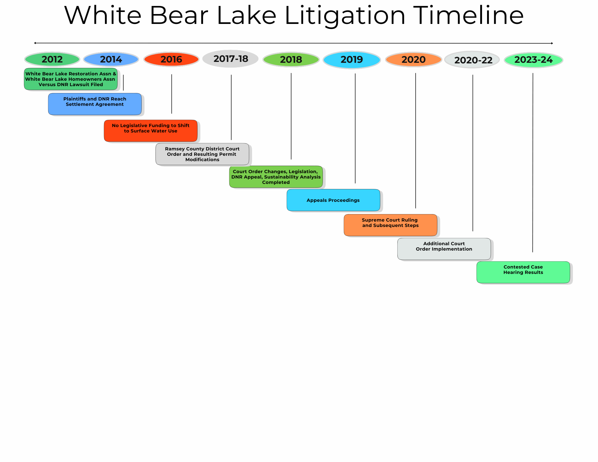
White Bear Lake Lawsuit Timeline
.

Slide 5

White Bear Lake Lawsuit Next Steps
01
On April 16th at 11:15, there will be an oral argument at the Minnesota Court of Appeals regarding a water appropriation permit appeal. We are appealing the Administrative law judge’s decision that requires us to implement and enforce a plan to phase down to 75/90 (condition No. 3).
02
December 16-19, 2025, the trial addresses the City’s objection to the DNR’s September 10, 2024, amendment to our water permit.

Slide 6

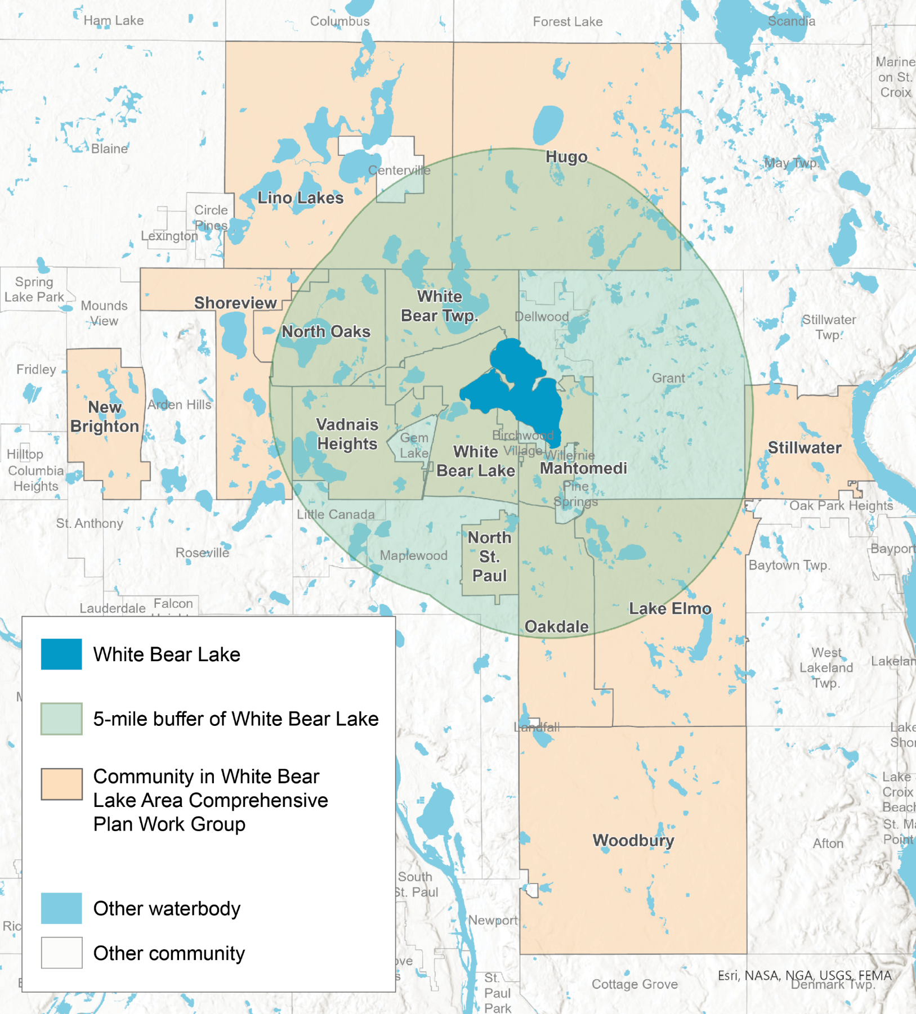
White Bear Lake Comprehensive Workgroup
01
A workgroup has been established to create a comprehensive plan that ensures communities in the White Bear Lake area have access to sufficient safe drinking water. This plan aims to support municipal growth while also ensuring the sustainability of surface water and groundwater resources to meet the community's needs.
02
15 different studies being done or considered by the group
HERE is a listing of the studies.
This is the current Lake level. HERE Protective level of 922
Legislative allocation of $2 million; will most likely need more to finish all studies.
03

Slide 7
White Bear Lake Comprehensive Workgroup
The court ordered the DNR to amend existing groundwater permits within a five-mile radius of White Bear Lake with the following stipulations:
  Require a residential irrigation ban when the water level of White Bear Lake drops below 923.5 feet. The ban remains in effect until the water level reaches 924 feet.
  Require all permittees to develop a per capita water use plan to reduce residential per capita water use to 75 gallons per day and total per capita water use to 90 gallons per day.
  Require public water suppliers to develop a contingency plan to shift their source of water from groundwater to surface water.
  Require all permittees to report to the DNR annually on collaborative efforts with other north and east metro communities to develop per capita water use plans.

Slide 8
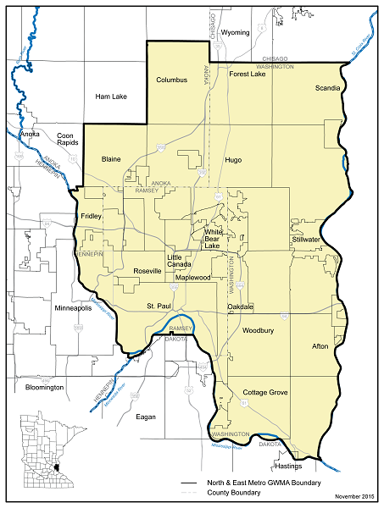
White Bear Lake Studies
01
One study is examining potential surface water connections for various cities.
02
The proximity of a city to the lake influences lake levels.
03
In this proposal, we will study surface water connections to cities closer to White Bear Lake than Lake Elmo. Presentation. Surface water will not be recommended for Lake Elmo due to the limited effect it would have on WBL in my opinion.
04
A key concern is how to fund this initiative. If cities in the east metro area benefit from switching to surface water, an east metro taxing district could be established, or state funding could cover costs. Further discussion on this will continue over the next two years.

Slide 9
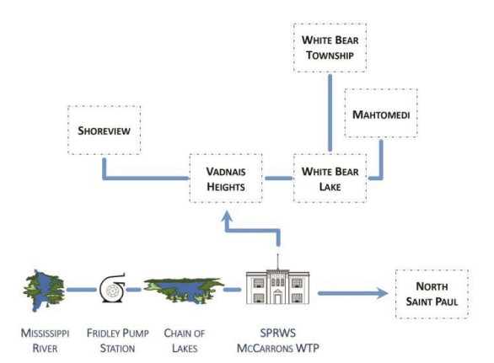
White Bear Lake Comprehensive Workgroup
One Option for Surface Water

Slide 10
White Bear Lake Comprehensive Workgroup Members
Bryan Bear, City of Hugo Clark Schroeder, City of Lake Elmo Michael Grochala, City of Lino Lakes Bob Goebel, City of Mahtomedi Craig Schlichting, City of New Brighton Kevin Kress, City of North Oaks Morgan Dawley, City of North St. Paul Chris Volkers, City of Oakdale Tom Wesolowski, City of Shoreview Shawn Sanders, City of Stillwater Racquel Vaske, Saint Paul Regional Water Services | Jim Hauth, City of Vadnais Heights Paul Kauppi, City of White Bear Lake Mary Van Milligen, City of Woodbury Pat Christopherson, White Bear Township David Weum, Department of Health Jason Moeckel, Department of Natural Resources vacant, Metropolitan Area Water Supply Advisory Committee (MAWSAC) Liz Kaufenberg, Minnesota Pollution Control Agency

Slide 11
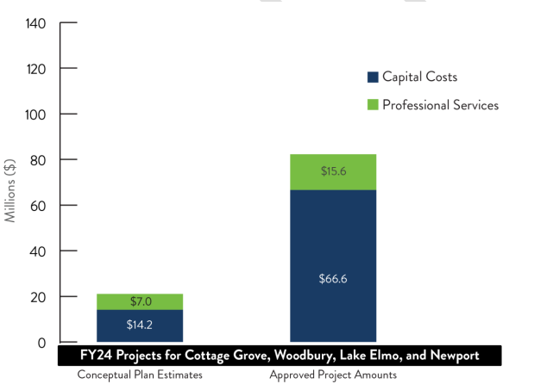
3M Priority One Workgroup
01
This fund is managed by a Trustee who reviews and approves projects according to their charter. This document is from 2020, so some members’ names have changed.
02
All the past meetings and notes are HERE
03
Annual report for 2024 HERE
04
Approved projects are more expensive than the conceptual estimate, and hence they are anticipating the fund will run out by 2027.

Slide 12

3M Priority One Workgroup
This group is composed of one representative each from the MPCA, DNR, 3M, Washington County, and one representative from each of the following communities: Afton, Cottage Grove, Lake Elmo, Lakeland, Lakeland Shores, Maplewood, Newport, Oakdale, St. Paul Park, Woodbury, the townships of Denmark, Grey Cloud Island, and West Lakeland, and the Prairie Island Indian
Community. One representative from the Citizen–Business Group will also be a liaison to this group. Each community, MPCA, DNR, and 3M can designate one alternate when their representative is unable to participate in a meeting. MAP.

Slide 13
3M Priority One Workgroup Lake Elmo Projects
Well 2 PFAS Treatment Project.
Contract #1: Well 2 PFAS Removal Equipment. We have been informed that a delay in equipment delivery is anticipated and are working with the Contractor to mitigate impacts.
Contract #2: Well 2 Generator Equipment. The generator delivery date has been moved up to May 13, 2025 (previously June 4). Contract #3: Well 2 Water Treatment Plant General Construction Contract. Demolition work is substantially completed at Wellhouse No. 2 and the contractor is starting masonry, electrical and concrete work.
South Water Treatment Plant (WTP) and Wells.
A preliminary site plan has been developed with land acquisition requirements identified, it will require and acquisition of approximately 8-acres.
North Water Treatment Plant (WTP) for Well 4 and Well 5.
A draft preliminary design proposal was received by SEH and is currently under review by the City Engineering team. Once the work plan and fee is finalized, staff will prepare a Planning Grant through the MPCA to fund the study. The study purpose is to prepare the preliminary design and Site analysis for the North Water Treatment Plant for Well 4 and Well 5. Staff is currently working on preparing a MPCA grant.

Slide 14
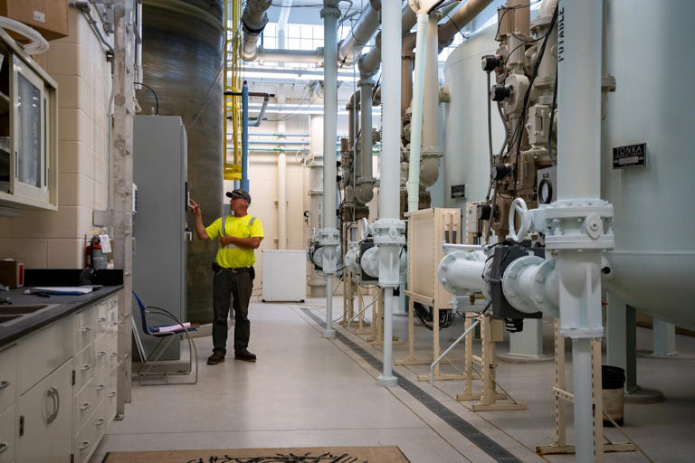
3M Priority One Workgroup
01
What’s next after the 3M settlement fund runs of money?
02
In 2007, the MPCA and 3M negotiated a Consent Order to bring investigation and cleanup of the three disposal sites under the formal Superfund process. These sites are in Oakdale, Woodbury,
© Angelina Katsanis/Star Tribune/TNS
and Cottage Grove. The Washington County Landfill (WCL) in Lake Elmo was NOT included. 2007 Decree, Listing from AG office of exhibits from the 2018 settlement. HERE
03
3M is requesting mediation to resolve disputes with the MPCA regarding “what is reasonable and necessary,” under the 2007 decree.

Slide 15
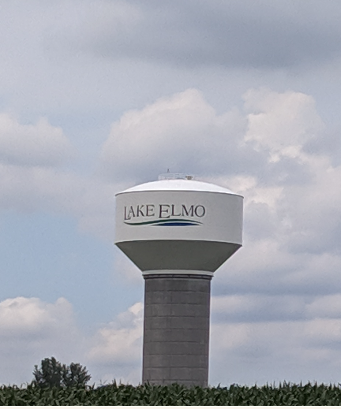
PFAS Plume
Lake Elmo’s concern for both City water supplies and private wells
03
Our plume is also influenced by project 1007 which is a project which stabilized the lake levels in the tri-lakes area from 1987 but also ended up creating a path for PFAS transmission further downstream. Project
04
MPCA is analyzing the plume to see what percentage of mixed molecules come from which landfill.
05
One of the long-term goals is to eliminate the PFAS in the aquifers. The only way to do that is to pump out the water and reinject it back in, or divert some of it to drinking water

Slide 16
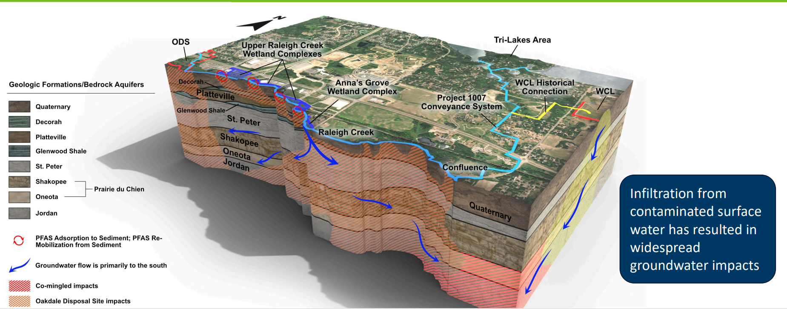
Project 1007- Highway for PFAS Transmission
.

Slide 17
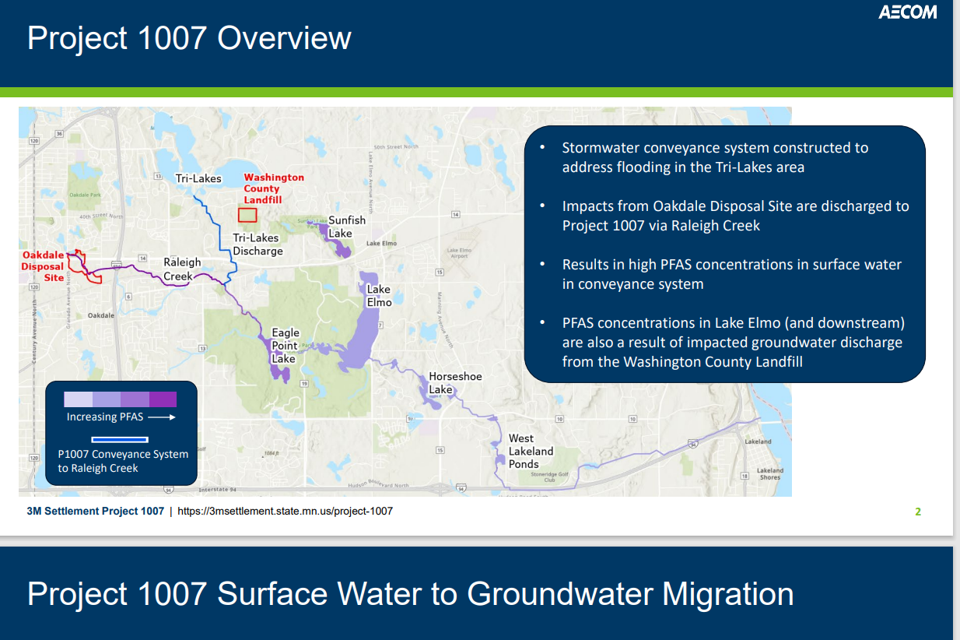
Project 1007- Highway for PFAS Transmission
.

Slide 18
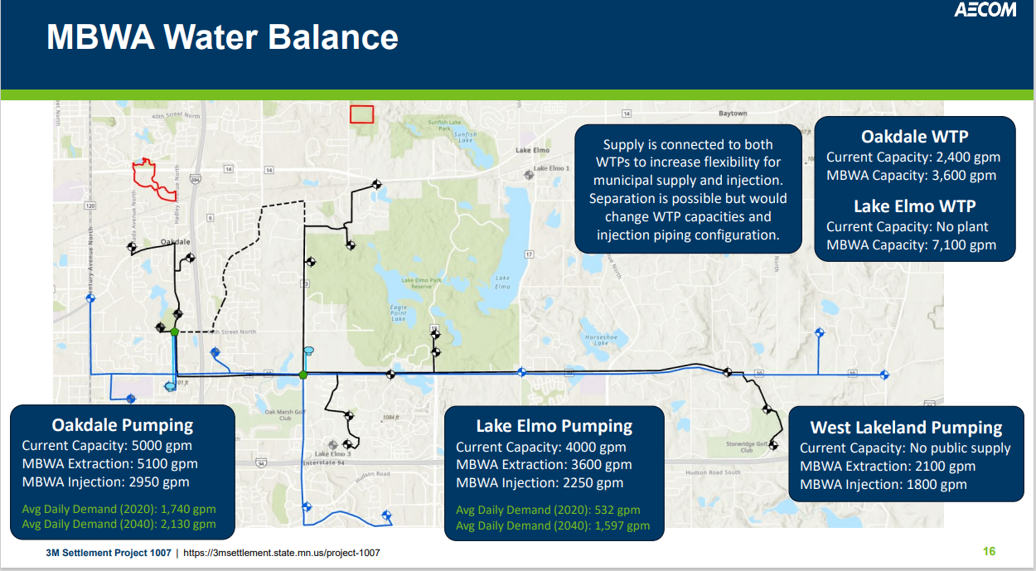
Project 1007 Multi-Benefit Well Arrays Proposal 1
.

Slide 19
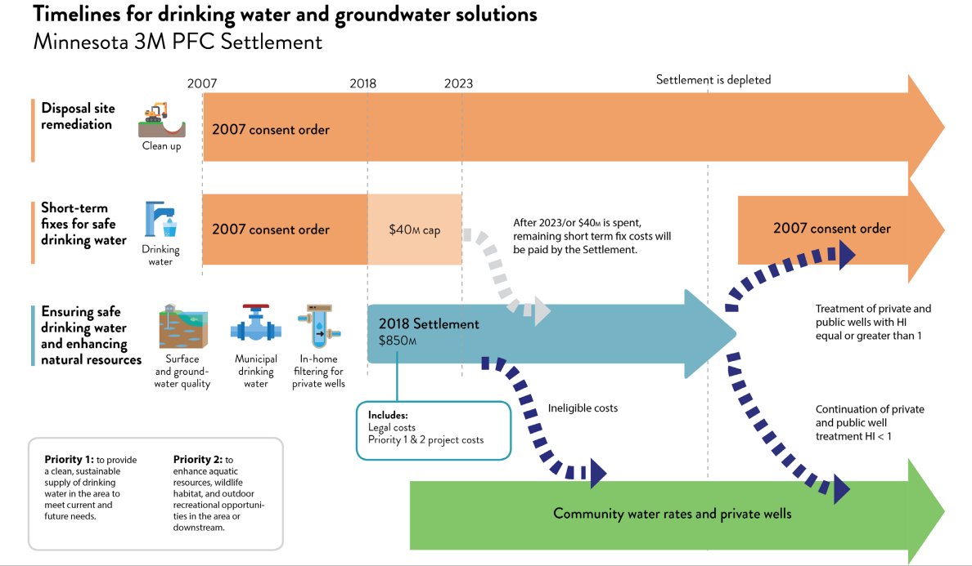
Long Term Funding

Slide 20

Long Term Funding
Due to the comingled plume, The 2007 Consent Decree might only cover a portion of ongoing expenses related to the molecules from Oakdale and Washington County Landfill. At worst, 3M might not pay anything, and the MPCA's closed landfill program would provide some coverage.
In discussions with the Minnesota Pollution Control Agency (MPCA), efforts are underway to develop a funding framework for both private and public water treatment in Lake Elmo; however, the details are still being finalized. The agency is also exploring contributions from the two landfills in the area. Lake Elmo staff will continue to work closely with the MPCA, the 3M trustees, and 3M.
.

Slide 21


Long Term Funding
In 2019, the city approved an agreement that settled a multi-year lawsuit against 3M for contamination in our drinking water. This agreement released 3M from any liability from “PFAS” fluorinated organic substance. Lawsuit agreement is HERE. Because of this agreement, Lake Elmo cannot sue 3M for costs related to PFAS cleanup or treatment.
vs.
.

Slide 22
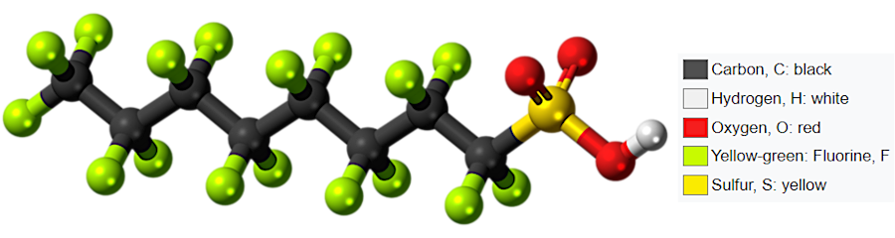
Washington County Landfill
Lake Elmo’s concern for both City water supplies and private wells
01
Due to the plume being made up of a different molecular mix from the Oakdale Landfill and another mix from the Washington County Landfill, we have a comingled plume. Private wells tests HERE shows different molecule if you look at each well.
.
02
PFOS is the primary PFAS constituent in the Oakdale site, whereas the Washington County Landfill has PFBA/PFOA signature. The main point, is both landfills have a mix of different PFAS which when we test downstream in the aquifer it is hard to tell what came from where.

Slide 23
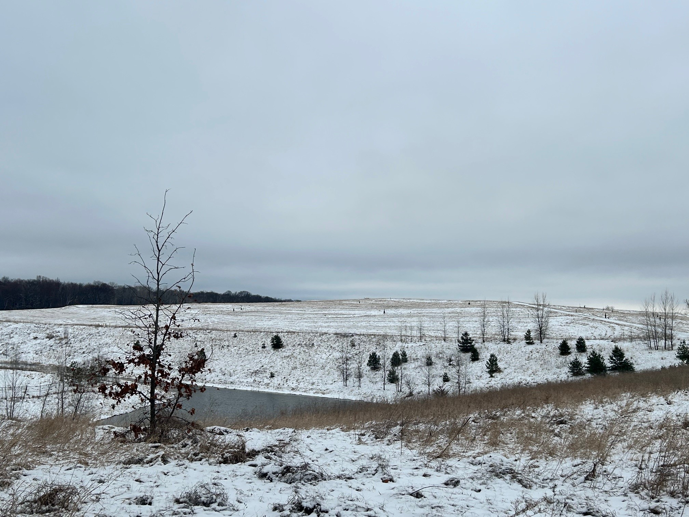
Washington County Landfill: Why do we own it?
The City took ownership of the landfill in 1995. The City is looking into the history of why, and if there were any disclosures at that time. Both Washington County and Ramsey County utilized the landfill from 1969 until 1975. Landfill page HERE.
Staff are reviewing old file boxes for agenda items from the mid-90s and has requested public information from Washington County.
.
In addition, the MPCA will review their files as well.

Slide 24

QUESTIONS?

