Slide 1
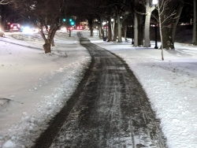
Potential Trail Snow Clearing
City of Lake Elmo

Slide 2
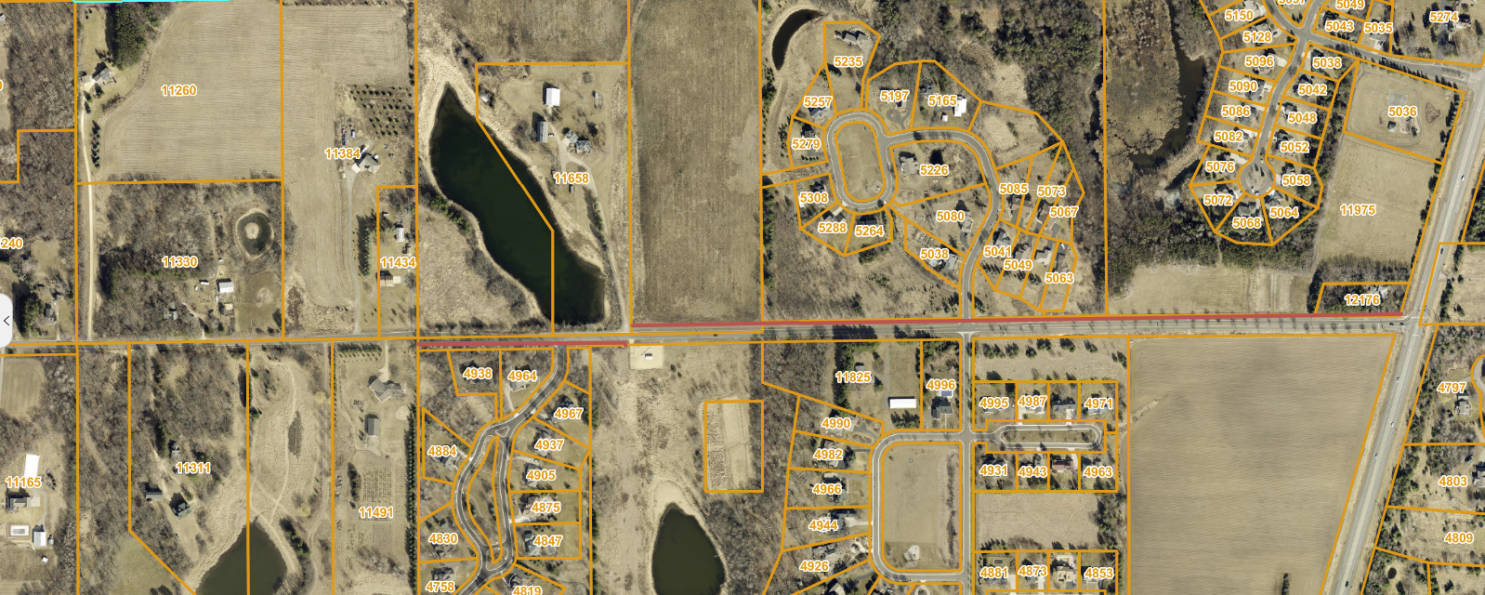
  50TH STREET TRAIL – CLEARED BY ABBUTTING PROPERTY OWNERS

Slide 3
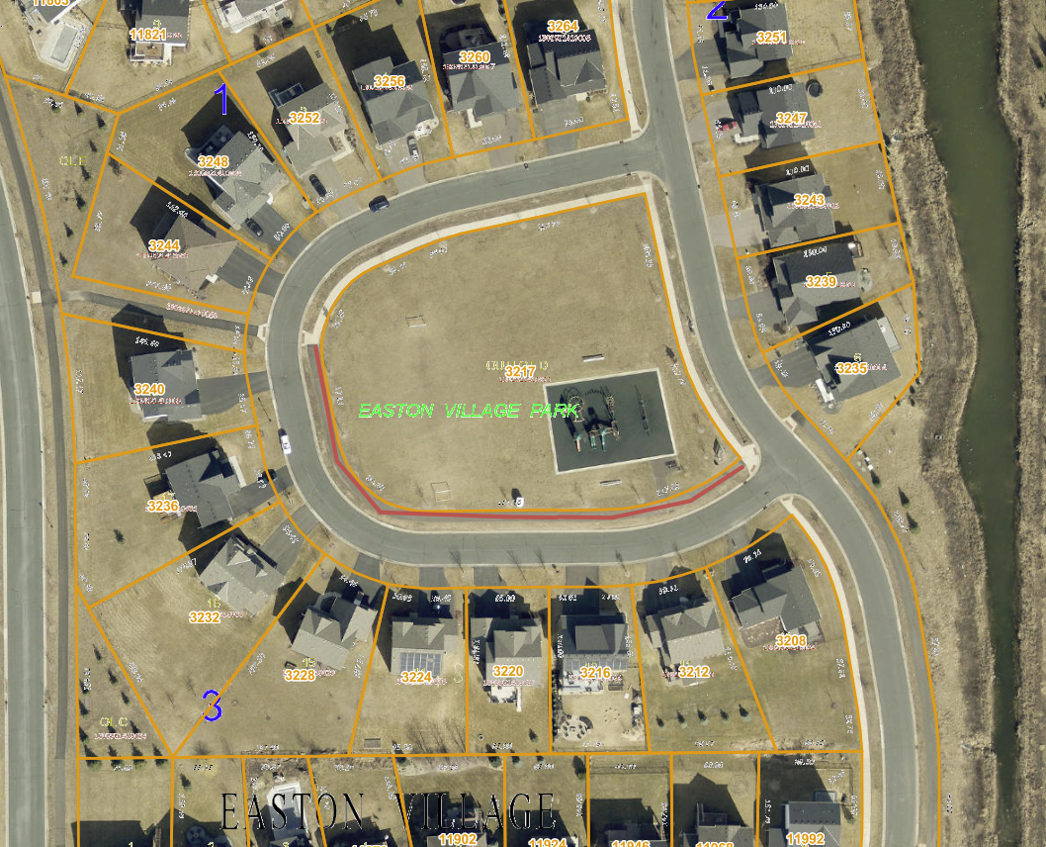
PILOT PARK TRAIL- PUBLIC WORKS CLEARED

Slide 4
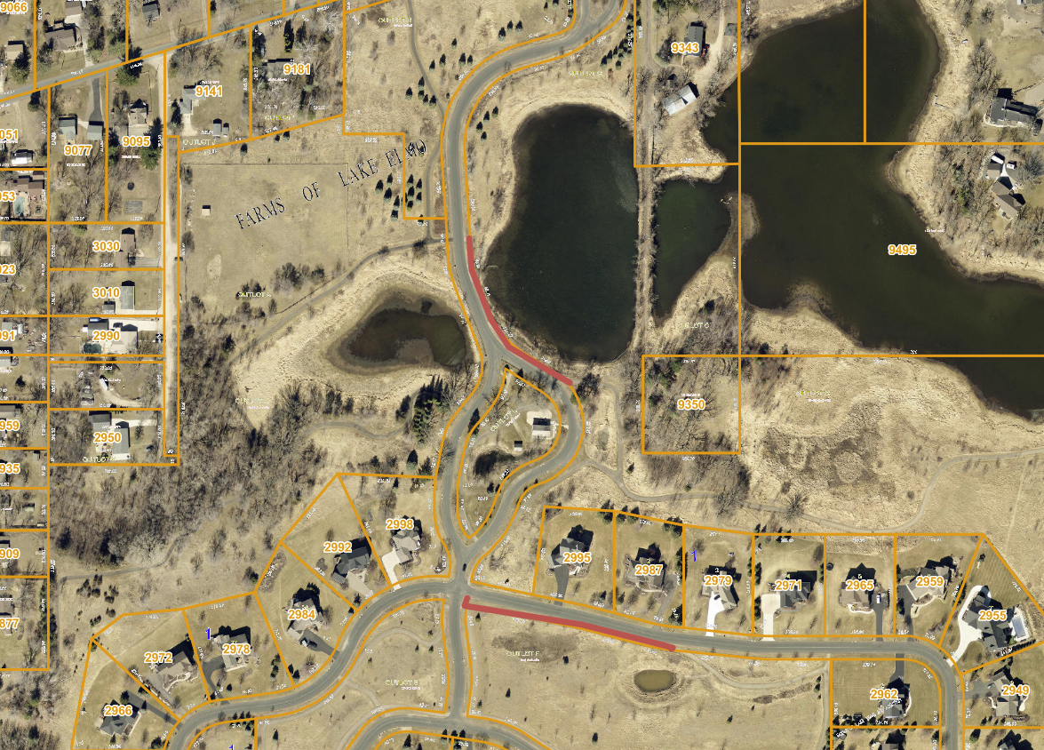
FARMS OF LAKE ELMO- HOA CLEARED

Slide 5
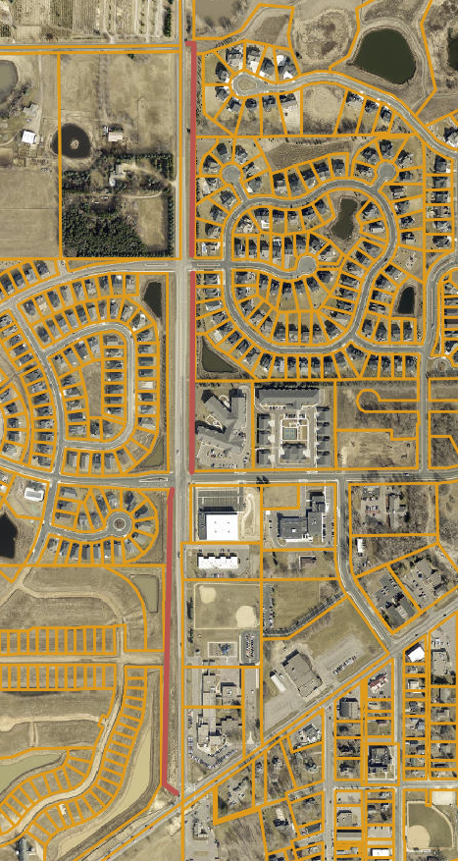
LAKE ELMO AVE – CLEARED BY HOA, CITY, COMMERCIAL PROPERTY AND RESIDENTS

Slide 6
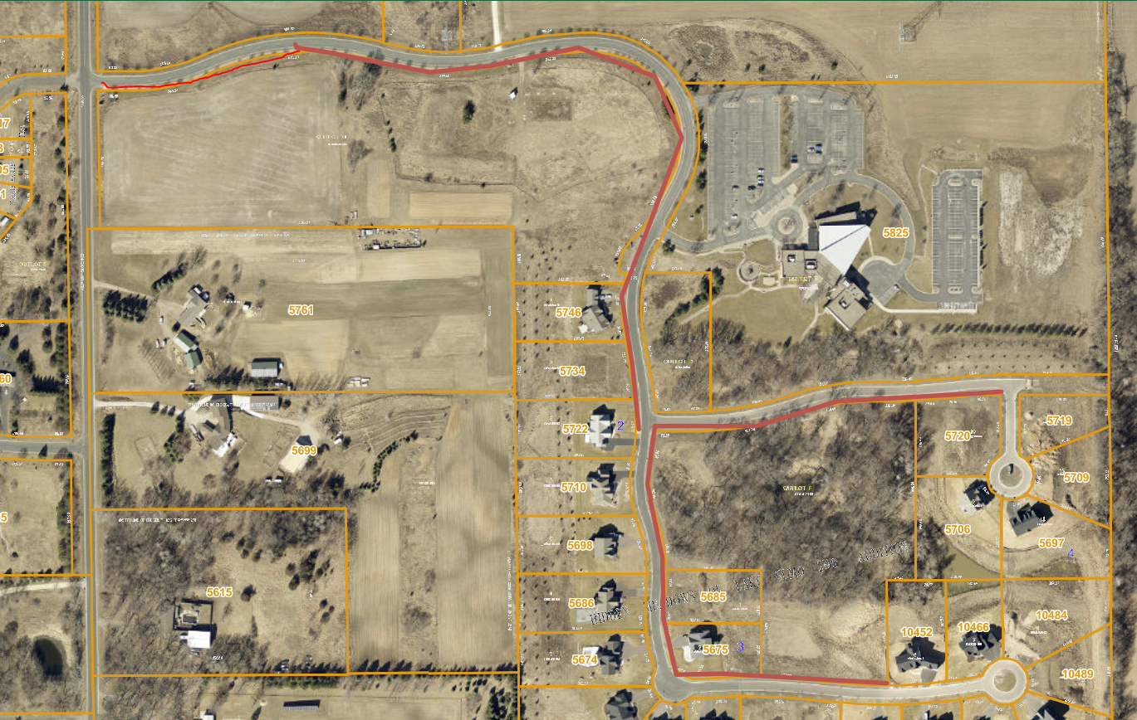
HIDEEN MEADOWS – CLEARED BY CHURCH, PUBLIC WORKS AND RESIDENTS

Slide 7
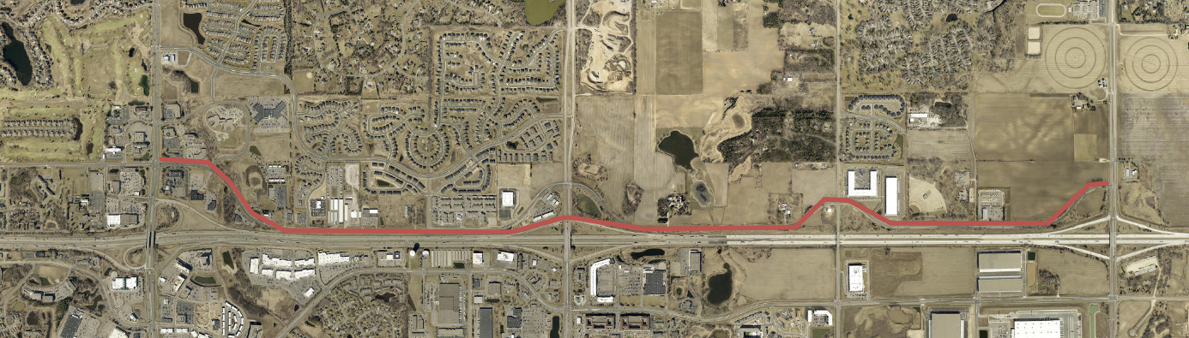
HUDSON BLVD- CLEARED BY PUBLIC WORKS, BUSINESSES, DEVELOPERS AND HOA

Slide 8
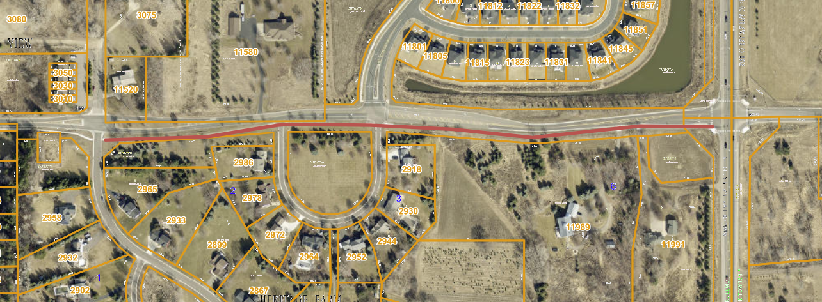
30TH ST - CLEARED BY RESIDENTS, HOA AND PUBLIC WORKS

Slide 9
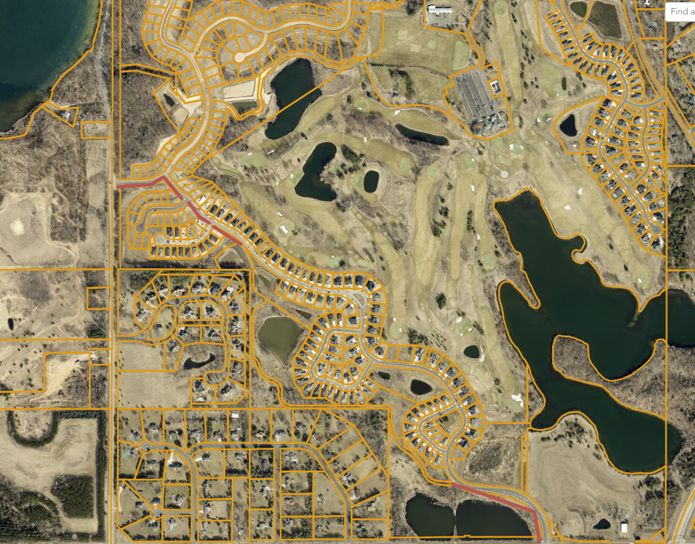
ROYAL GOLF SOUTH- CLEARED BY RESIDENTS, PUBLIC WORKS AND HOA

Slide 10
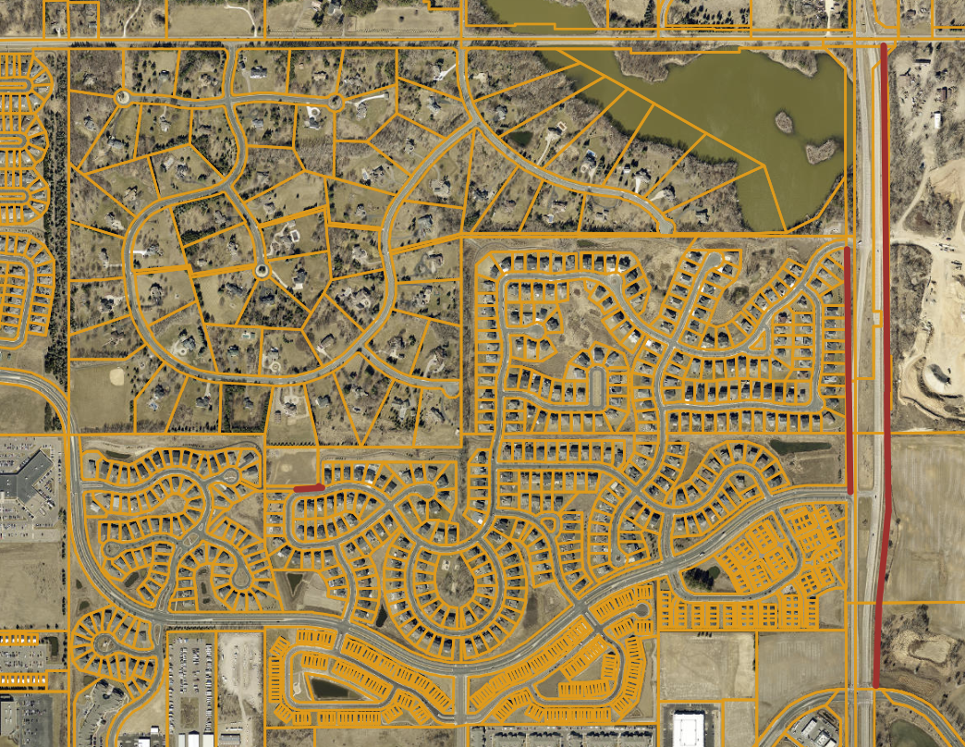
KEATS AVE, SAVONA, BOULDER PONDS- CLEARED BY CITY, RESIDENTS AND PROPERTY OWNERS

Slide 11
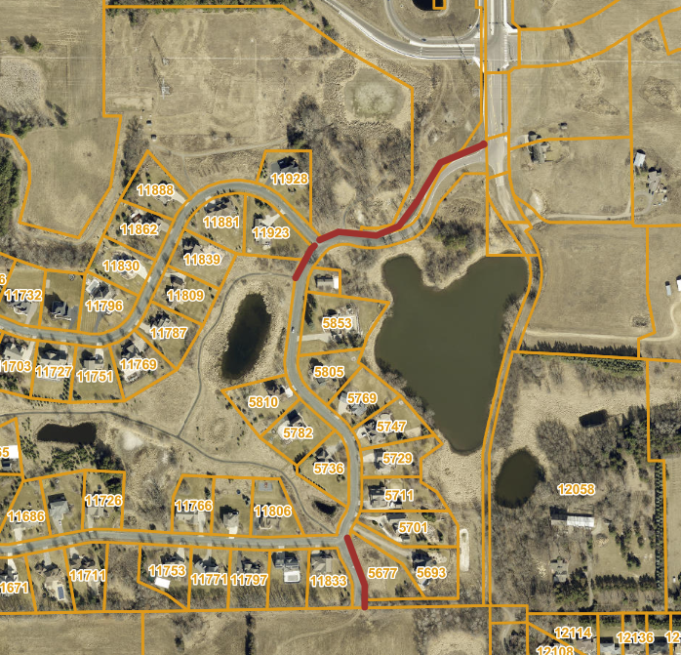
SANCTUARY- CLEARED BY PUBLIC WORKS, HOA AND RESIDENTS

Slide 12
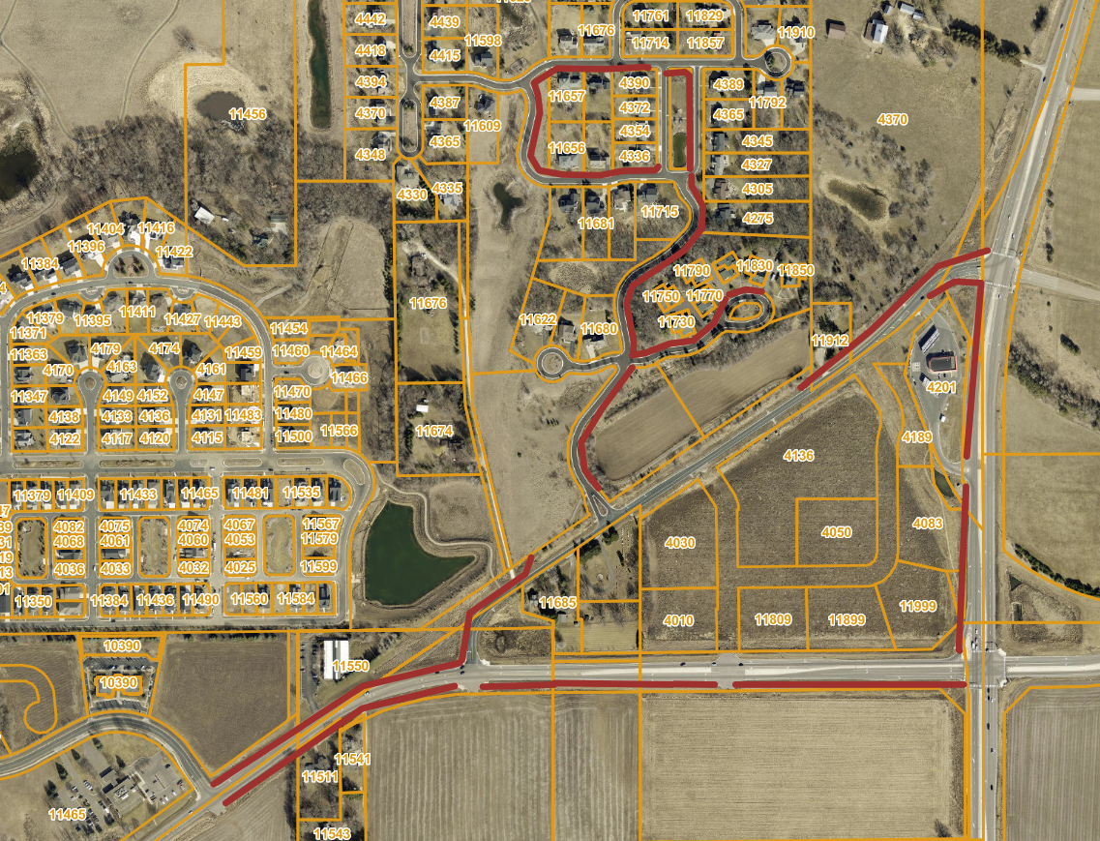
FIELDS OF ST CROIX 2ND ADDITION AND STILLWATER WAY/BLVD

Slide 13
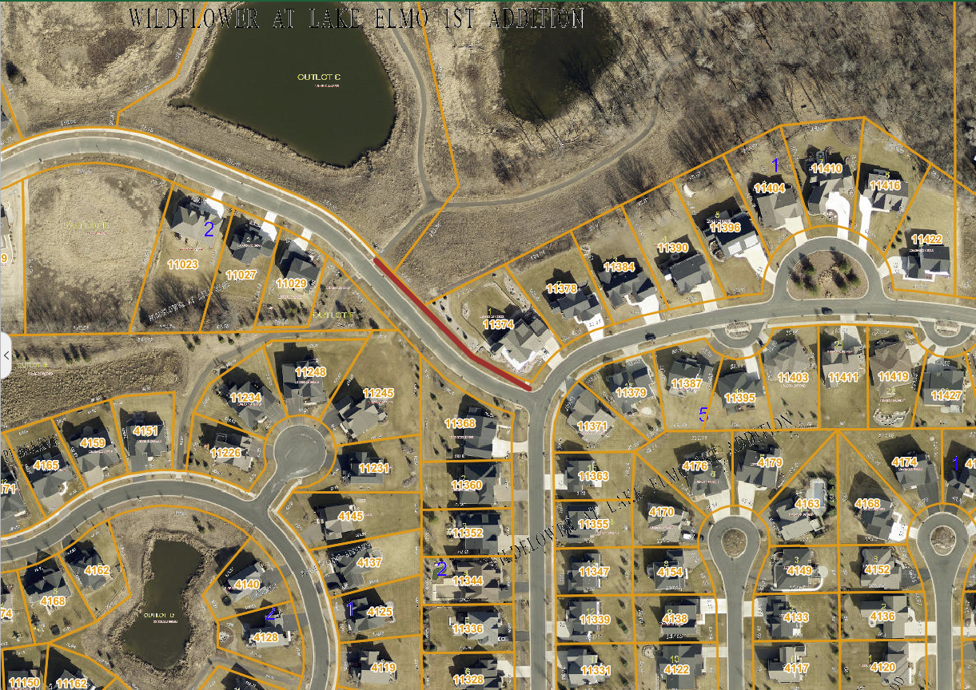
WILDFLOWER- CLEARED BY RESIDENT, HOA AND PUBLIC WORKS

Slide 14
THE END

