Slide 1


Water Treatment Plant
MUSA Expansion
Council Workshop | May 13, 2025

Slide 2

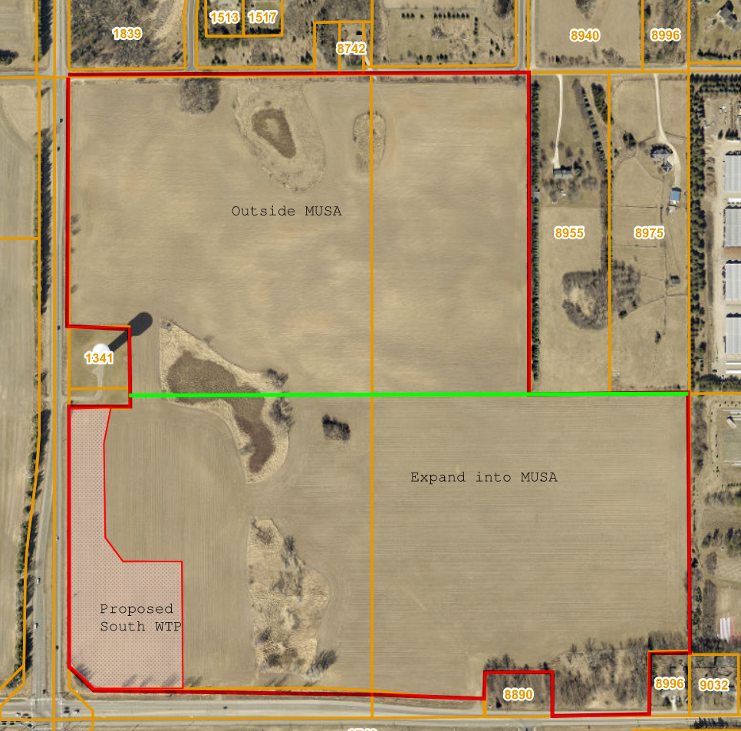
Proposed Site Acquisition
& MUSA Expansion
The City is seeking to purchase approximately 8.2 Acres located at the northeast corner of 10th Street North (CSAH 10) and Inwood Avenue (CSAH 13).
Property to be used for the South Water Treatment Plant (WTP) and Well 6.
A Comp Plan Amendment would be required for the project to extend public sanitary sewer service for the new water treatment facility.
Property owner is requesting MUSA expansion over all or a portion of their properties.

Slide 3
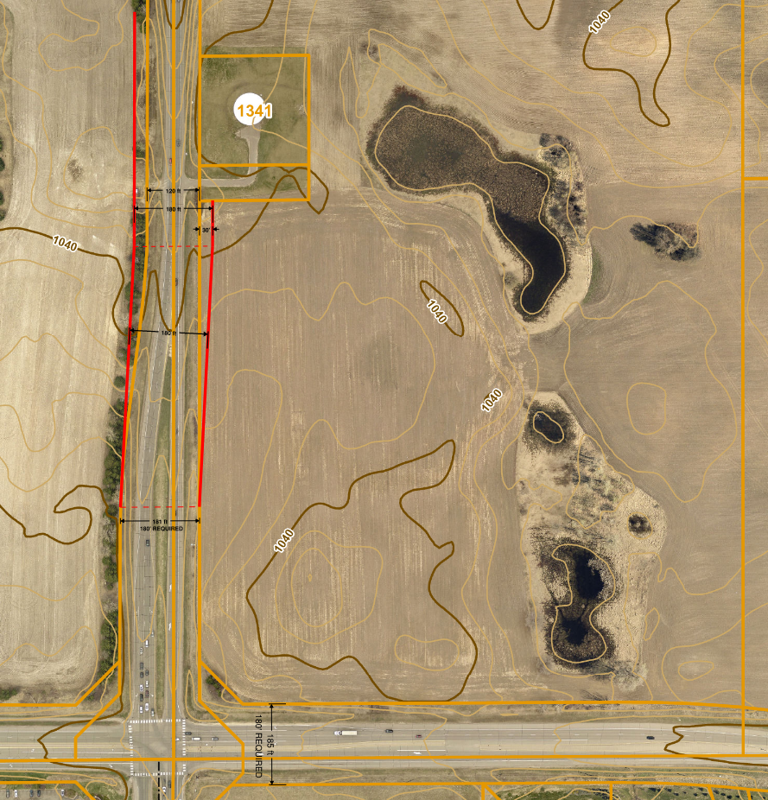
Future County R/W Considerations
10th Street North (CSAH 10). Existing 185-ft. R/W is sufficient for future roadway expansion and intersection improvements.
Inwood Avenue (CSAH 13). Future R/W requires 180-ft. and may require a potential lane shift near the water tower access roadway.

Slide 4
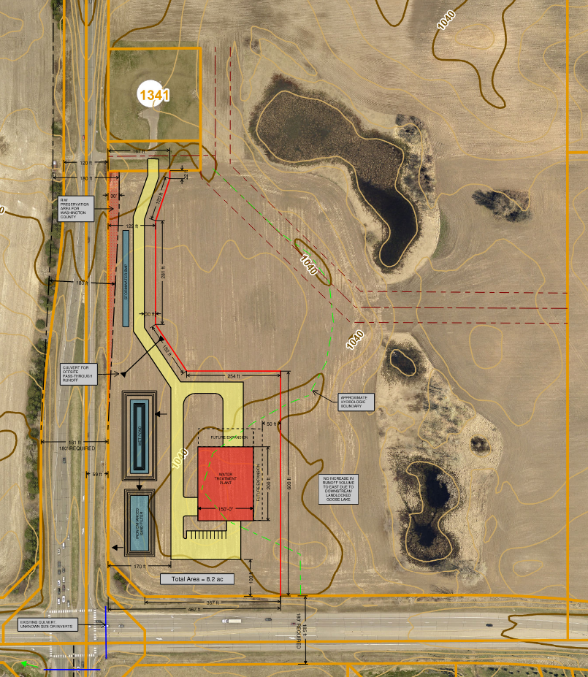
South WTP Preliminary Site Plan
Watershed and storm water management.
  Watershed divide between SWWD & VBWD.
  Test Pumping and Well Development Discharges.
  WTP Elevations, Underground Clear Well Storage, and Floodplain considerations.
Site Access.
  Access is proposed from the existing Water Tower public R/W.
  Access and circulation to accommodate chemical delivery and media change out operations.
Building Size and Elevations.
  WTP to be approx. 150’ x 200’ located at high point. Approx. 100’ and 170’ CR setbacks.
  Building height to be 2 - 2.5 stories.
Utility Piping and Layout Not Shown.

Slide 5
Next Steps
01
City to execute Right-of-Entry and Purchase Option Agreements with Property Owner.
City to conduct due diligence site investigations, including topographic surveys, soil investigations, and to construct a test well (including pump testing, well development, and water quality testing).
02
Upon due diligence confirmation of site feasibility, the City applies for Comp Plan Amendment, subdivides and purchases the property.
03

Slide 6
Issue before the Council
The property owner (VORAN711 LAND HOLDINGS LLC) has requested that a portion of their property be considered in the MUSA Expansion
Should the City Council consider purchasing the 8.2 acres and only include that portion in the MUSA?
Should the City Council consider including additional acreage into the MUSA, and if so, how many acres and at what density?

Slide 7
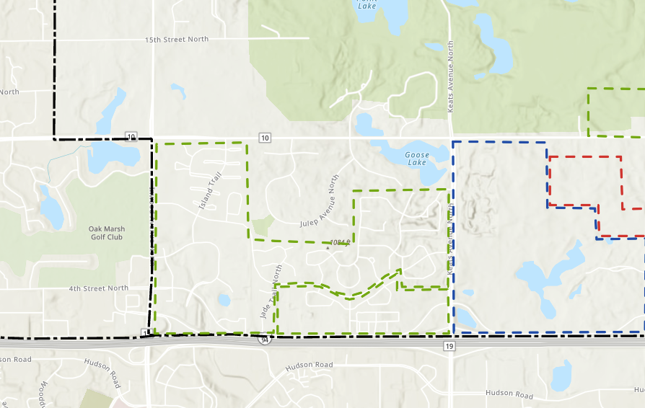
MUSA Boundary

Slide 8

63.03 Acres

Slide 9
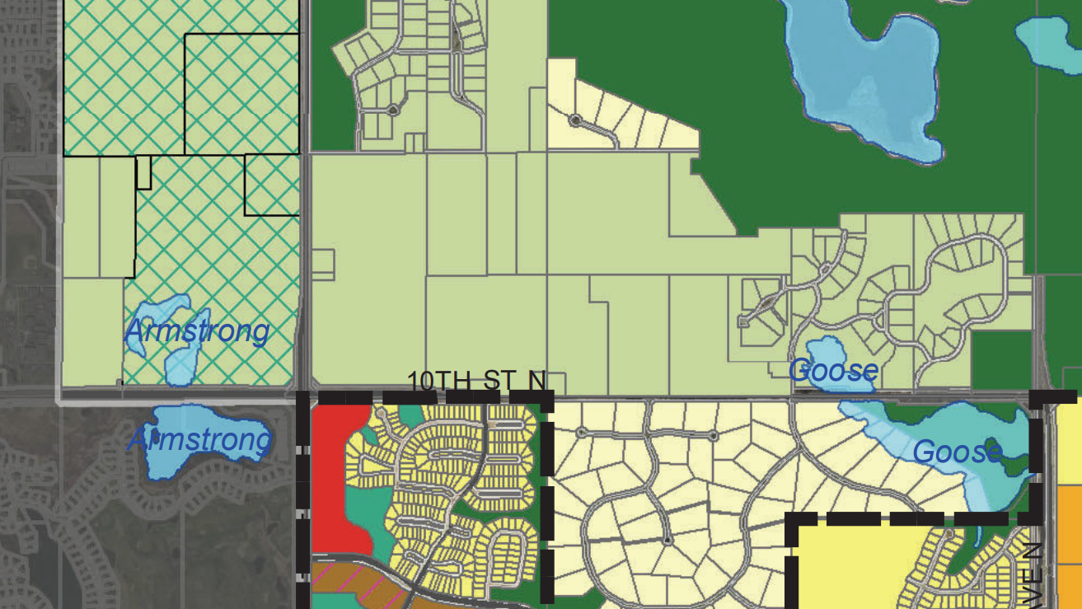
Land Use
Rural Area Development
Base Density 10 acres/unit
OP-PUD 0.6 units/acre
63 acres = 38 houses
Low Density Residential
2.5 – 4 units/acre
63 acres | 51.4 net acres = 128 – 205 units

Slide 10
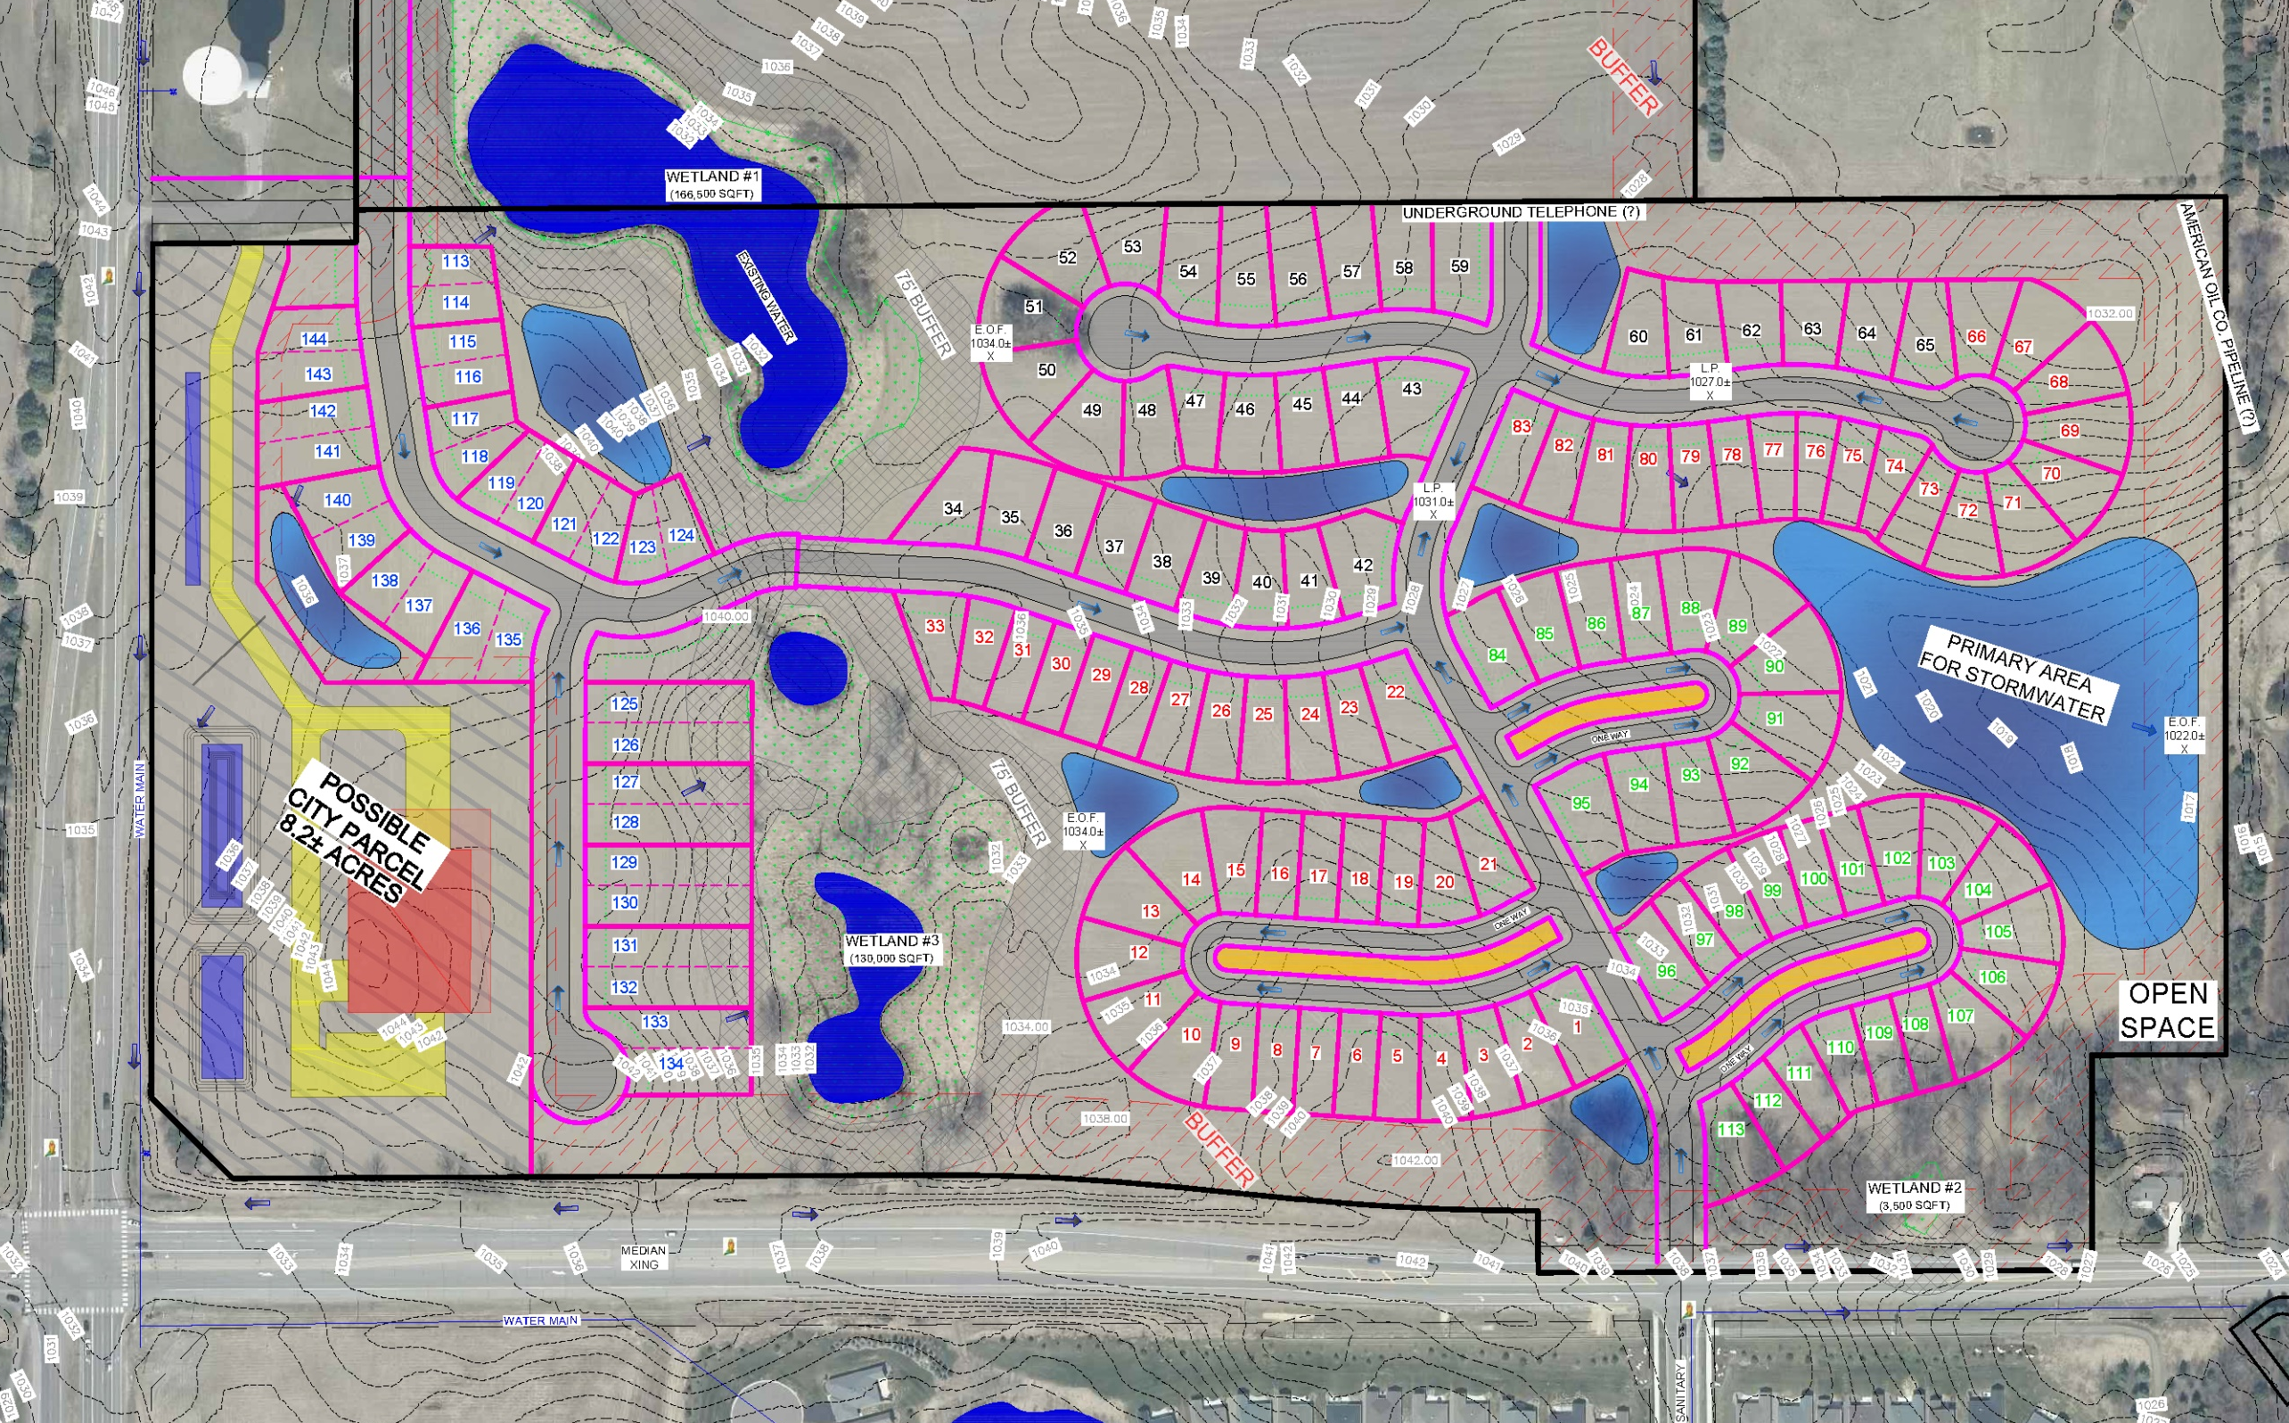
Concept Plan
Low Density Residential
2.8 units/acre
63 acres | 51.4 net acres = 144 units
113 SFH units
32 Twinhome units
PUD flexibility required for lot sizes
LDR – SFH 8,000 sqft lot |
60’ lot width
Two-family 5,000 sqft lot | 35’ lot width

Slide 11
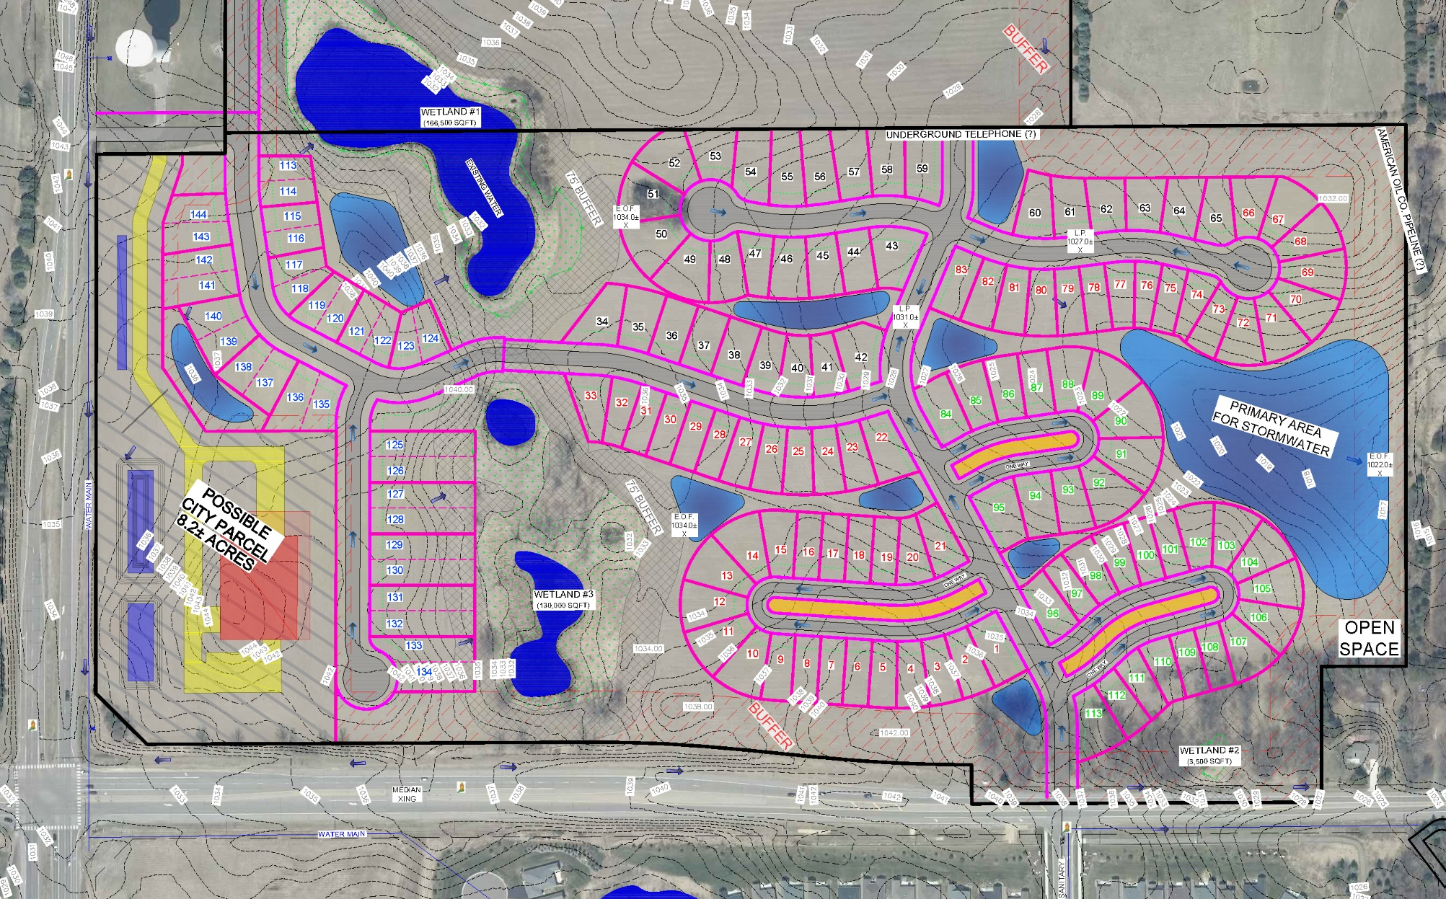
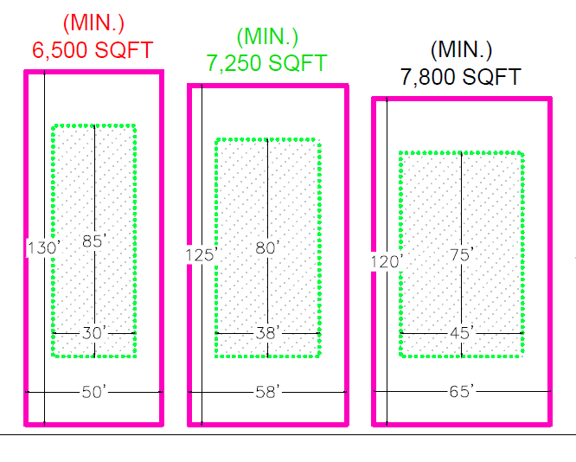

Slide 12
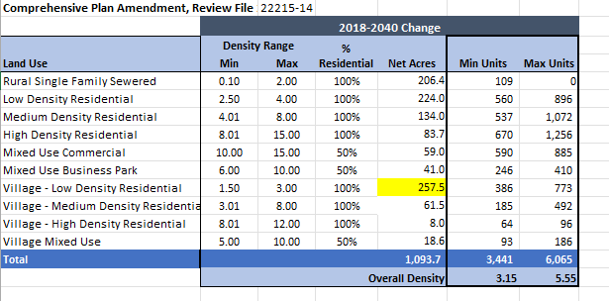
Plat Monitoring
The Met Council’s plat monitoring | March 2025
3.88 units/acre
The City will need to remain above 3.5 units/acre to comply with the 2050 Comp Plan.
Net Acres | Min Units | Max Units
1145.1 | 3,569 | 6,270
Overall Density | 3.11 | 5.47

Slide 13
QUESTIONS?

