Slide 1

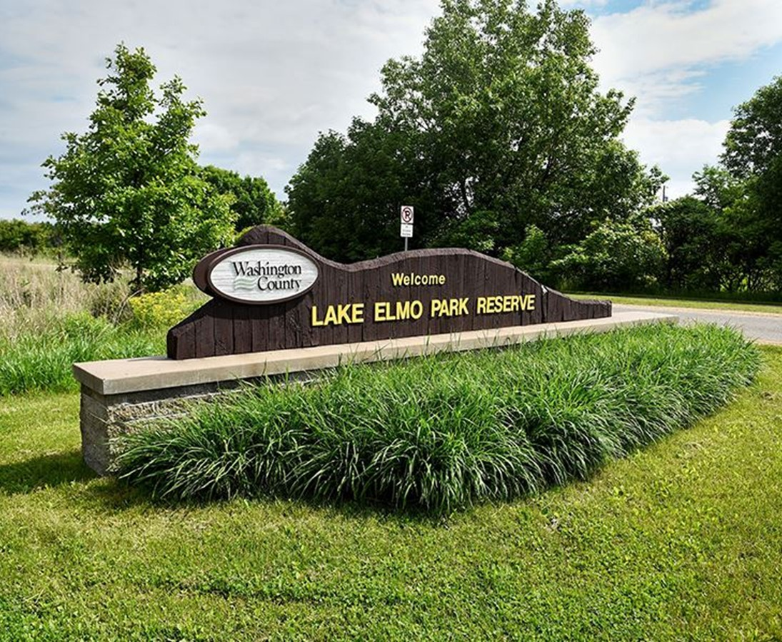
City of
Lake Elmo
Public Works Operational Assessment
May 2025

Slide 2
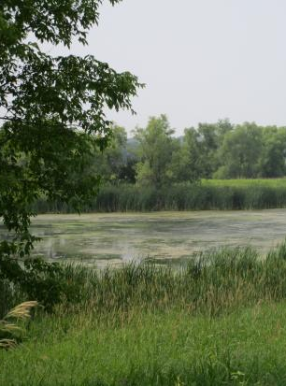
Agenda
Project Overview
Observations
Analysis and Recommendations
Notes:
Michelle

Slide 3
Project Overview

Slide 4
Project Goals
Review technology, processes, and policies
Evaluate staffing and review organizational structure
Identify opportunities for improved efficiency and effectiveness of operations

Slide 5




Project Work Completed
BEGIN ENGAGEMENT | UNDERSTAND CONTEXT | ASSESS | PREPARE PROJECT DELIVERABLES
Major Activities Kick-off meeting Issued data request | Major Activities Collected data and documents Interviewed staff Reviewed data and documentation Documented current state | Major Activities Identified best management practices Assessed operations, staffing levels, and structure Prepared preliminary observations and recommendations Validated findings with Department leadership | Major Activities Prepared report with findings and recommendations

Slide 6
Observations
Notes:
Emily

Slide 7

General Observations
Growth within the City is the #1 workload driver within the Department
  Growth in workload has far outpaced the rate of population growth
The Department provides a high level of service, has identified appropriate service level targets, and meets those targets
  Continuing to meet service level targets is likely unsustainable
Much of the City’s infrastructure is new – this will change and impacts will be negative unless planned for proactively

Slide 8
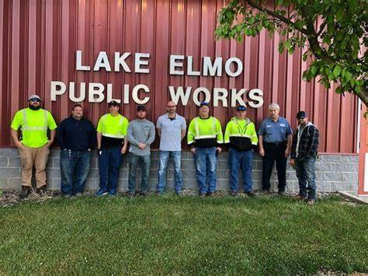
Staffing Observations
The Department last created additional Operator positions in 2019
From 2019 to 2023, the Department has experienced rapid growth in its major service areas, cumulatively increasing by:
    74% increase in sewer customers
    39% increase in sewer pipe length
    43% increase in water customers
    55% increase in water pipe length
    23% increase in park acreage
Notes:
Emily

Slide 9
Sewer Customer Accounts per PW FTE

Slide 10
Analysis and Recommendations
Notes:
Michelle

Slide 11
Yearly Planning and Prioritization
Observations
Many DPW projects are seasonal or periodic
Communication to operators is task-oriented rather than project-oriented
Recommendations
Create an annual work plan to articulate when significant work initiatives are scheduled or expected to take place
  Plan should identify the activities to be undertaken, which weeks of the year the activity is expected to occur, along with staffing and resource requirements
  Prominently post the work plan in the workplace
  Review periodically

Slide 12
Organizational Structure & Staffing - PTO
Observations
There has been tension between Operators wanting to take PTO and the Department wanting to be staffed to get work done
There are enough Operators with enough time off that on average at least one Operator would be absent each workday
Demand for PTO is clustered around holidays, the summer, on school breaks, etc.
The summer schedule of 9x4 + 4 has positive and negative outcomes
  The longer summer hours are more productive
  Everyone wants Fridays off

Slide 13
Organizational Structure & Staffing - PTO
Recommendations
Separate the operators into two groups during the summer, a Mon – Thurs group and a Tues – Fri group. Each group works 4 10-hour days
  Everyone gets a 3-day weekend (except whoever is on call)
  This may reduce total demand for PTO in the summer
  10-hour days are likely to be more productive
Use the annual work plan to revisit PTO limits
  Determine what minimum staffing levels are needed throughout the year
  The need to be able to allow for PTO can inform the annual work plan
    Potentially plan for “low power” weeks around holidays

Slide 14
Organizational Structure & Staffing
Observations
Workloads have increased over the last 6 years, but operator staffing has not
The Lead Operator role is not a supervisory position – but sort of is
  The Lead Operator’s “span of control” is high at 8 operators
The addition of PFAS treatment will only complicate the operation of the water system
Some operators do not feel comfortable with rounds because they do not do them often
If more operators are hired, doing rounds will become less frequent for each operator
  This infrequency makes it harder to train new operators, harder for existing operators to retain knowledge, and harder to gain a feel for the system.

Slide 15
Organizational Structure & Staffing
Recommendation
Increase staffing by 2 Operators and 1 Lead Operator
  A 2nd Lead Operator will help reduce span of control, especially as more Operators are added
  The 2nd Lead Operator should be scheduled opposite the 1st during summer hours, assuming 4x10 work schedules are implemented
  Given the budget timing and current staff size, aim to fill 2 new positions (1 Lead Operator, 1 Operator) this year

Slide 16
Organizational Structure & Staffing
Recommendation
Designate ~6 Operators as Utility Specialists. Limit these operators to Operator II’s and I’s (ideally, I’s). Limit on-call rotations to this group of “Utility Specialists”
  Will concentrate and amplify experience and knowledge in the mechanical / treatment components of the utility system
  May require some incentive to entice Operators to be Utility Specialists

Slide 17
Organizational Structure & Staffing
Observations
The City recently lost an admin assistant who was assigned 0.4 FTE to DPW
DPW has need for administrative / clerical assistance
Recommendation
Hire an administrative assistant to assist with DPWs administrative needs
  Ideally, this person would have PW or utility experience
  This person should be computer literate, able to learn new software packages, and able to read and navigate in a map in GIS
  Create a binder of SOPs for this person to use to help expand their role
  This position should start at 0.5 FTE in DPW, but may be adjusted in the future
Notes:
Adam was spending a lot of his time dealing with complaints; the AA would be developing the severity of the issue, service requests, etc. This would be a great use of the AA’s time, especially since Adam is going to do planning. just make sure we articulate this.

Slide 18
Organizational Structure & Staffing
Observation
DPW is using non-ASCE-certified Operators to do some auto repair and maintenance
Recommendation
Either hire a certified mechanic or sign a service contract with a local vendor
  Auto repair is not a core function of DPW
  Having non-certified mechanics work on vehicles likely exposes the City to liability
  Basic maintenance, such as oil changes or tire rotations are often included free as part of a service contract

Slide 19
Organizational Structure & Staffing
Observations
The City’s Parks Master Plan calls for a Parks Director
The MP does not provide guidance on role / scope of the Parks Director position
It is rare to have a Parks Director without a separate Parks Department or staff
Recommendation
Stakeholders should collaborate as to the proper role / title / timing of a Parks leadership position
  Parks Advisory Board, City Council, and City staff should conduct a workshop to identify:
    Position title and role
    Timing of hiring
    Location within the City’s organizational structure
Notes:
Adam was spending a lot of his time dealing with complaints; the AA would be developing the severity of the issue, service requests, etc. This would be a great use of the AA’s time, especially since Adam is going to do planning. just make sure we articulate this.

Slide 20
Work Processes
Observations
The City uses Beehive as an asset management system
Beehive appears to be well-implemented, but lacks a Parks module
Beehive is neither used as a work order system nor do Operators use it much in the field beyond as a tool for locates/GIS mapping
Recommendation
Implement Beehive as a full CMMS for DPW
  Obtain the Parks module and tablets to be issued to Operators in the field
  Develop Beehive’s capabilities to issue and track work orders
  Invest in training for staff to learn how to use Beehive properly – write and assign work orders, enter data, search work orders, etc.

Slide 21
Leadership Training
Observations
Leadership / supervisory positions are often left to “figure out” how to do the leadership and supervising parts of their jobs
Morale is low among operators, some of whom report experiencing high levels of work-related anxiety
Recommendation
Obtain leadership training for the Director, Assistant Director, and Lead Operator(s) to foster the soft skills necessary for positive morale and conduct within the workplace

Slide 22
Safety
Observation
Safety issues were reported that outline a culture that deprioritizes safety over efficiency and productivity
Operators are concerned that jobs are assigned with fewer staff than knowledgeable 3rd parties would recommend
Recommendation
Work to instill and sustain a culture of safety
  Ensure appropriate staffing for all activities that require multiple operators, specifically for street work, tree trimming, and manhole operations
  Develop SOPs and guidelines for safety that are mutually agreed upon between operators and management
  Provide appropriate channels to report unsafe activities or direction that undercuts agreed upon safety practices

Slide 23
QA
&

Slide 24
Thank you!
Contact: Brian Kirsch, Ph.D.
919.259.0804 / bkirsch@raftelis.com

