Slide 1

Lake Elmo - Lawn water conservation solutions
Identify optimum mixtures for Twin Cities lawns
Gary Deters
Lawn Water Conservation Educator

Slide 2
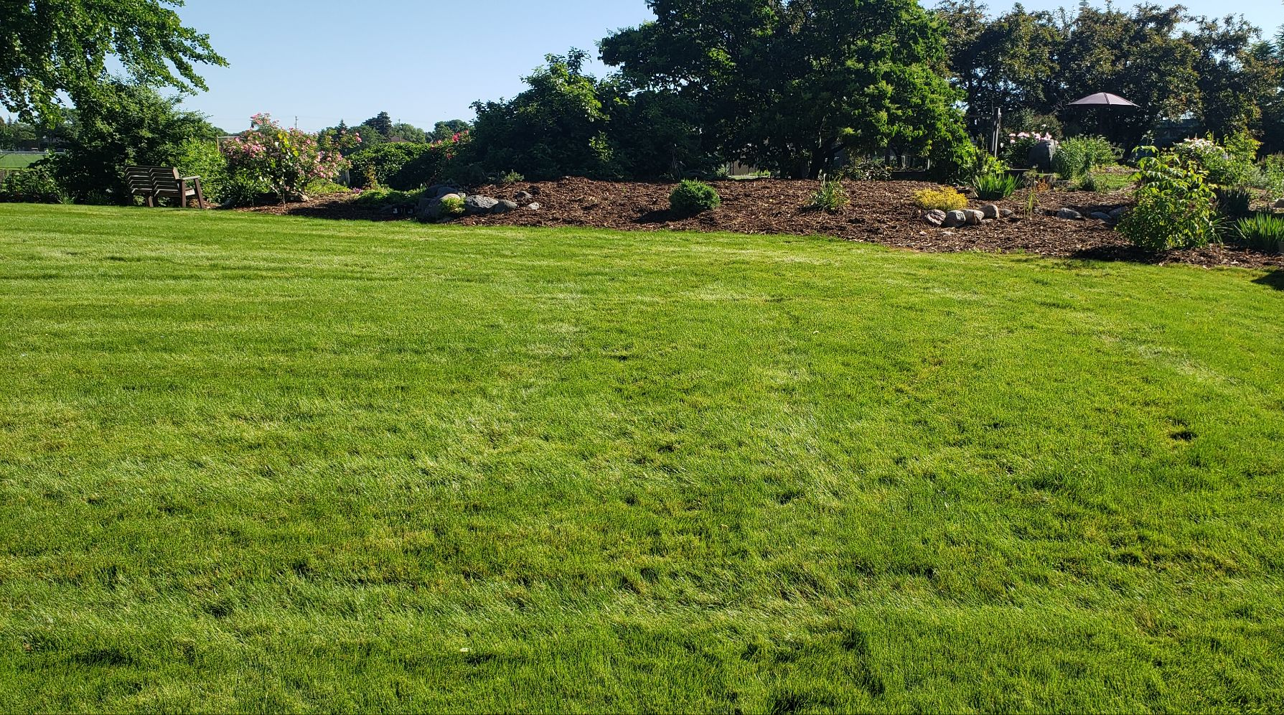
Introduction
We know there are lawn seed mixtures better for lawn water conservation, but residents struggle to find and use them
Too much use of Kentucky bluegrass sod, which requires long-term high watering needs to be functional and aesthetically pleasing
There are significant barriers to using the most well-adapted turfgrasses on Twin Cities lawns
Low-input mixture

Slide 3
Why are there barriers?
Expectations - Homeowners often prefer the lush, green look of Kentucky bluegrass, but it requires a lot of water and fertilizer to look “good”
Resistant to change - General resistance to changing lawn care practices
Availability - Easy access to Kentucky bluegrass sod and a limited retail presence for drought-tolerant grass seed mixtures
Lack of public awareness - Homeowners might not be fully aware of the benefits of drought-tolerant turfgrasses, such as reduced water needs

Slide 4
Project overview
We are going to establish multi-species mixture studies at 4 metro sites in the summer of 2025
Cultivars for each species will be selected based on relevant performance data
We will work with the Minnesota Board of Water & Soil Resources (BWSR) and turfgrass seed vendors to develop a process to recommend best lawn water conservation species mixtures for Twin Cities lawns
Seed vendors will be able to use approved cultivars (from other related trials) to fulfill mixture requirements

Slide 5
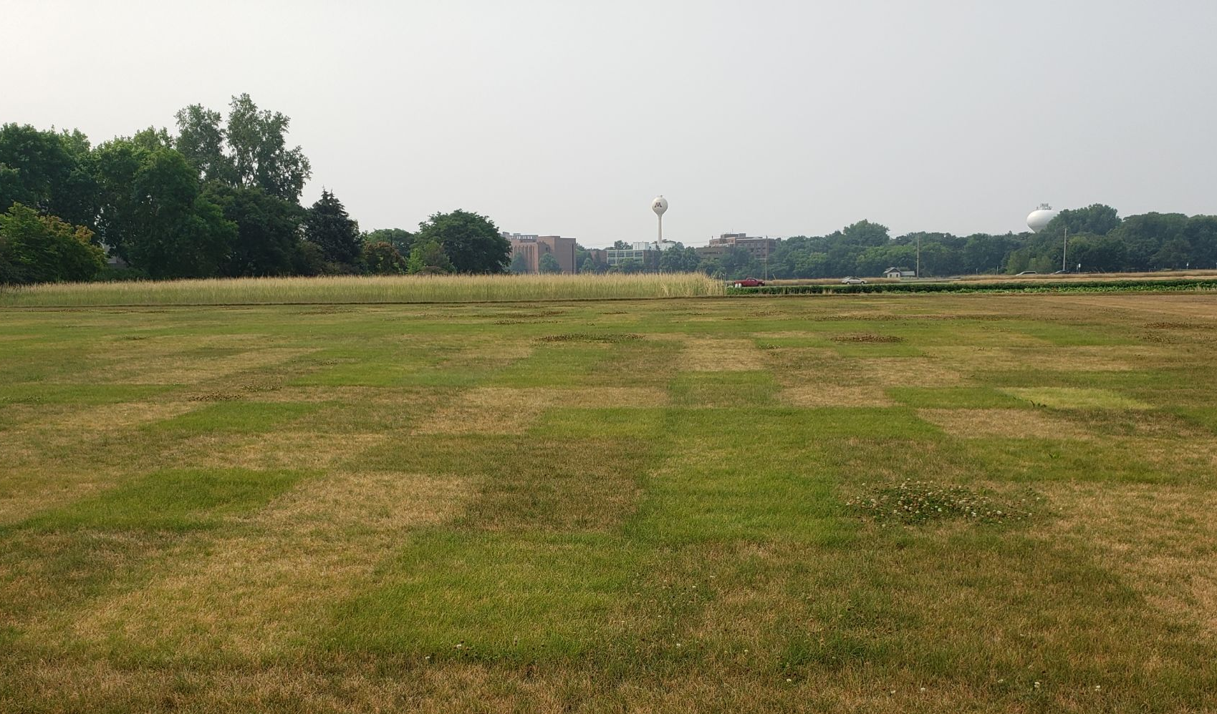
Benefits to the Lake Elmo and the Twin Cities
Homeowners will be more easily able to access better turfgrass seed mixtures for their lawns
Cities could recommend new lawns only use these mixtures, which will save water
Similar to UMN research for MnDOT that led to new roadside turfgrass seed mixture recommendations
Research plots on UMN campus

Slide 6
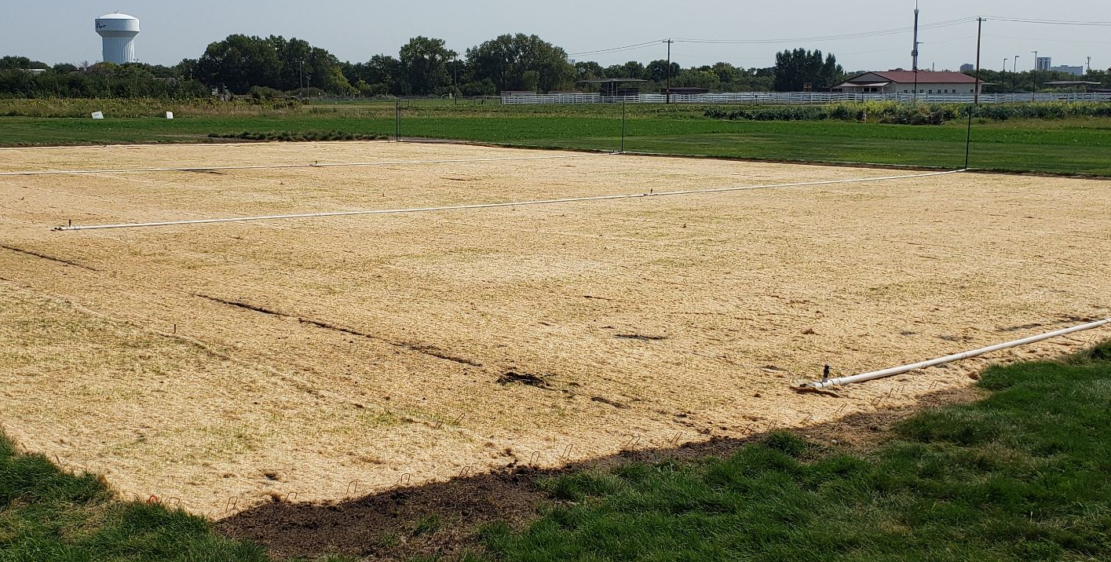
Establishing the site
We will pay for water and hookups needed for fire hydrant conversion
Use a seeding blanket to help hold moisture and increase establishment rate and prevent washouts
Mowing and maintenance - City take over after year 1?
Seeding blanket

Slide 7
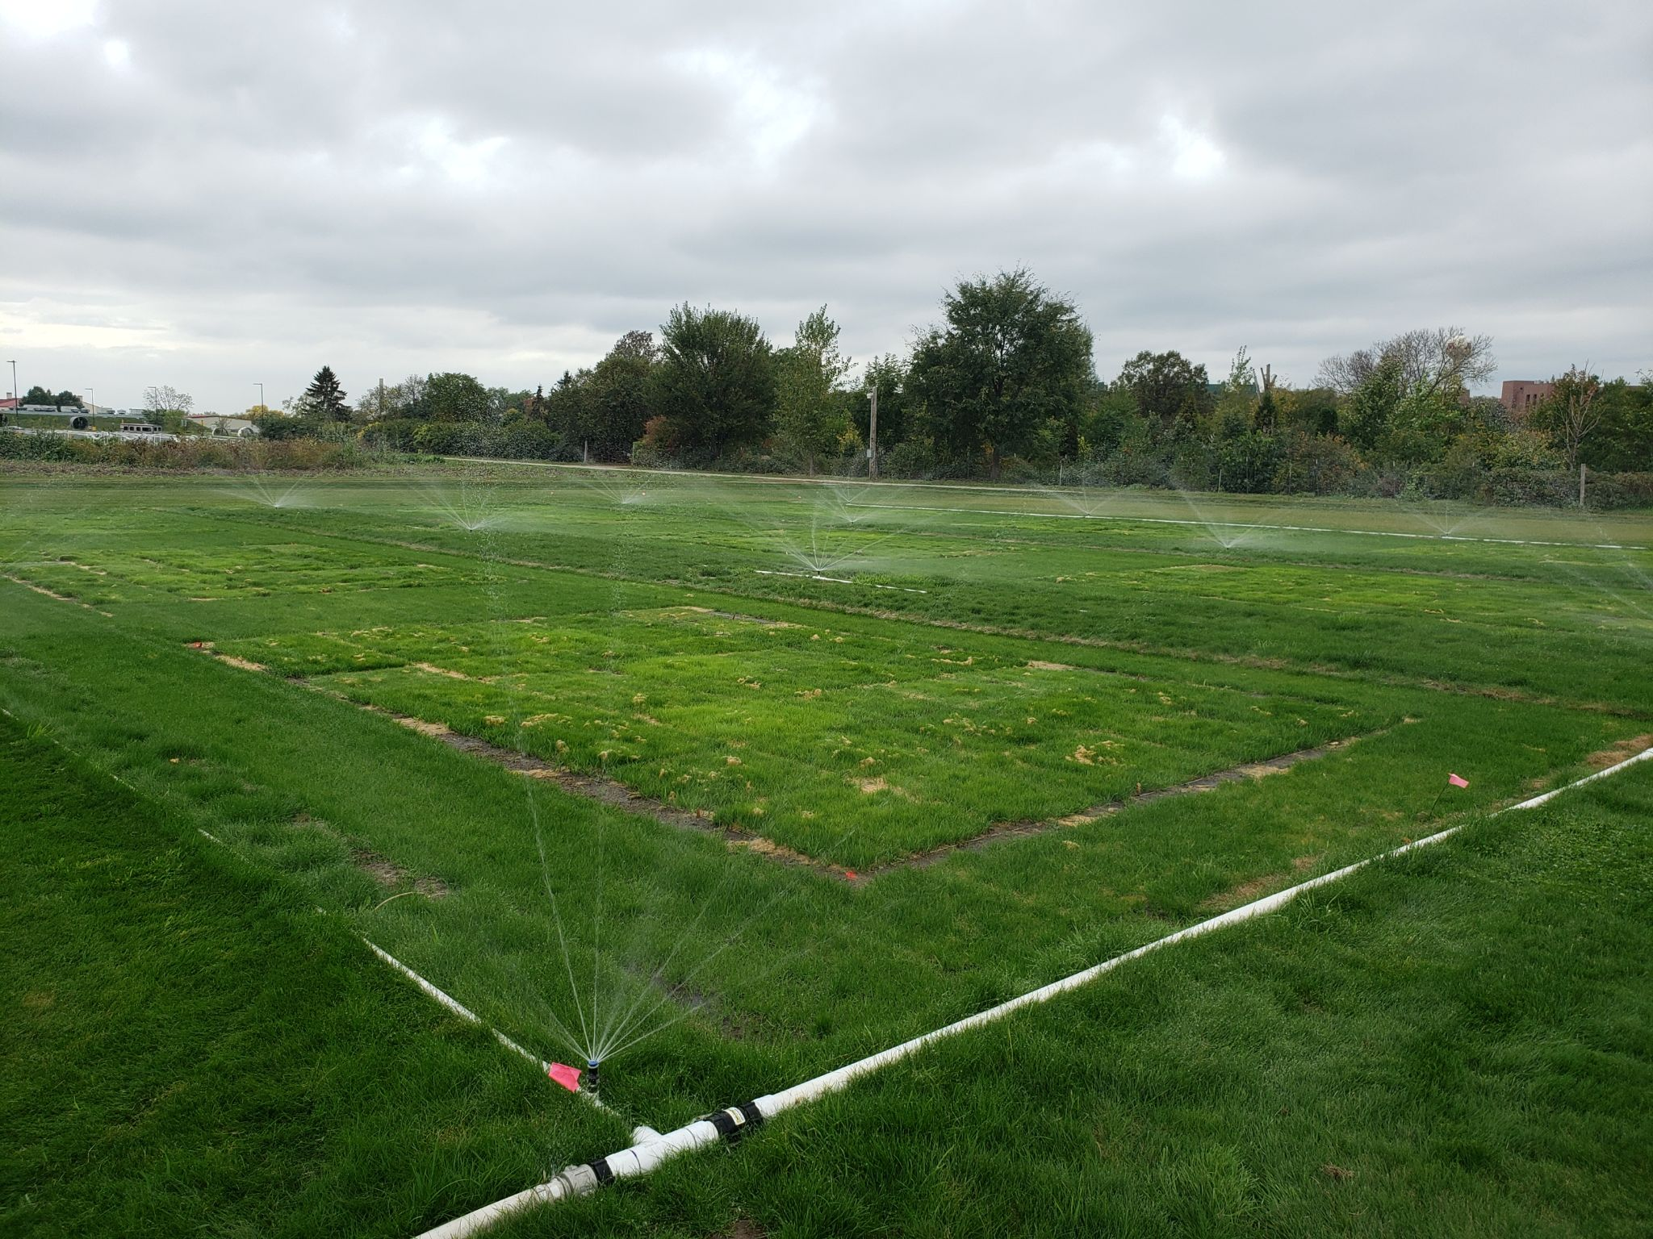
How will the site get watered?
We will use modular irrigation system
  Complete with rain sensor
  MP rotator nozzles which are EPA WaterSense approved
  Lower water-use nozzle
Water several times a day during initial establishment for optimal seed germination
Irrigation will not be used once established during years 2026-27
Irrigation set-up

Slide 8
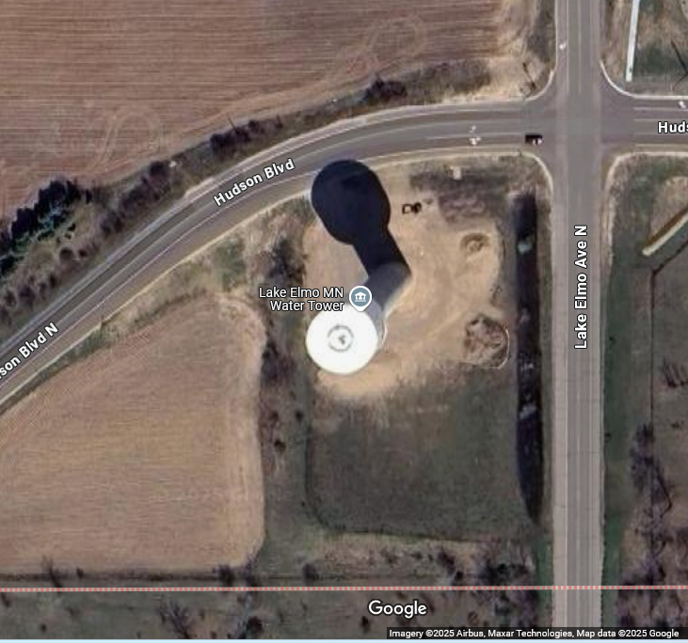
Establishing a Research Site for Drought-Tolerant Turfgrass Mixtures
Next to the Lake Elmo water tower
There is access to the site for public viewing, if needed
Access to water for the establishment of the plots
Lake Elmo is a city with water concerns, so it would be good to demonstrate the most well-adapted grasses
Research site

Slide 9
Timeline - With access agreement approved
2025 - Year 1 - Summer/Fall - Establish the turfgrass mixture plots
  Seed around August 15th
2026 - Year 2 - Maintenance and data collection
2027 - Year 3 - Maintenance and data collection
2028 and beyond - either return the site to original or keep plots for continuous research (in consultation with the city)

Slide 10
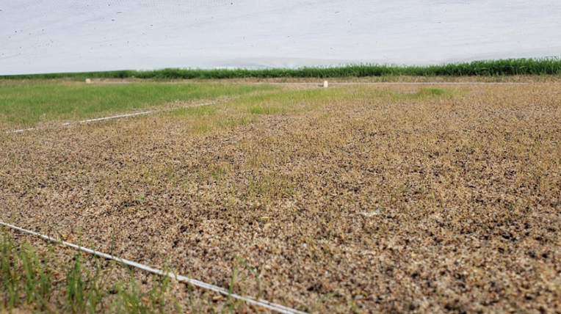
Challenges: Watering restrictions and need for an extension
We are requesting a waiver to water new seed and beyond the initial 15 days
  Establishing a lawn from seed often requires more than 15 days because not all seed germinates and establishes at the same pace
  Could lead to a failure due to lack of water on a hot, windy day with immature seedlings
  Once this site is established no irrigation will be used to determine the best performing mixtures
Seeding failure

Slide 11

Signage - if desired
We can post signage explaining the project to the public and create a landing page for homeowners to learn about drought tolerant grasses and water conservation.
Signage example

Slide 12
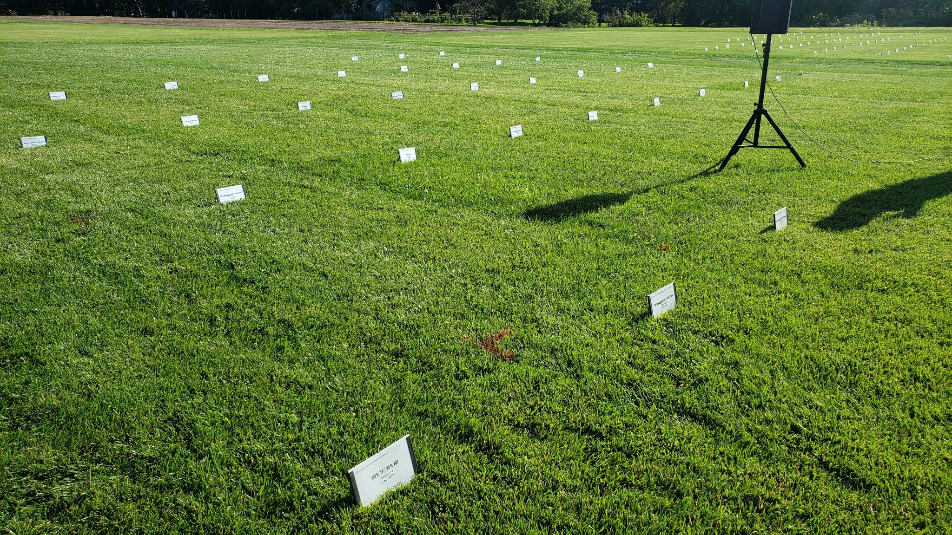
Expected outcomes because of the mixture research
Water conservation - Overall less water used with new mixtures
Cost savings - for residents and city infrastructure
Environmental impact - less watering, less runoff and pollution
Aesthetic appeal - Attractive lawns with less water
Educational value - Opportunities for community education on using lower input grasses
Tall fescue and Kentucky bluegrass mixture study

Slide 13
Thank you!

