Slide 1
The Excelsior Group
Adelaide Landing
Preliminary Plat and PUD
Monday, May 1, 2017
City Council Meeting
Notes:
Tonight we are holding a public hearing on a request for a minor subdivision and CUP

Slide 2
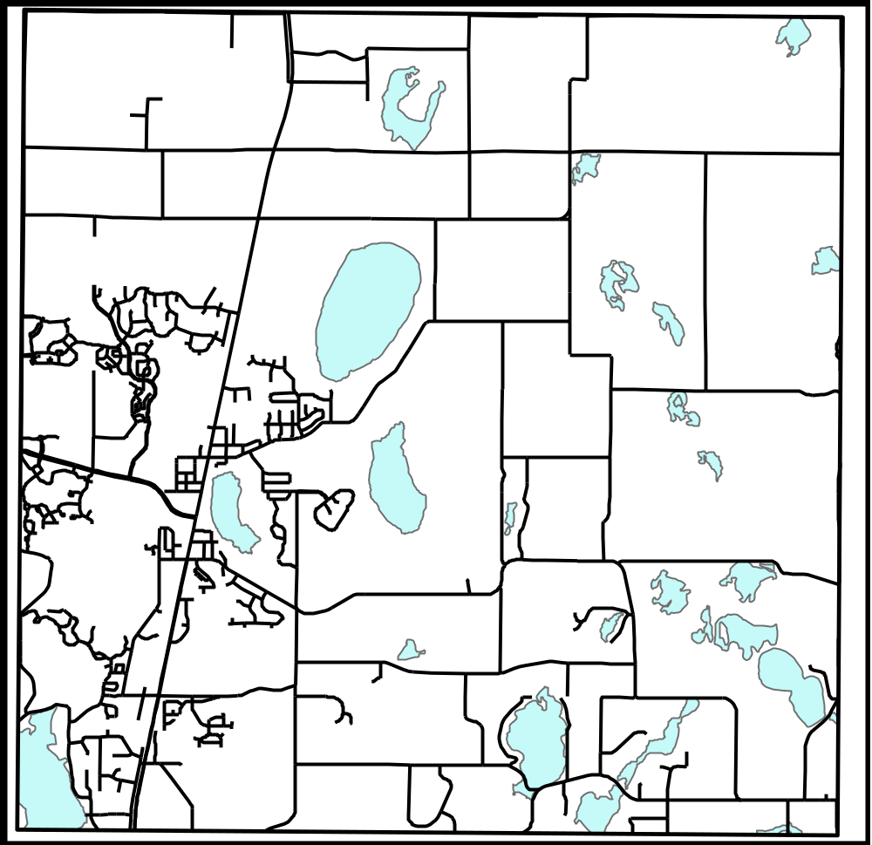
Henna Ave
170th Street
Highway 61
Keystone Ave
CSAH 8
Site
137th Street
Homestead Ave
130th Street
Goodview Ave
Notes:
The property is located north of Frenchman RD (County Road 8) and west of Everton Ave. N.

Slide 3
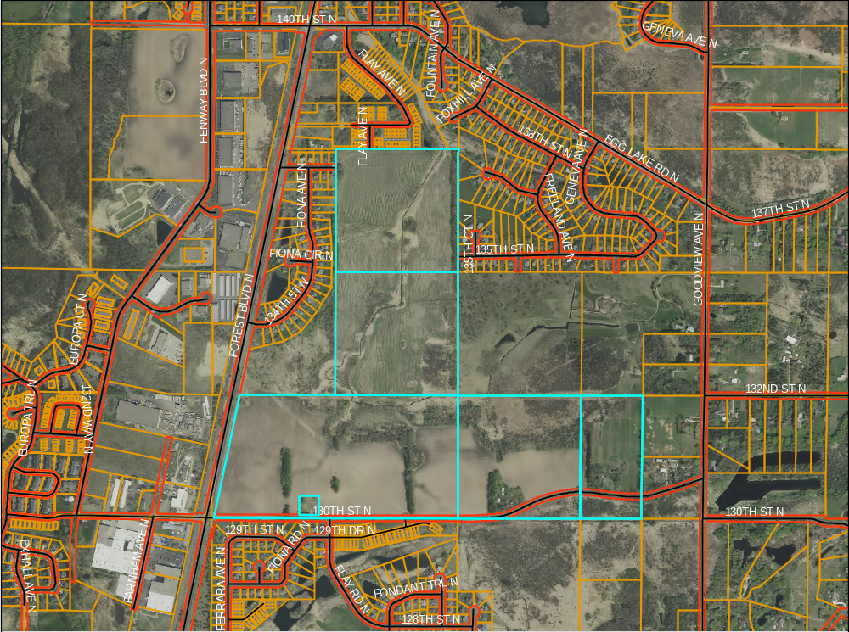
City Owned Outlot
Notes:
The property to the north is zoned Low Density Multiple Family Residential (R-4) and occupied by the Pineview Meadows townhome development. The properties to the east, south, and west are zoned Single Family Detached Residential (R-3) and occupied by the Country Ponds, Beaver Ponds, and Birch Tree Ponds residential developments. The properties to the west, across Highway 61, are zoning General Industrial (I-3) and are occupied by industrial uses. There are also a few vacant parcels to the east that are also zoned Single Family Detached Residential (R-3).

Slide 4
Description of Request
Approval of a preliminary plat and planned unit development (PUD)
The property totals 216 acres, 146 buildable acres, comprising of 6 parcels.
  Use of the City owned outlot is proposed, but not include in acreage or density calculations
The preliminary plat includes 319 single family units and 10 outlots.

Slide 5
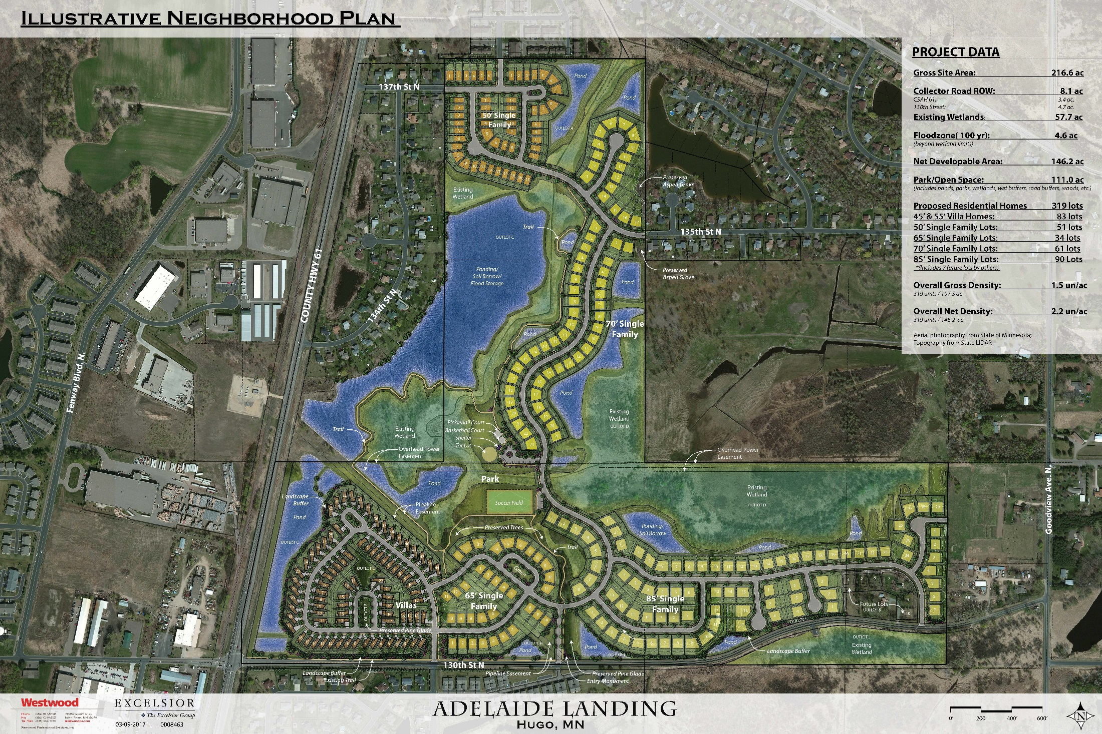
Notes:
Show locations of streets.
Blue is ponds.
The light green is wetlands
The darker green is upland, as shown in the park areas and trial locations.
Most of the outlots will be owned by the City, except the homes in the street loops.
I will go over more specifics of the development through my presentation.

Slide 6
Background, Cont.
April 17th City Council Meeting
Action was taken on the EAW and wetland replacement plan.
The preliminary plat and PUD request was tabled, as requested by the applicant, to further review the approving conditions in the resolutions.
Public Comment
  Construction of pond along the rear property line
  Drainage
  Traffic

Slide 7
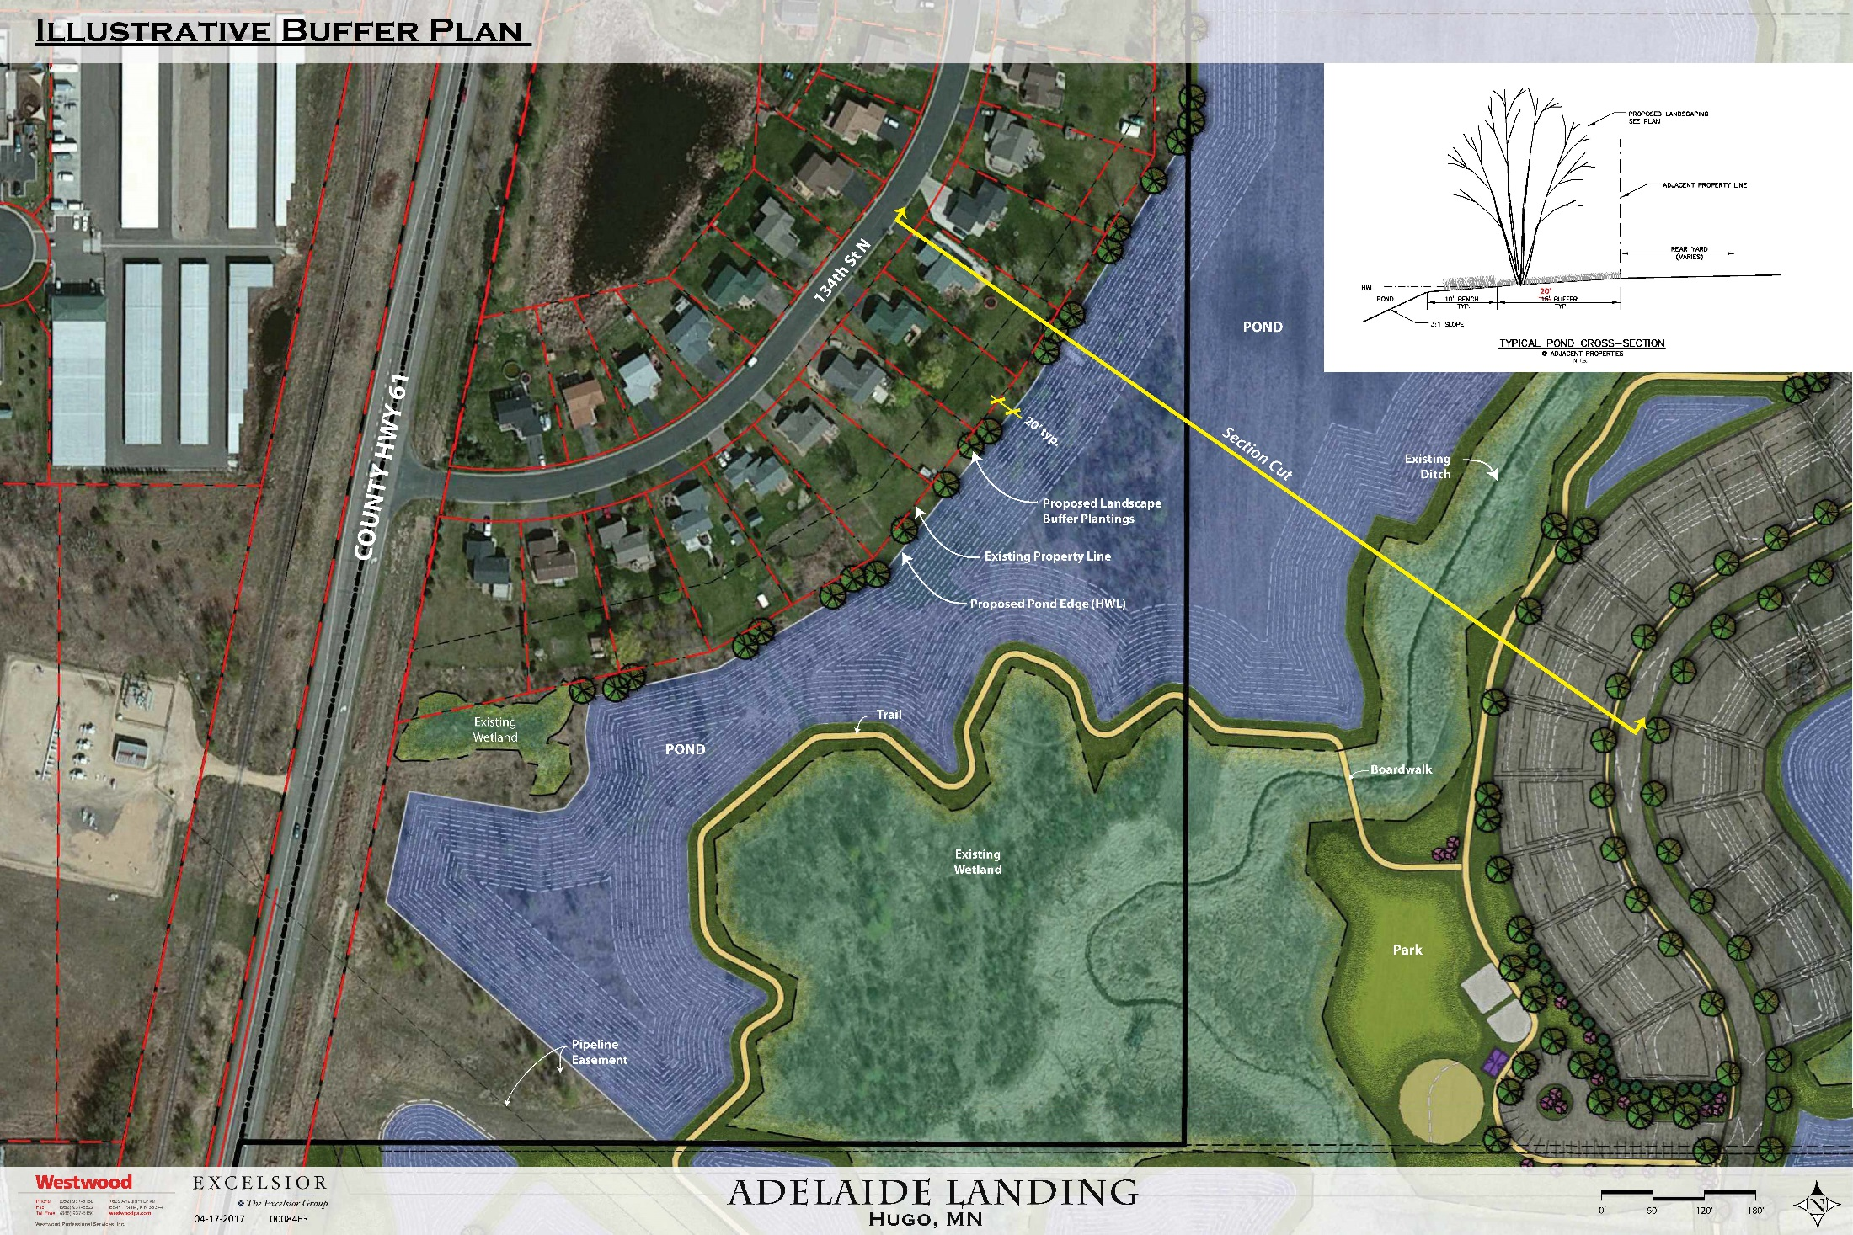
Notes:
The plan is the same from the last meeting. The developer is proposing to use the City owned property for a pond, landscaping, and a trail system. This property will remain as City owned.
The use results in the removal of brush and the trees.
The developer is proposing to have a 20 foot strip of land between the pond and the rear property lines of the lots in the Country ponds development.
They are showing additional landscaping along the rear property lines.
Staff is comfortable with the plan as proposed.
The use of the City owned property for a pond, landscaping, and trails, is something that the City Council should discuss tonight.

Slide 8
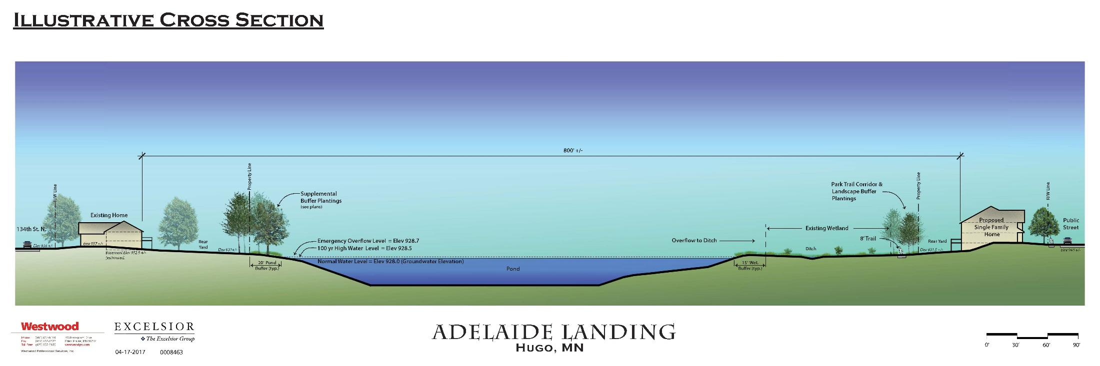

Slide 9
Drainage
An extensive stormwater management plan has been designed for the site.
The ponds are designed for:
  Rate control
  Volume control
  Water quality
The floodplain of the property has been studied and will not be expanded.
  The flood elevation will not increase.
Notes:
An extensive stormwater management plan has been planned for the site.
This is apparent from the large ponds shown on the plans.
slows the water down,
Reducing the amount of water that leaves the site,
And improved water quality
This happens through the storage in the ponds and the stormwater reuse.
The City Engineer is her and can answer any other detailed questions on the drainage for the property.

Slide 10
Traffic
The neighborhoods surrounding the proposed development were planned to be connected to other developments at some time.
We encourage connections of neighborhoods through our comprehensive plan.
This results in additional traffic on the roads.
We have worked with the developer to design the streets in this proposed development to slow down traffic.

Slide 11
Traffic, Cont.
Discussions with MnDOT on Highway 61
  Corridor plan
  Easement dedication
  Comp Plan – Land Use Plan
Timing and Funding
  Limited amount of funds
  Regional system
Notes:
We have had discussions with MnDOT throughout the years on Highway 61.
There is a corridor plan, so we know what the expansion will look like. We have been getting easements along TH 61 as property develops. And we have to submit our Land Use Plan to the Met Council and MnDOT for approval to ensure it does not have a negative impact to the regional system.
The items left for Highway 61 are the timing and funding. The State is allocated a certain amount of funding for road projects, it is not an endless pot of money. We have discussions with MnDOT frequently and what they tell us is, they prioritize the projects based on where they will be the greatest benefit to the regional system. We have seen over the last several years the construction from St. Paul along 694 and 35E up to County Road J. The next project in this quadrant is the 35w/35E Split. All of these projects help ease congestion, even here in Hugo.
For Highway 61 to rank higher in priority, it is likely there will need to be more traffic and more safety issues.

Slide 12
130th Street Improvements
Currently a two-lane, rural section roadway
Upgrade to a two-lane, urban section roadway
Design
  Roundabout considered at Flay Avenue
  8 foot wide bituminous trail on the north side
Shown in the City CIP as a future improvement
Cost Share/Timing
  The developer will be responsible for 44% of the total project cost.
  One-third of the cost will be paid over the first three phases of the development.
Notes:
As the proposed development moves forward, nearly all of the roadway segment between Highway 61 and Goodview Avenue will be developed on the north and south sides. 130th Street is currently a two-lane, rural section roadway. Staff recommended, and the City Council and Commissions agreed, during the sketch plan that the upgrade of 130th Street to an urban-section road between Highway 61 and Goodview Avenue should be completed with the development as outlined in the City’s long-range plans.
Staff has been working with the applicant on a number of items regarding the improvement/reconstruction of 130th Street. The design of the road is being discussed and the addition of a roundabout at Flay Avenue and 130th Street is being considered. The design will include an 8 foot bituminous trial on the north side.
Staff is discussing with the applicant the appropriate cost share and timing of the improvements.
-The developer will be responsible for 44% of the total project cost.
One-third of the cost will be paid during the first three phases of the development. The developer is estimating phase 3 to happen on 2019.
This requires coordination with the CC on the CIP and how this project fits in. We expect to have these discussions at the City’s mid year budget review in August.

Slide 13
Conclusion
Staff believes that the layout of the proposed Adelaide Landing PUD general plan exceeds the City’s standards for residential developments.
The rezoning/PUD is consistent with the Comprehensive Plan in terms of land use and density.
It is in staff’s opinion that the Adelaide Landing PUD general plan has offered a creative and efficient method to planning the site, all which meets the intent of the PUD ordinance.

Slide 14
Recommendation
Staff recommended approval of the preliminary plat and PUD to the Planning Commission , subject to the conditions listed in the resolutions.
The Planning Commission recommended approval of the requests, subject to the conditions on the resolutions, and the addition of two conditions:
The developer shall work with staff on trail a connection to the County Ponds neighborhood to the west.
The developer shall work with staff regarding moving the pond back from the rear lot lines of the County Ponds neighborhood to the west and review the trees in the area.
Proposed Motions:
  Move to adopt the ordinance approving the rezoning of the property from R-3 to PUD.
  Move to adopt the resolution approving the PUD.
  Move to adopt the resolution approving the
  Preliminary Plat.

Slide 16
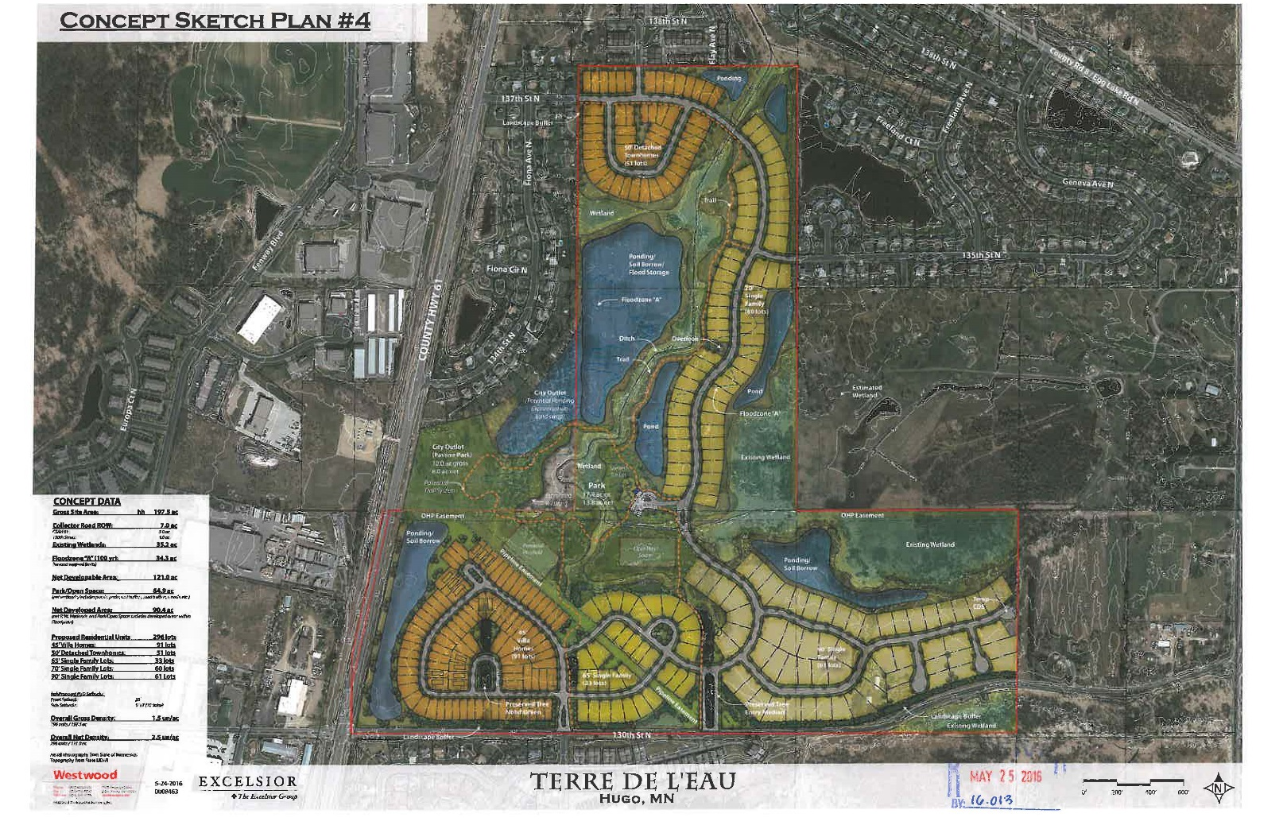

Slide 17
PUD, Cont.
Lot Size
 | R-3 Zoning District |  | 45’ and 55’ Wide Villa Lots | 50’ Wide Lots | 65’ Wide Lots | 70’ Wide Lots | 85’ Wide Lots
Lot Size (min) | 10,400 SF |  | 5,850 SF | 6,513 SF | 8,450 SF | 9,029 SF | 11,050 SF
Lot Size (avg) |  |  | 8,601 SF | 8,138 SF | 11,823 SF | 10,529 SF | 13,017 SF
Lot Width (min) | 80 Ft |  | 45 Ft | 50 Ft | 65 Ft | 70 Ft | 85 Ft
Lot Depth (min) | 100 Ft |  | 130 Ft | 130 Ft | 130 Ft | 130 Ft | 130 Ft
*Requested PUD flexibility highlighted in grey
Notes:
The applicant is asking for a variety of lot sizes for various housing products.
Min lot size of 5,850 sqf, where 10,400 is allowed by ordinance.
Min lot width of 45 ft, where 80 feet is allowed by ordinance.
The Planning Commission has seen these lot sizes in developments such as, Victor gardens, Fable Hill and Clearwater Cove.

Slide 18
PUD, Cont.
Setbacks
 | R-3 Zoning District |  | 45’ and 55’ Wide Villa Lots | 50’, 65’ and 70’ Wide Lots | 85’ Wide Lots
Front Setback (min) | 30 Ft |  | 20 Ft – Side Load Garage 25 Ft – Front Load Garage | 25 Ft | 25 Ft
Side Setback (min) | 10 Ft |  | 7.5 Ft | 7.5 Ft | 10 Ft
Rear Setback (min) | 30 Ft |  | 25 Ft | 30 Ft | 30 Ft
Lot Impervious (max) | 50% |  | 55% | 50% | 50%
*Requested PUD flexibility highlighted in grey

Slide 19
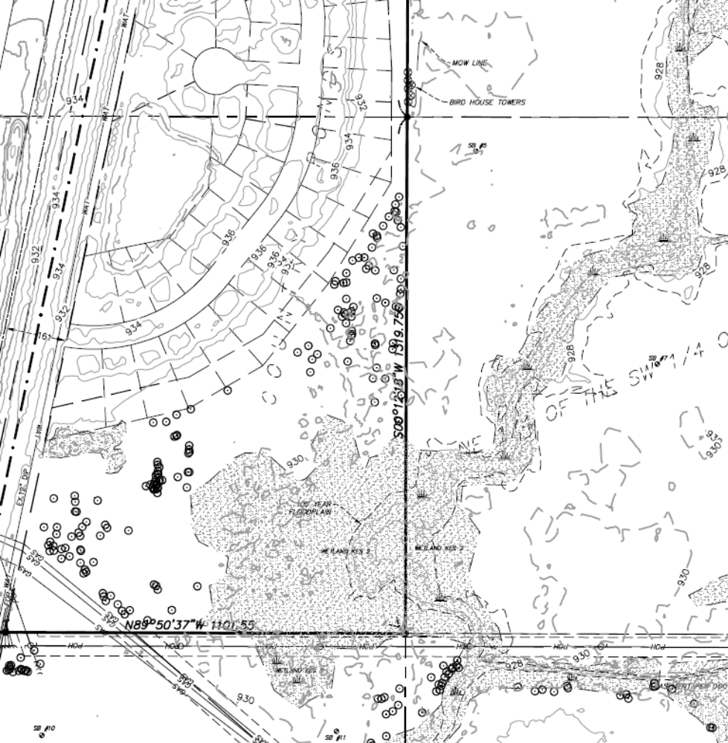

Slide 20
Notes:
Existing area shown on the plans between the ponds on the rear lot lines is 15 feet.
The developer is proposing to slightly increase the area from 15 feet to 20 feet from the rear lot lines of Country Ponds.
Staff visited the property and most of the area is covered in brush and did not find significant trees. The EAW did not note any protected areas.
The developer agreed to add a sidewalk along 137th Street.
The developer agreed to work with staff on additional connections to the park.

Slide 21
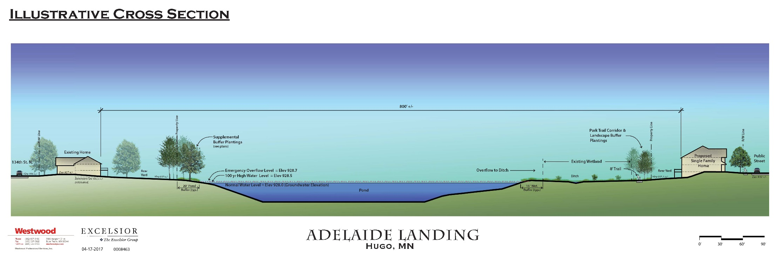

Slide 22
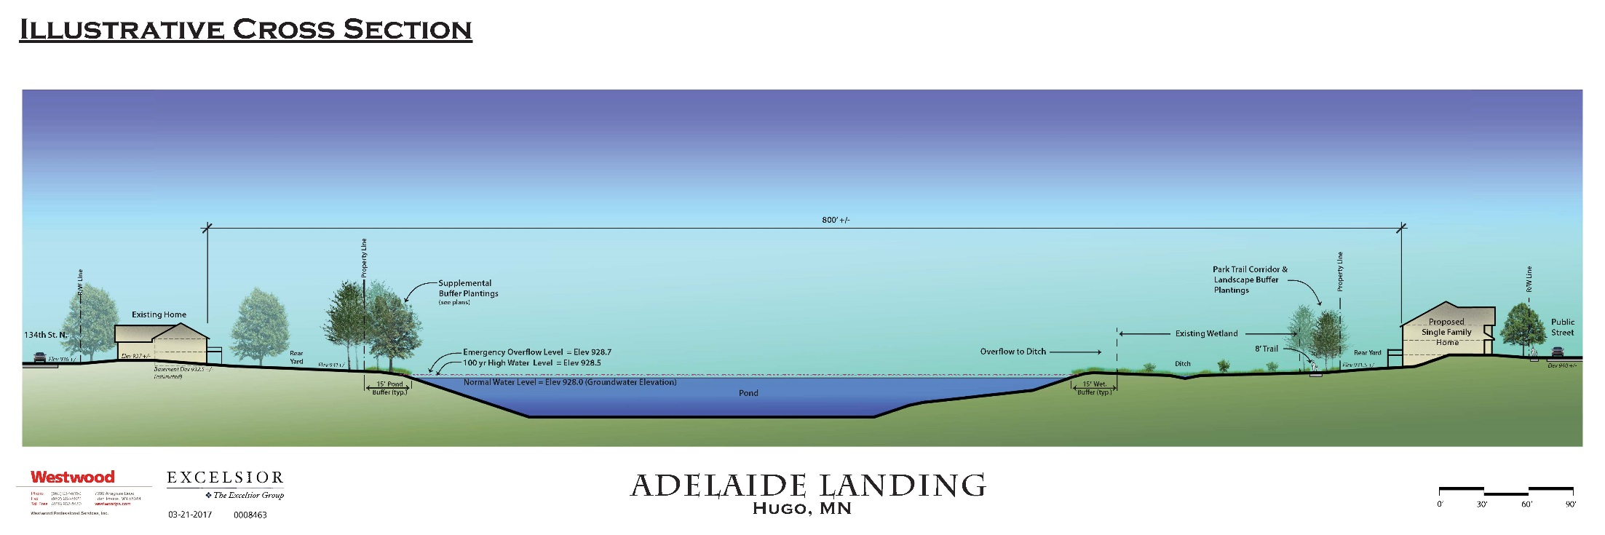

Slide 23
