Slide 1
Public Waters Inventory
Monday, August 21, 2017
City Council

Slide 2
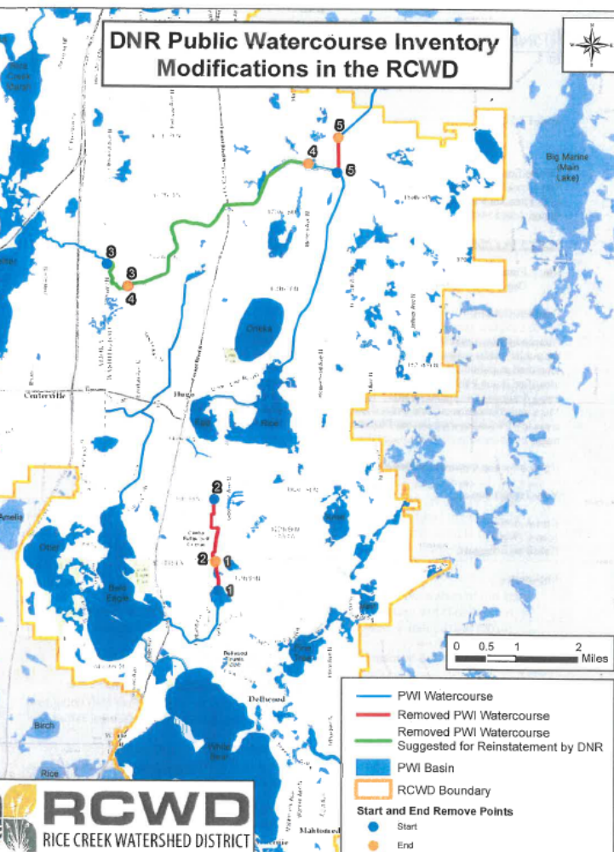

Slide 3
Background
Manager Waller discussed possible changes to Pubic Waters Inventory
  Aug 7, 2017
Discussion was about sending letter to DNR expressing concerns
Staff has obtained additional information

Slide 4
History
1979 designation of “Public Waters” by DNR
  An “Inventory” was created ----------- PWI
    Includes a list and a map
  Process included public input before adoption
2015 Buffer Law
  “Public Waters” are relevant to the buffer law
  Original PWI Maps were reviewed
  Some ditches are on the map but not on the list
    Proper notice was not provided to landowners – they might not know their ditches are shown as “public waters”
    JD-2 (Hardwood Creek) is one of these
April 2017 order removed these ditches from the PWI

Slide 5
Recent developments
RCWD received some communication from DNR indicating DNR’s recommendation to put JD-2 back on the PWI.
RCWD wants DNR to follow the original statutory process (with notice to landowners) for PWI inclusion.
RCWD does not know what process DNR will follow
2017 DNR order anticipates a review of subject ditches for PWI inclusion subject to public comment.
RCWD has not taken an stance on PWI designation
Notes:
One of the 2017 City Council focus goals was to evaluate possible solar panel installation at City facilities. Staff believed the replacement of the Fire Hall roof would be a good opportunity to investigate the opportunity to put solar panels on the roof of the facility.
Staff worked with a solar company who provided us with two potential systems. The first allows the City for apply for the Xcel solar rewards program. This program helps offset the cost of the install. It is a 19.8 kW system, which is 59 panels. The system would save the City $1,426/year. With using the Xcel rewards program, the system would cost approximately $35,600 and there would be a 25 year payback.
The second system maximizes the space on the fire hall roof by using 147 panels for a 49.245 kW system. The project would cost $108,000 and the City would save $3,567/year. This would mean there would be a 30 year payback.
None of these numbers include the degradation of the panel production nor any maintenance costs post install.

Slide 6
Conclusion
PWI inclusion (designating the ditch as “public waters”) could have multiple consequences to landowners, City, RCWD, etc.
Staff has not analyzed this matter
  Would prefer to do so through a proper process…

Slide 7
Recommendation
Staff will contact DNR staff to inquire about intended process
Staff will follow-up with letter

