Slide 1
130th Street Improvement Project
September 18, 2017

Slide 2
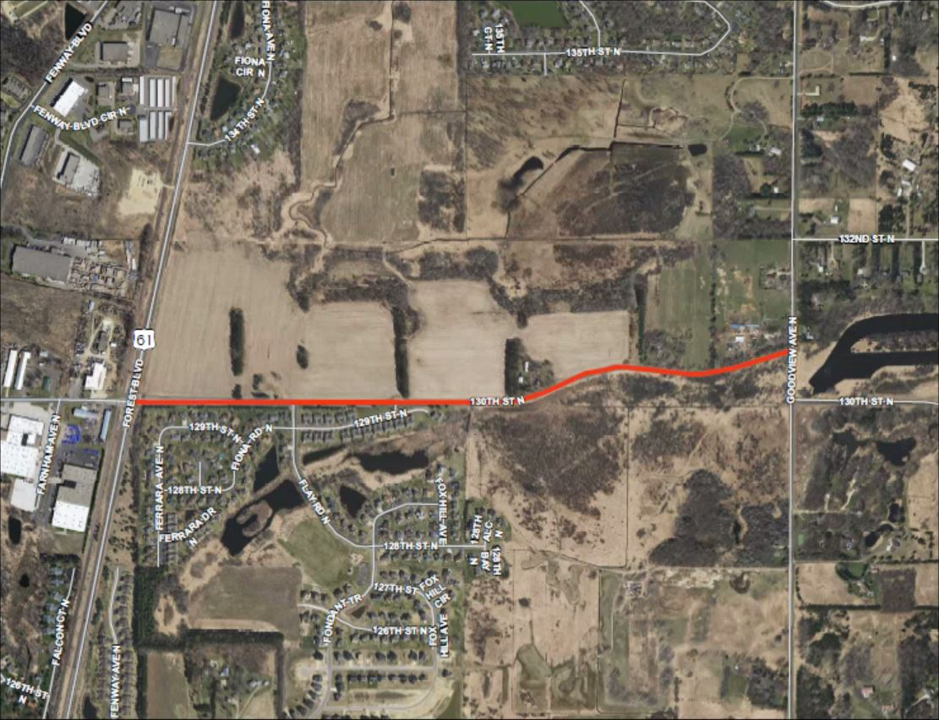
130th Street Project Location
Sunset
Lake

Slide 3
Background
130th Street has been identified as a roadway for improvement, however not on CIP
Adelaide Landing has started construction on their initial phase
  Development Agreement Requires 44% of projects costs to be paid to the City ($1,566,520)
  1/3 due at each of the first three phases ($521,840)
Beaver Ponds previously contributed funds used for 130th Street and TH 61 Improvements

Slide 4
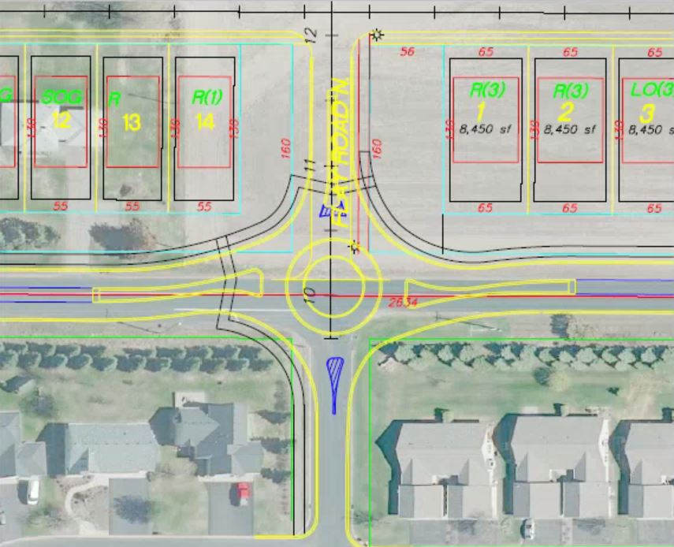
130th Street Considerations
Urban Section with Roundabout at Flay Avenue and 130th Street
2019 Construction
Pedestrian Trail
Affect on CIP
Wetland Delineation
Soil Borings

Slide 5
Recommendation/Next Steps
Further Evaluate Design Alternatives and coordinate with development team
Complete wetland delineation
Complete soil borings
Meet with adjacent land owners

