Slide 1
Assessment Hearing
North Sunset Lake Area
Roadway Improvement Project
October 2, 2017

Slide 2
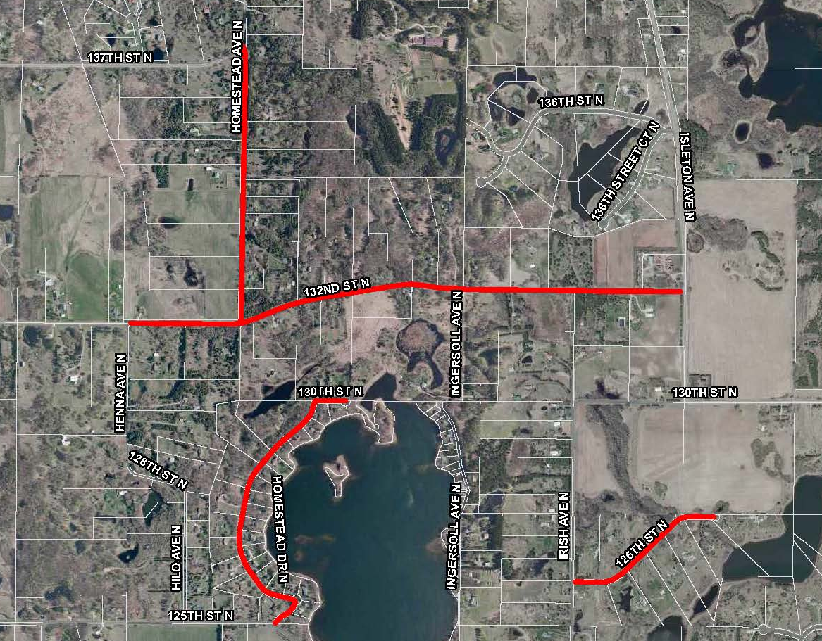
Sunset
Lake

Slide 3
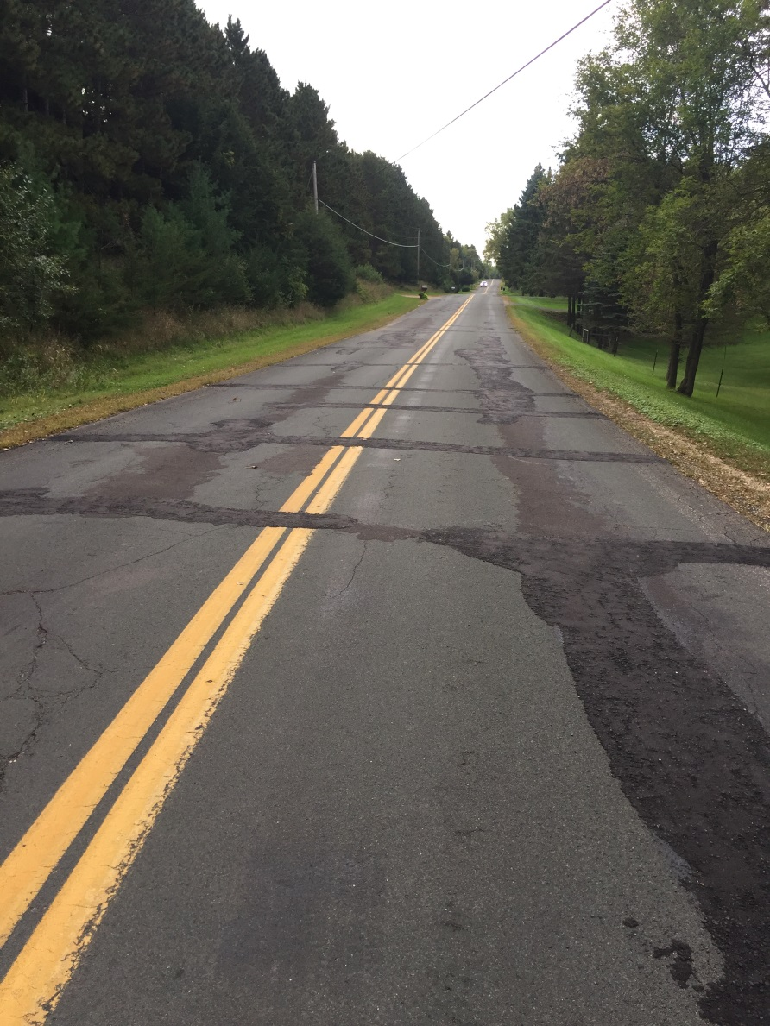
Pre Construction – Homestead Avenue

Slide 4
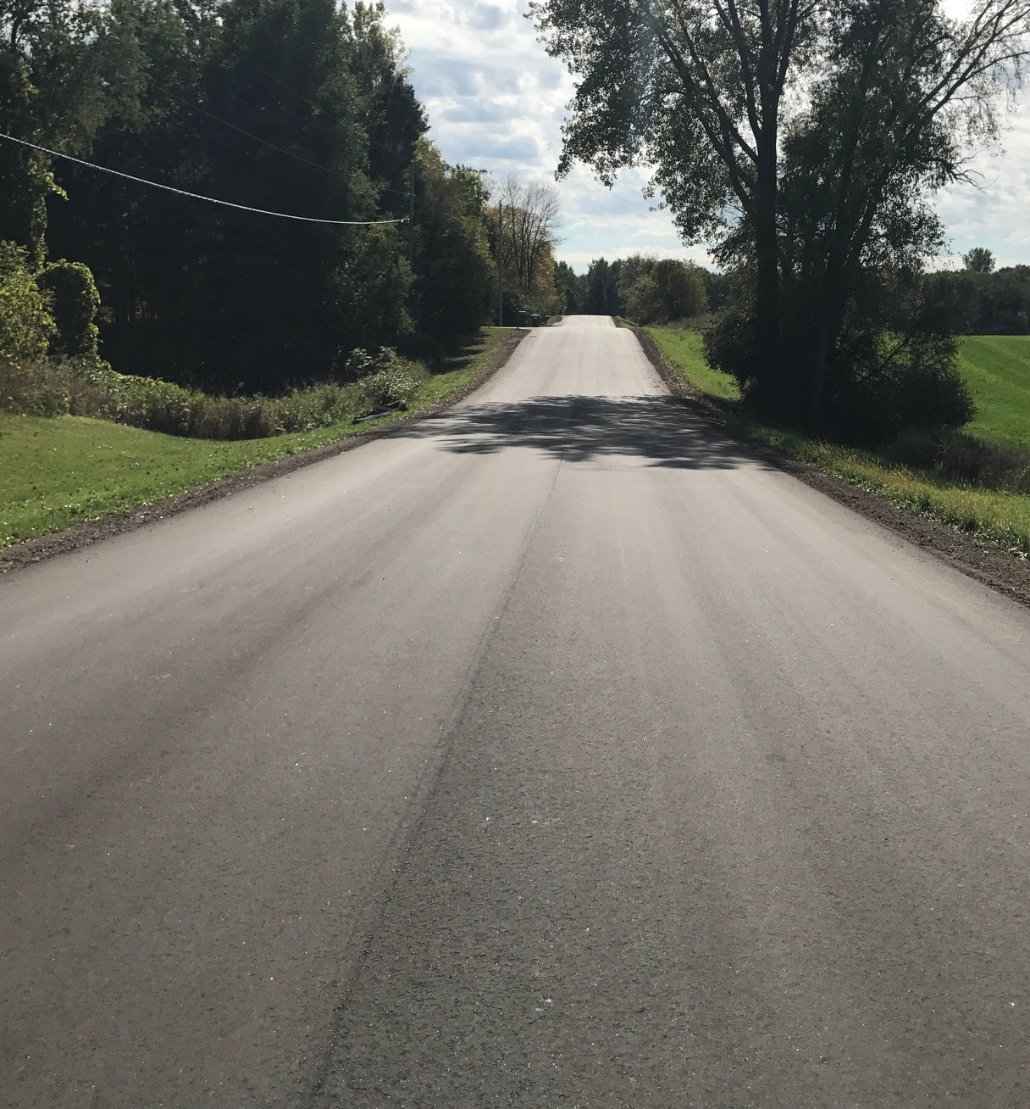
Post Construction – Homestead Avenue

Slide 5
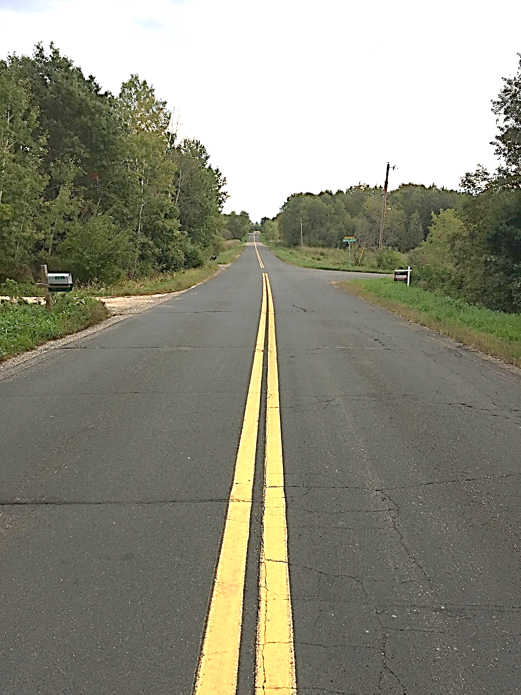
Pre Construction – 132nd Street

Slide 6
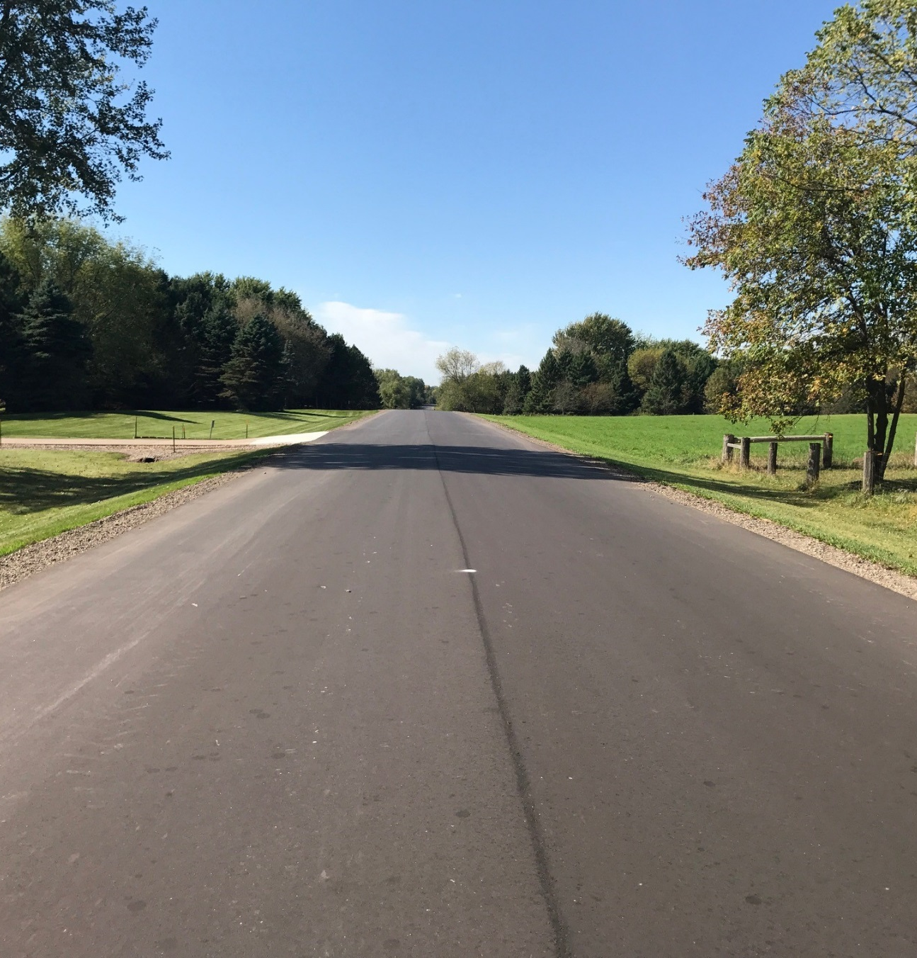
Post Construction – 132nd Street

Slide 7
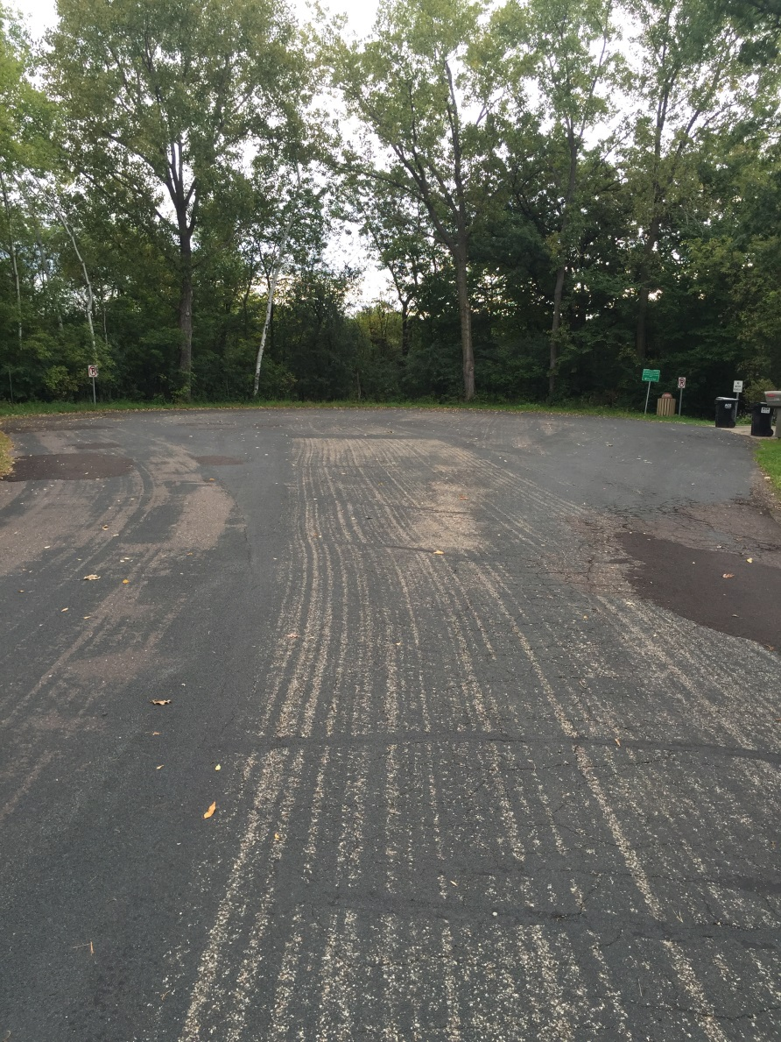
Pre Construction – Homestead Drive

Slide 8
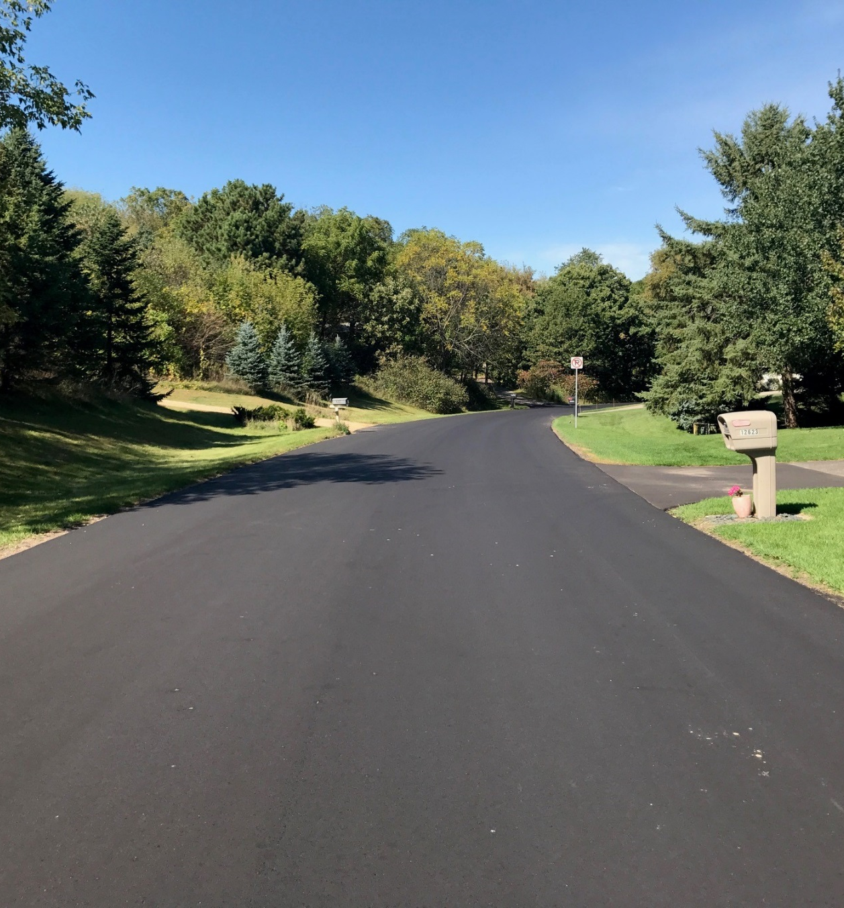
Post Construction – Homestead Drive

Slide 9
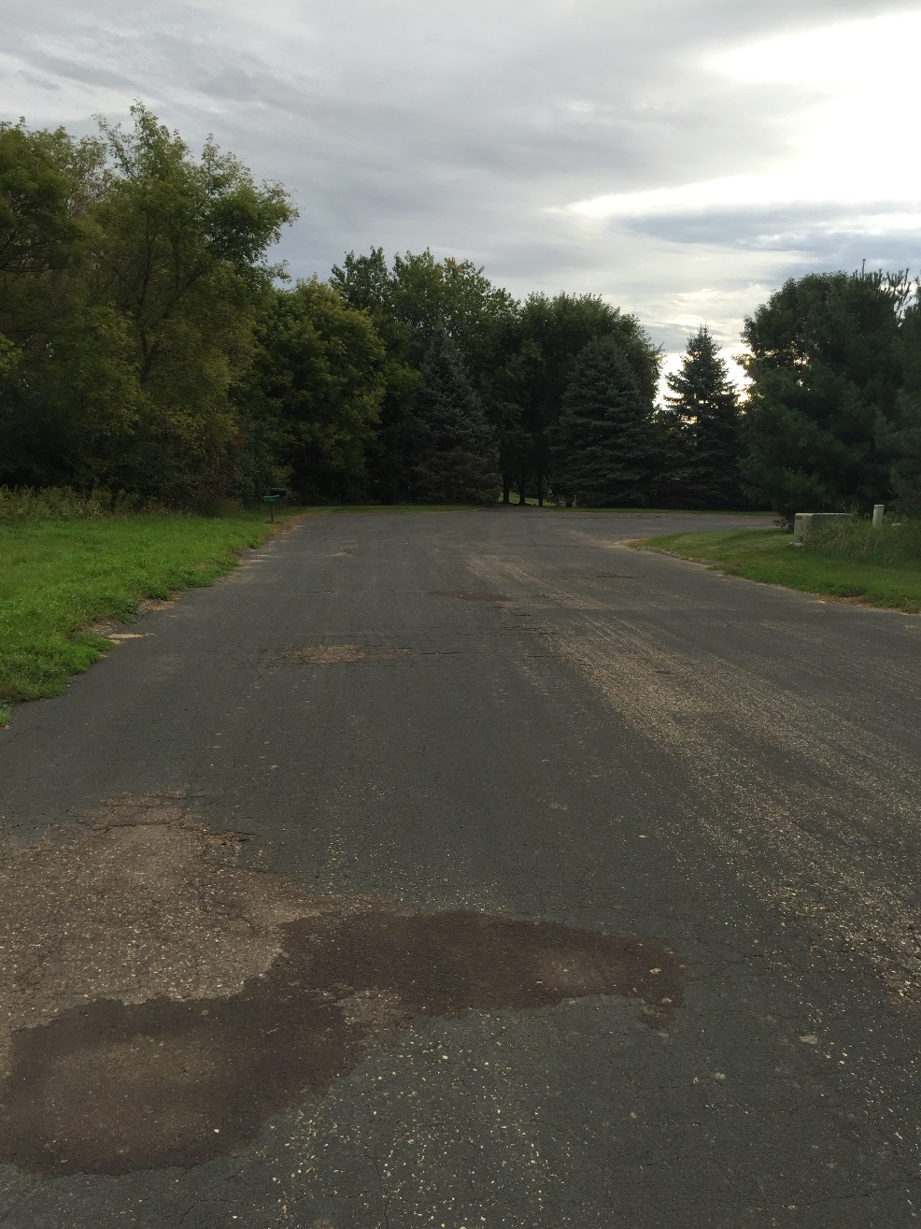
Pre Construction– 126th Street

Slide 10
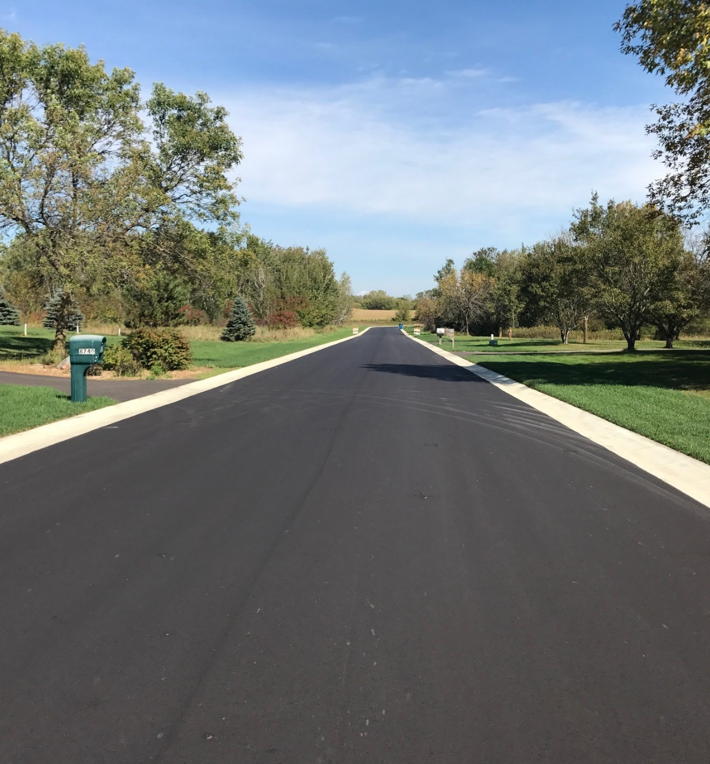
Post Construction– 126th Street

Slide 11
Projected Costs/Financing
Total Project Cost $1,480,300
  Assessments $280,500
  City Funds $1,199,800
    Capital Improvement Fund
    State Aid Funding
Assessment Rates
  Single Family (Rural Roadway Reclamation) $3,400

Slide 12
City Assessment Policy
Rural Roadway Reclamation
  $3,400/unit
  Direct frontage
  Access
  Review potential subdivisions
Corner lots prorated
0.5 unit
Homestead Ave N
0.5 unit
132nd Street N

Slide 13
Corner/other lot examples
Through lot
3-roadway frontages
Street A
Street A
0.5 unit
0.33 unit
0.33 unit
Street B
0.5 unit
0.33 unit
Street B
Street C

Slide 14
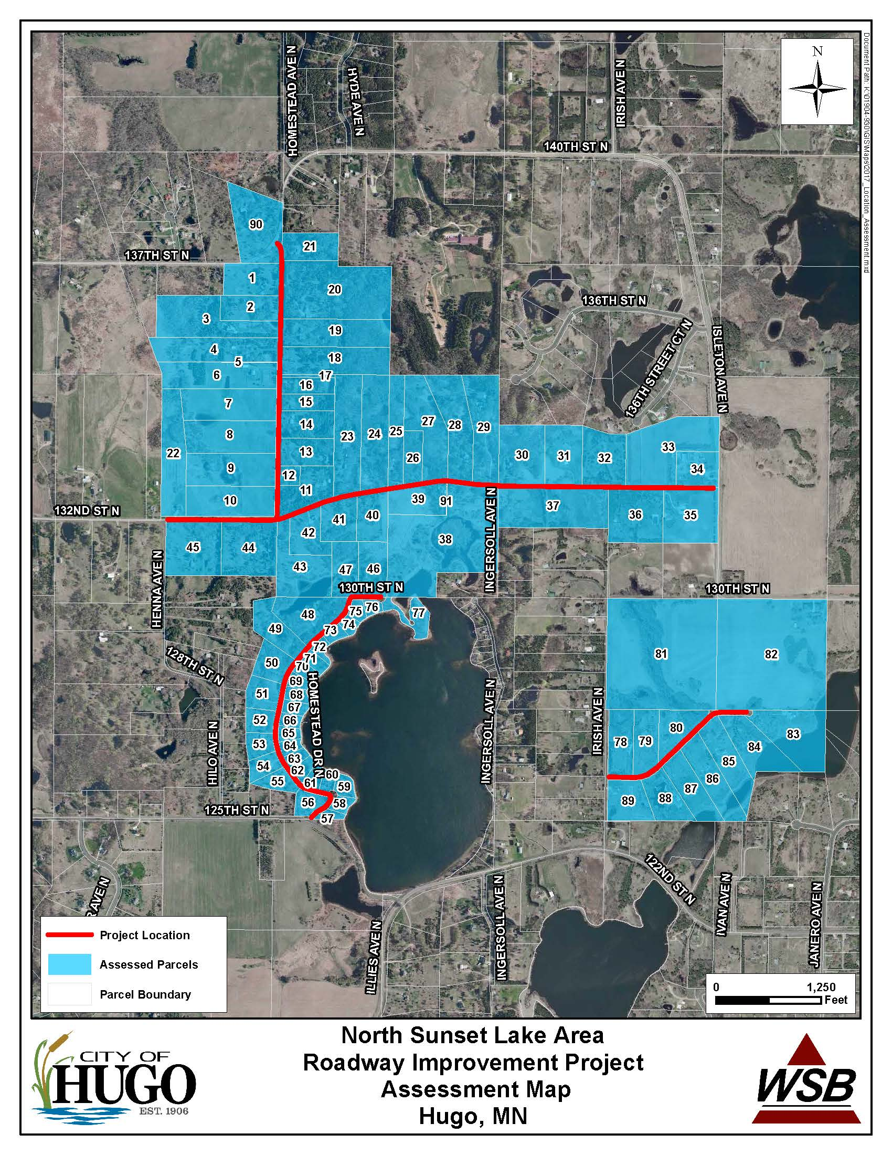
Assessment Map

Slide 15
City Assessment Policy
Assessments spread over a 10-year period at 4.27%
Can prepay assessment with no interest if done so within 30 days of Assessment Roll adoption (by Nov. 1, 2017)
Assessments will be certified to Washington County this fall for taxes payable in 2018
Senior Citizen deferral is available for those 65 years of age or older
Following the Adoption of the assessment roll, each property owner will be mailed detailed information regarding their assessment

Slide 16
Potential Schedule
Neighborhood meeting Sept 22, 2016
City Council Receives Feasibility Nov 7, 2016
Public Hearing/consider implementing project Dec 5, 2016
Plan/Specification Preparation Jan-Feb 2017
Neighborhood Open House With Plans February 2017
Project Bidding March 2017
Award Construction Contract April 2017
Construction May-Oct 2017
Assessment Hearing Oct 2, 2017
Assessment pre-pay period October 2017

Slide 17
Next Steps
Hold Assessment Hearing
Consider Resolution Adopting Assessment Roll

