Slide 1
Abatement Hearing
Dennis & Karen Schultz
13101 Henna Avenue
Monday, September 18, 2017
Notes:
Good evening. Tonight we are here to hold an abatement hearing for Dennis & Karen Schultz for their property located on 13101 Henna Aven. N.

Slide 2
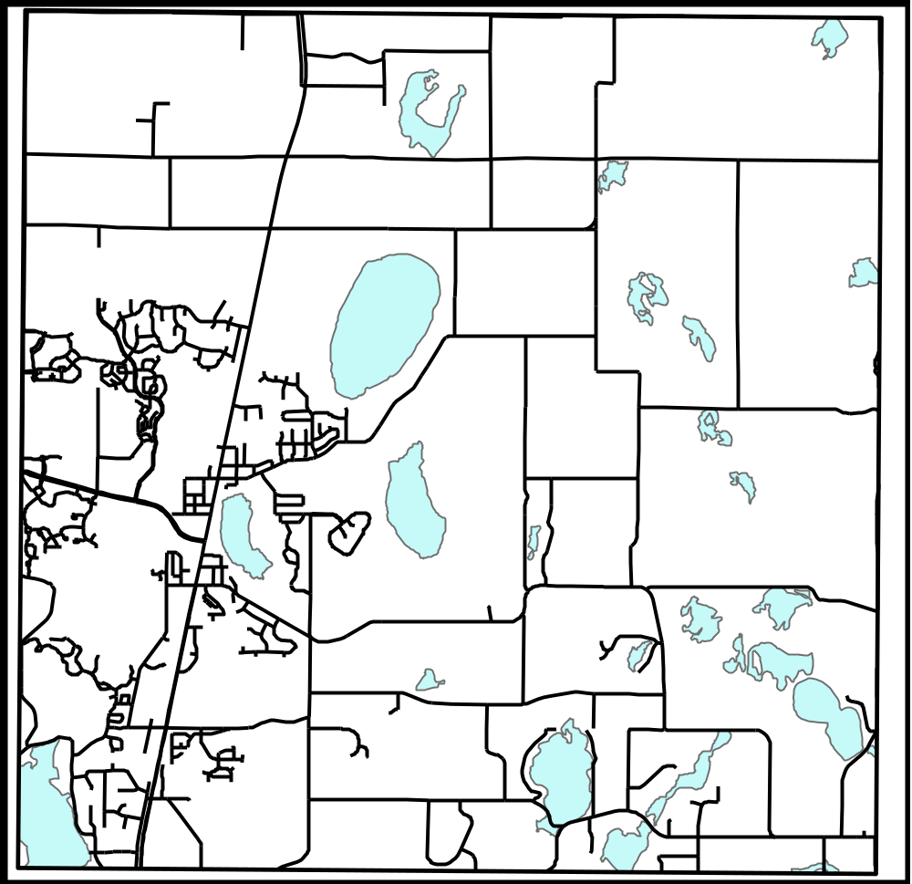
170th Street
Henna Ave
Highway 61
CSAH 8
Site
Notes:
The property is located south of 132nd St. N. and east of Henna Ave.

Slide 3
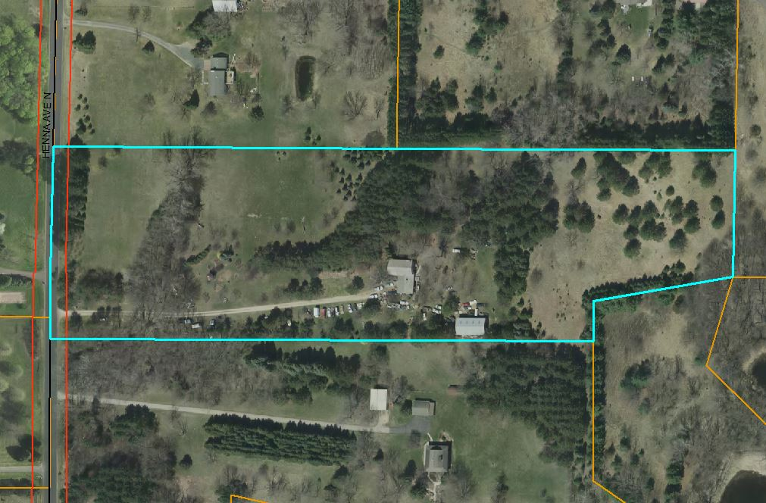

Slide 4
Background
The City received a complaint regarding trash, debris, and junk vehicles lying about the property.
City staff inspected the property and confirmed that there were nuisance violations, which included the accumulation of 40-50 junk vehicles, small machinery, boats, tires, and other miscellaneous junk and debris.

Slide 5
Background
The first violation letter was sent on August 8, 2016.
City staff repeatedly contacted and met with the property owner to encourage and assist with formulating a plan and action to eliminate junk, wrecked and old vehicles and materials littering the property.
The property owner has not corrected the situation despite requests for voluntary compliance and offers of assistance.
Notes:
Consistent with the City’s approach of attempting to work with the property owner directly before seeking any formal intervention, City staff repeatedly contacted and met with the property owner to encourage and assist with formulating a plan and action to eliminate junk, wrecked and old vehicles and materials littering the property. Although the property owner has made some progress with the property, it has been minimal and the situation has not been corrected. There are still multiple Code violations on the property.

Slide 6
Background
The City Council held an abatement hearing on September 9, 2017.
At this meeting, the Council directed the property owner to remove the following items by November 15, 2017:
  All miscellaneous junk, debris, and rubbish.
    This includes all materials that are now being stored outside, such as miscellaneous equipment, machinery, sinks, barrels, containers, storage tanks, bicycles, lawn chairs, signs, tires, etc.
  All vehicles that are not considered to have substantial value.
    A case shall be made for any vehicle believed to have substantial value. A case may be made through providing the City with comparable vehicle listings, assessed values of vehicles, or any other evidence which demonstrates a vehicle is of substantial value.
The City Council asked for an update at their November 20, 2017 meeting.
Notes:
The City Council held an abatement hearing on September 9, 2017.
You gave direction to the property owner to remove all miscellaneous junk, debris, and rubbish as well as all vehicles that are not considered to have substantial value.
This was to be completed by November 15th and asked for an update at your November 20th meeting.

Slide 7
Violations
Municipal Code Chapter 46, article I., Section 46-2 and 46-3:
  Section 46.2 – Public nuisances affecting health, safety, comfort or repose.
    (3) The accumulation of garbage and rubbish not in containers, as required by ordinance of the city;
    (5) An accumulation of tin cans, bottles, glass, trash or debris of any nature or description;
  Section 46.3 – Public nuisances affecting peace and safety.
    (1) The piling, storing or keeping of wrecked or junked machines or vehicles and other junk or debris other than by persons involved in commercial business where the city council deems certain accumulations are necessary in the course of transacting business.
Notes:
Although the property owner has made some progress, there are still violations on site. These can be documented in the photos attached to order of abatement from the November 15th inspection. The violations on site are the following, which include an accumulation of rubbish not in containers, an accumulation of trash and debris, and the piling or storing of junked machines or vehicles. Because of the violations still on site, staff is presenting the Council with an order of abatement for the property.

Slide 8
Summary of Order
The code violations shall be corrected and brought into compliance within 30 days of the service and posting of this order upon the property owners.
If property is not brought into compliance in the 30 days, the City will enter the property and mark each piece of rubbish or junk vehicle using spray paint.
If those items are not removed within 10 days, the City may enter the property and remove them at the cost to the owners.
  Any costs incurred by the City shall be assessed as taxes.
Notes:
The summary of the order is…

Slide 9
Conclusion/Recommendation
City staff has been working with the property owners to bring the property into compliance by cleaning up the trash, debris, and junk vehicles. Although some progress has been made by the property owners, it has been slow progress and the site still has multiple violations.
City staff recommends the City Council open the abatement hearing and take comment and testimony from the property owner and/or their representatives.
Staff recommends the Council approve the order to abate the property located at 13101 Henna Ave. N. to bring the property into compliance with City Code.

