Slide 1

Yellow Ribbon Update

Slide 2



Slide 3
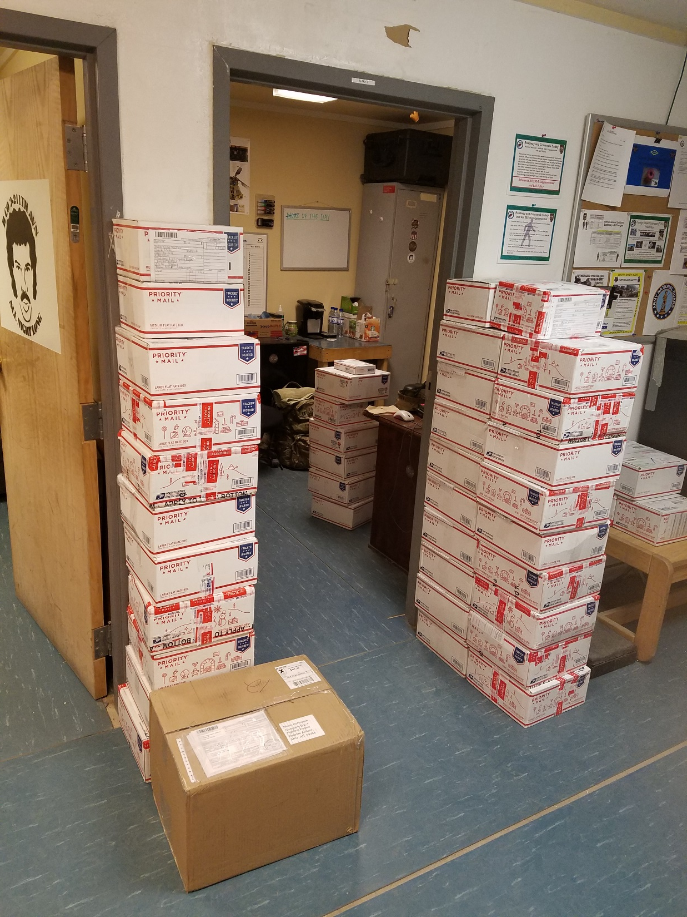

Slide 4


Slide 5


Slide 6
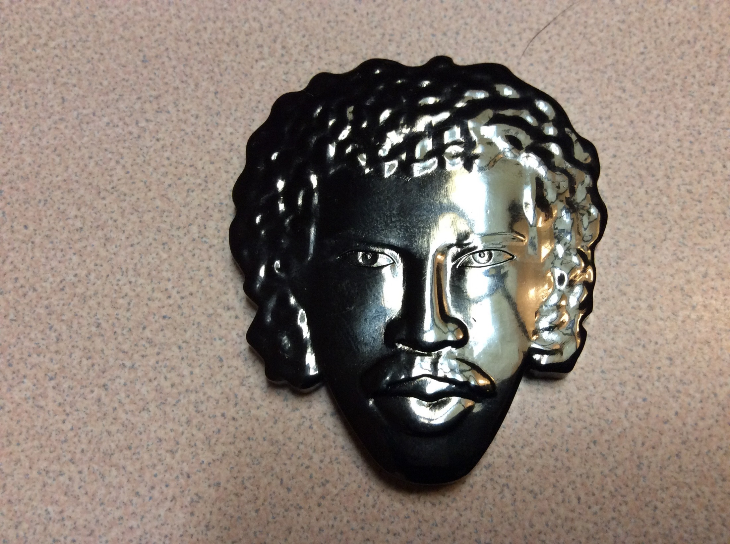

Slide 7


Slide 8
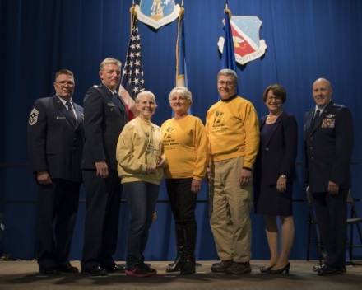

Slide 9
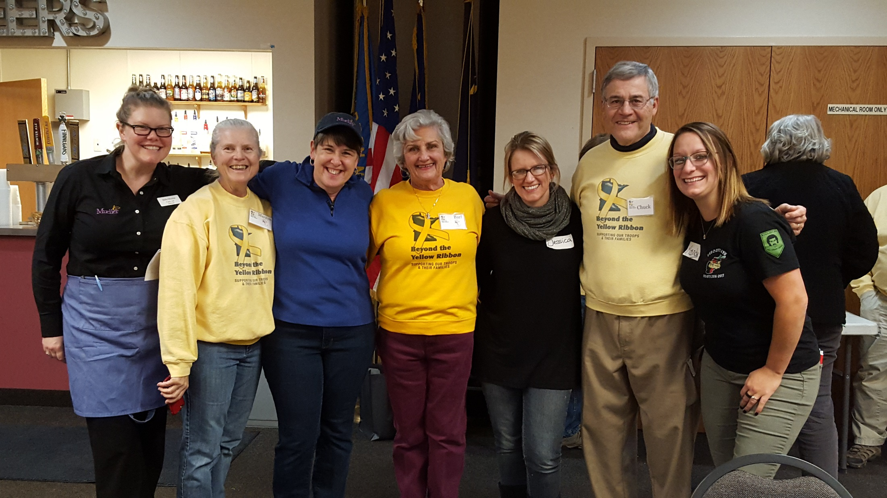

Slide 10
Administrative Presentations
December 18, 2017

Slide 11
Goal Setting Session
Annual meeting to set goals for the coming year
Staff suggests Monday, January 29, 2018
7 p.m.

