Slide 1
Proposal:
City of Lake Elmo Nature Center at Sunfish Lake Park
Presented by Tony Manzara
5050 Kirkwood Ave N, Lake Elmo
651-439-0389

Slide 2
Basic Idea: private-public partnership
Private fundraising to plan and construct a Nature Center building in Lake Elmo’s Sunfish Lake Park
Transfer to City ownership when complete
City Parks Budget would be responsible for future
  Utilities
  Maintenance
  Security
Private fundraising for endowment for some operations
  Naturalist salary
  Recruitment and training of docents
  Upgrade/renewal of trail signs
  Identification and marking of trees and other features

Slide 3
Benefits
Brings us together to build community spirit
Provides nature interpretation and education opportunities
Encourages higher utilization of one of Lake Elmo’s jewels
Affords opportunities for naturalist, and volunteer docents
Offers a possible connection to ISD 834 for nature education
Serves as a memorial to the late Sally Manzara

Slide 4
Encouraging Community Involvement
Opportunity for volunteer docents to lead tours of the Nature Center exhibits and walks on the trails, perhaps on a regular basis
Elementary School natural science class location?
High School Science Project location (with volunteer mentors)?
4H classes could use the space?
Bird counts and flower discovery days
Trail grooming and litter pick-up (not much litter now!)
Possible use of the exhibit room for meetings
Trail webcams to watch for animal activity
Volksmarch starting line
Bike trail waypoint

Slide 5
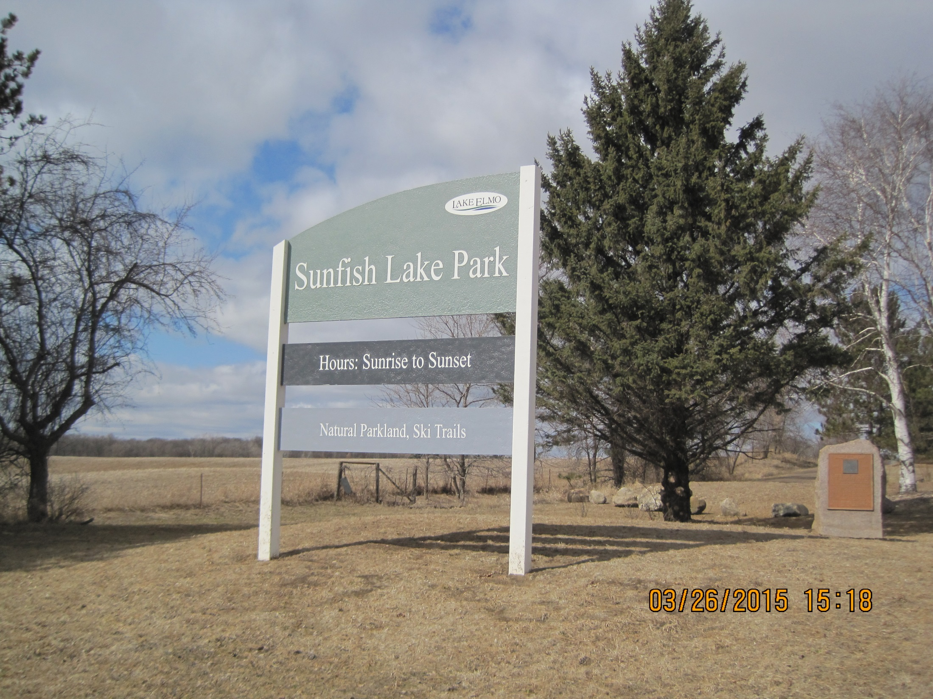

Slide 6
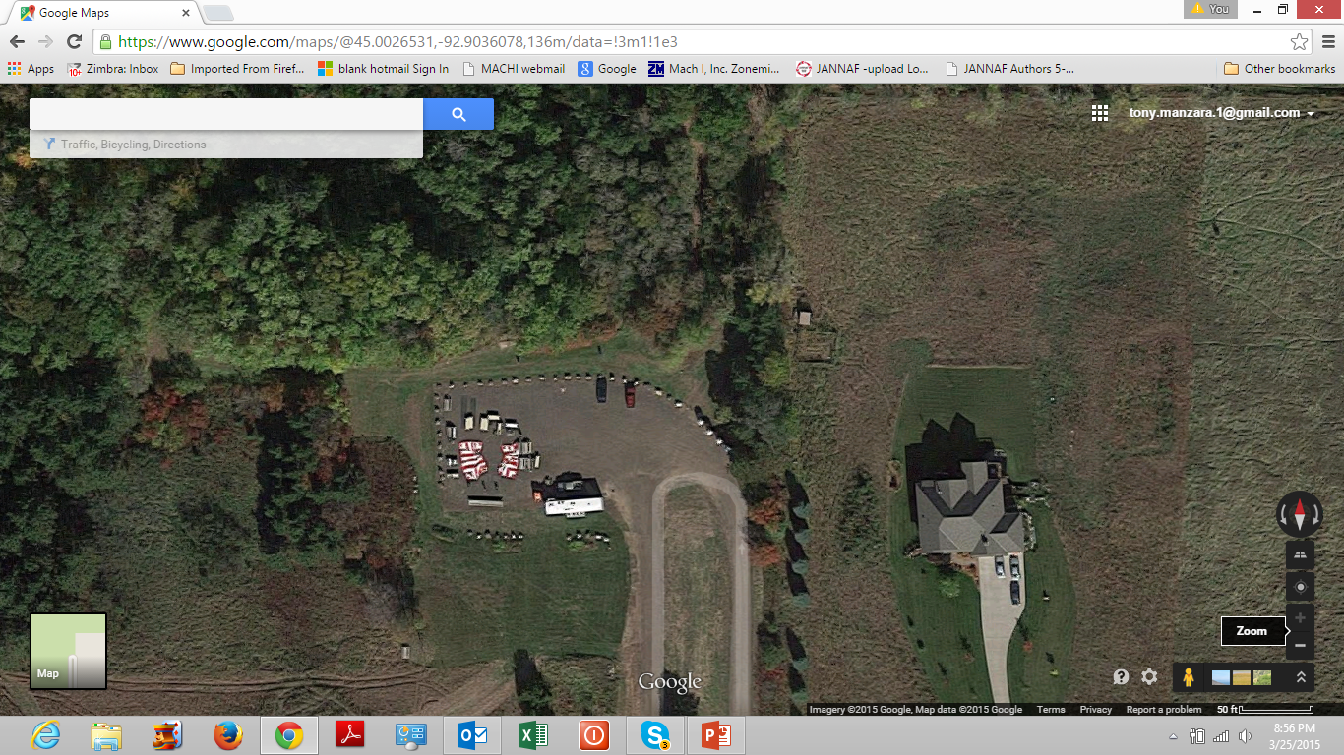
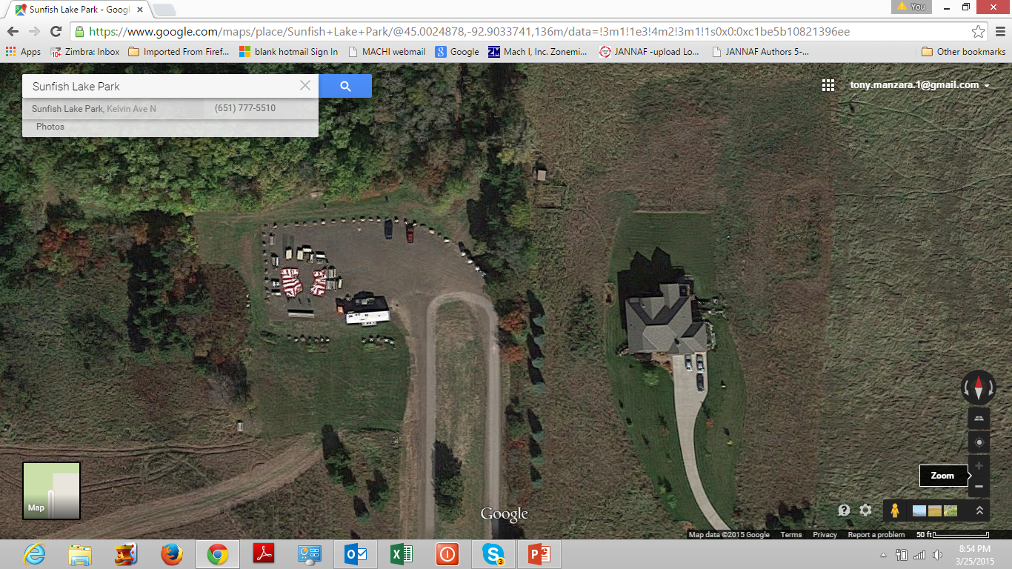
Maps and sketches
Nature Center

Slide 7
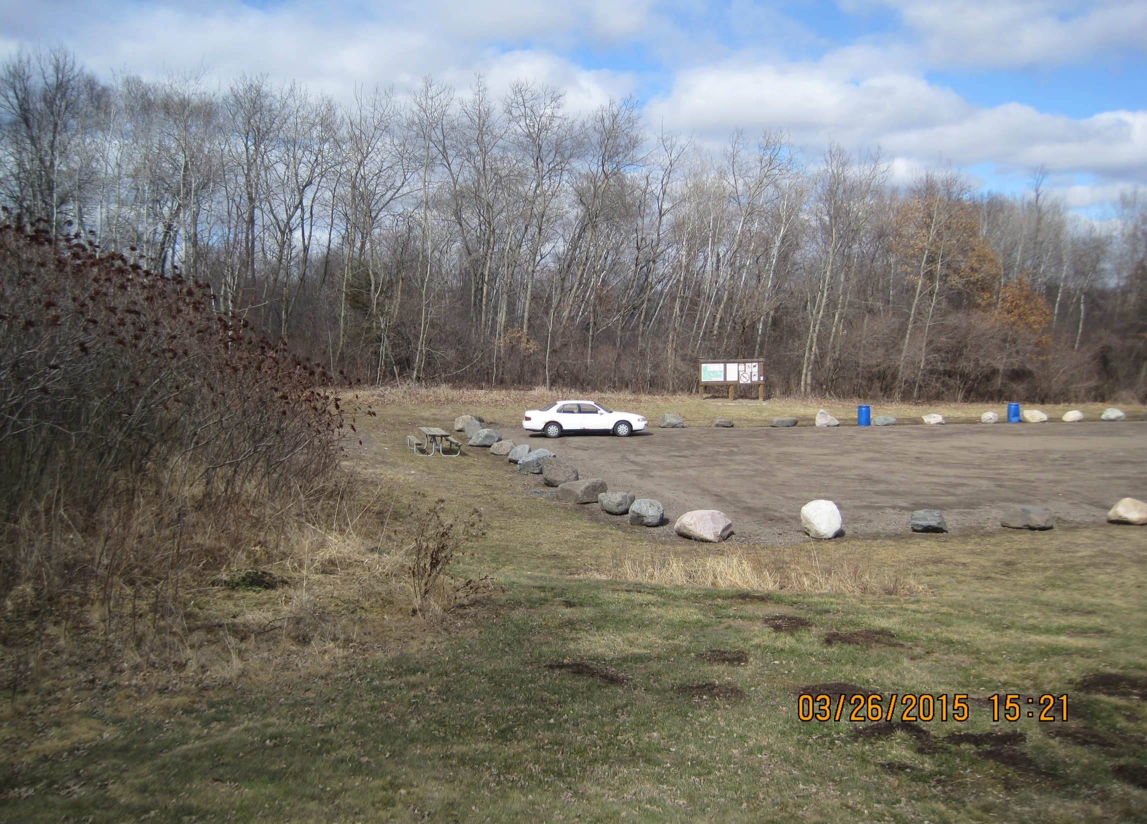

Slide 8
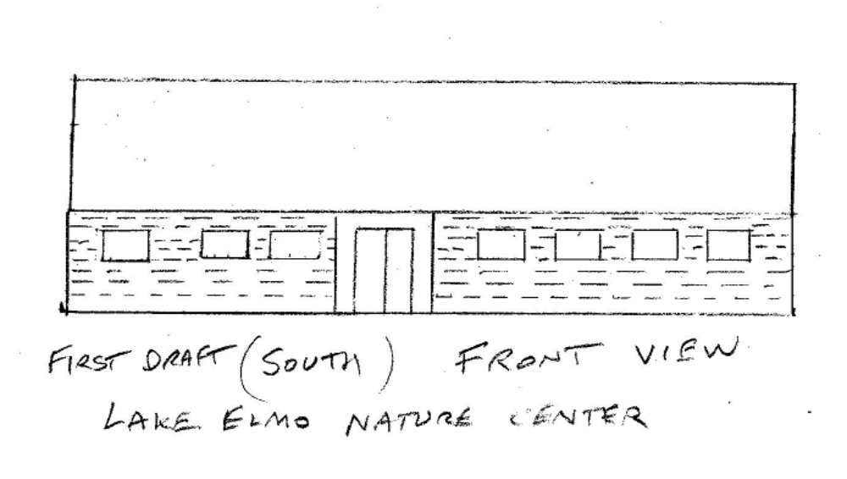
Roof area (solar panels?)

Slide 9
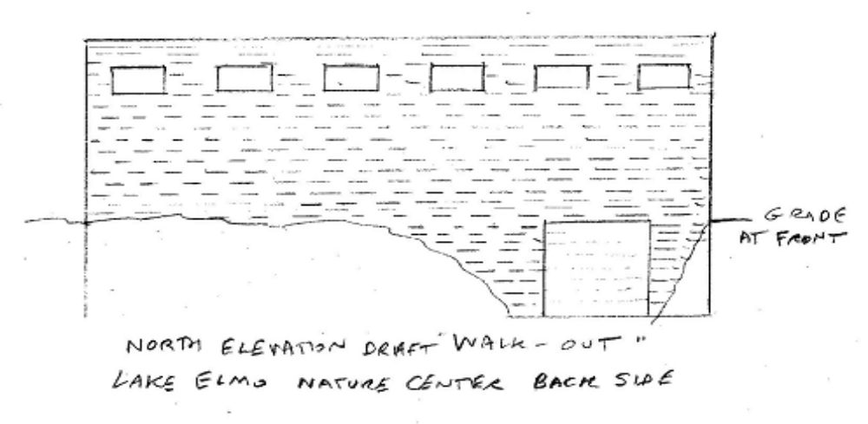

Slide 10
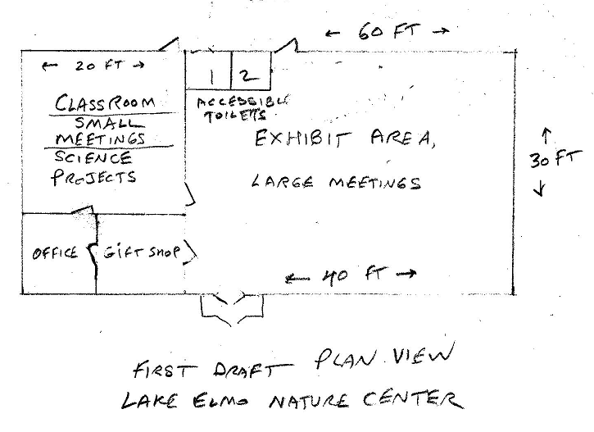
North
Is up

Slide 11
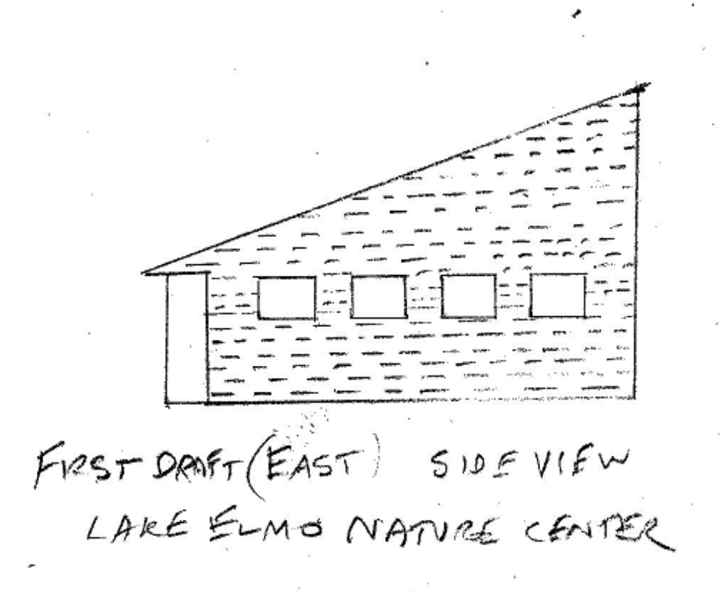

Slide 12
Building features
Modern energy-efficient low-maintenance design
ICF walls, Metal siding, Spancrete roof with solar panel overlay
Large Exhibit Area for photographs and specimens
Small Classroom & Project Area / Naturalist’s office
Small Gift Shop to help with fundraising
Possible meeting space in exhibit area
Storage space for some equipment on lower level “walk-out”
South-facing roof for solar panel efficiency
Passive-solar eaves and windows on south exposure
Small windows on north exposure
Possible mezzanine level along north wall for gallery or ? space

Slide 13
Utility considerations
Geothermal heat pump for HVAC, plenty of space for ground loop
Electrical power – how far to run?
Solar roof panels to power lights and heat pump on sunny days
Sell power to grid when it is not needed
Water supply from well or main?
Sewer Connection or septic system on-site?
Security cameras inside and outside

Slide 14
Funding mechanism (draft)
Establish 501 (c)(3) non-profit organization e.g. “Friends of Lake Elmo Nature Center” to accept tax-deductible donations.
Name a Board of Directors to oversee fundraising and operations
I would contribute about $125 K (from IRA if tax deductible) as the source of 100% matching funds to other donor’s contributions
The organization would start a campaign to collect matching donations from local residents and businesses
Many Baby Boomer retirees will face mandatory minimum withdrawals from IRA’s and 401(k) investments at age 70.5, in most years a charitable contribution is considered part of MRW and is untaxed

Slide 15
Funding mechanism (draft)
Local businesses could contribute cash, services or materials
Annual fundraising would be done to build up endowment fund
Gift Shop operation with profits to the endowment fund
For Example, Photo Contest (taken at Sunfish Lake Park) with rights to photos to go to gift shop to sell prints
Local arts and crafts could be sold on consignment to profit the fund
Building might cost $250K
Endowment fund might be targeted at $100K

Slide 16
Action so far -
Talked with Todd Williams, he liked this idea, said that Lake Elmo Parks commission was the place to start, suggested Shane Weis
Talked with Kyle Klatt 3/16, he suggested meeting with Alyssa MacLeod
Met with Alyssa on 3/23 – she said that there was a hope that such a project could be done, it fit with the strategic plan for parks development
Scheduled a meeting with Dave Magnuson (City Attorney of Stillwater, my personal attorney and friend) to discuss this sort of partnership
Talked with Shane Weis 3/26, he liked it, talked of bike trail proposal which might also use a NPO funding scheme. Planning for some enhancement of Sunfish Lake Park is part of LE Park Commission one-year plan
Sent draft of this presentation to Alyssa and Shane 3/26 for comments

Slide 17
Next Steps
Request 15 minutes at Parks Commission Meeting at 6:30 PM May 18th at Lake Elmo City Hall to give this presentation

