Slide 1

THE ROYAL GOLF CLUB
Lake Elmo, Minnesota
Park Commission Review
Concept PUD
August 15, 2016

Slide 2
Guiding Considerations
Create a High Quality, High Amenity Neighborhood with Recreational Facilities Forming a Strong Sense of Identity
  Neighborhood Fitness Center
  Youth Par 3 Golf Course
  Swimming Pools
  Trails and Sidewalks Creating Linkages Between Neighborhoods and the Clubhouse Area
  9 Custom Home Builders, Architectural Control, 4-Sided Architecture
  Amenities designed with Common Themes
Respect for Existing Conditions
  21 Different Wetland Basins
  Variable Topography – 70’ Feet of Grade Change Across Site
  Woodlands
  3 Different Environmental Lakes, Each with its Own Shoreland Overlay
  DNR Waterway Connecting lake Elmo to Horseshoe Lake
  Access Limited by Surrounding Neighborhoods and Protected Natural Features

Slide 3
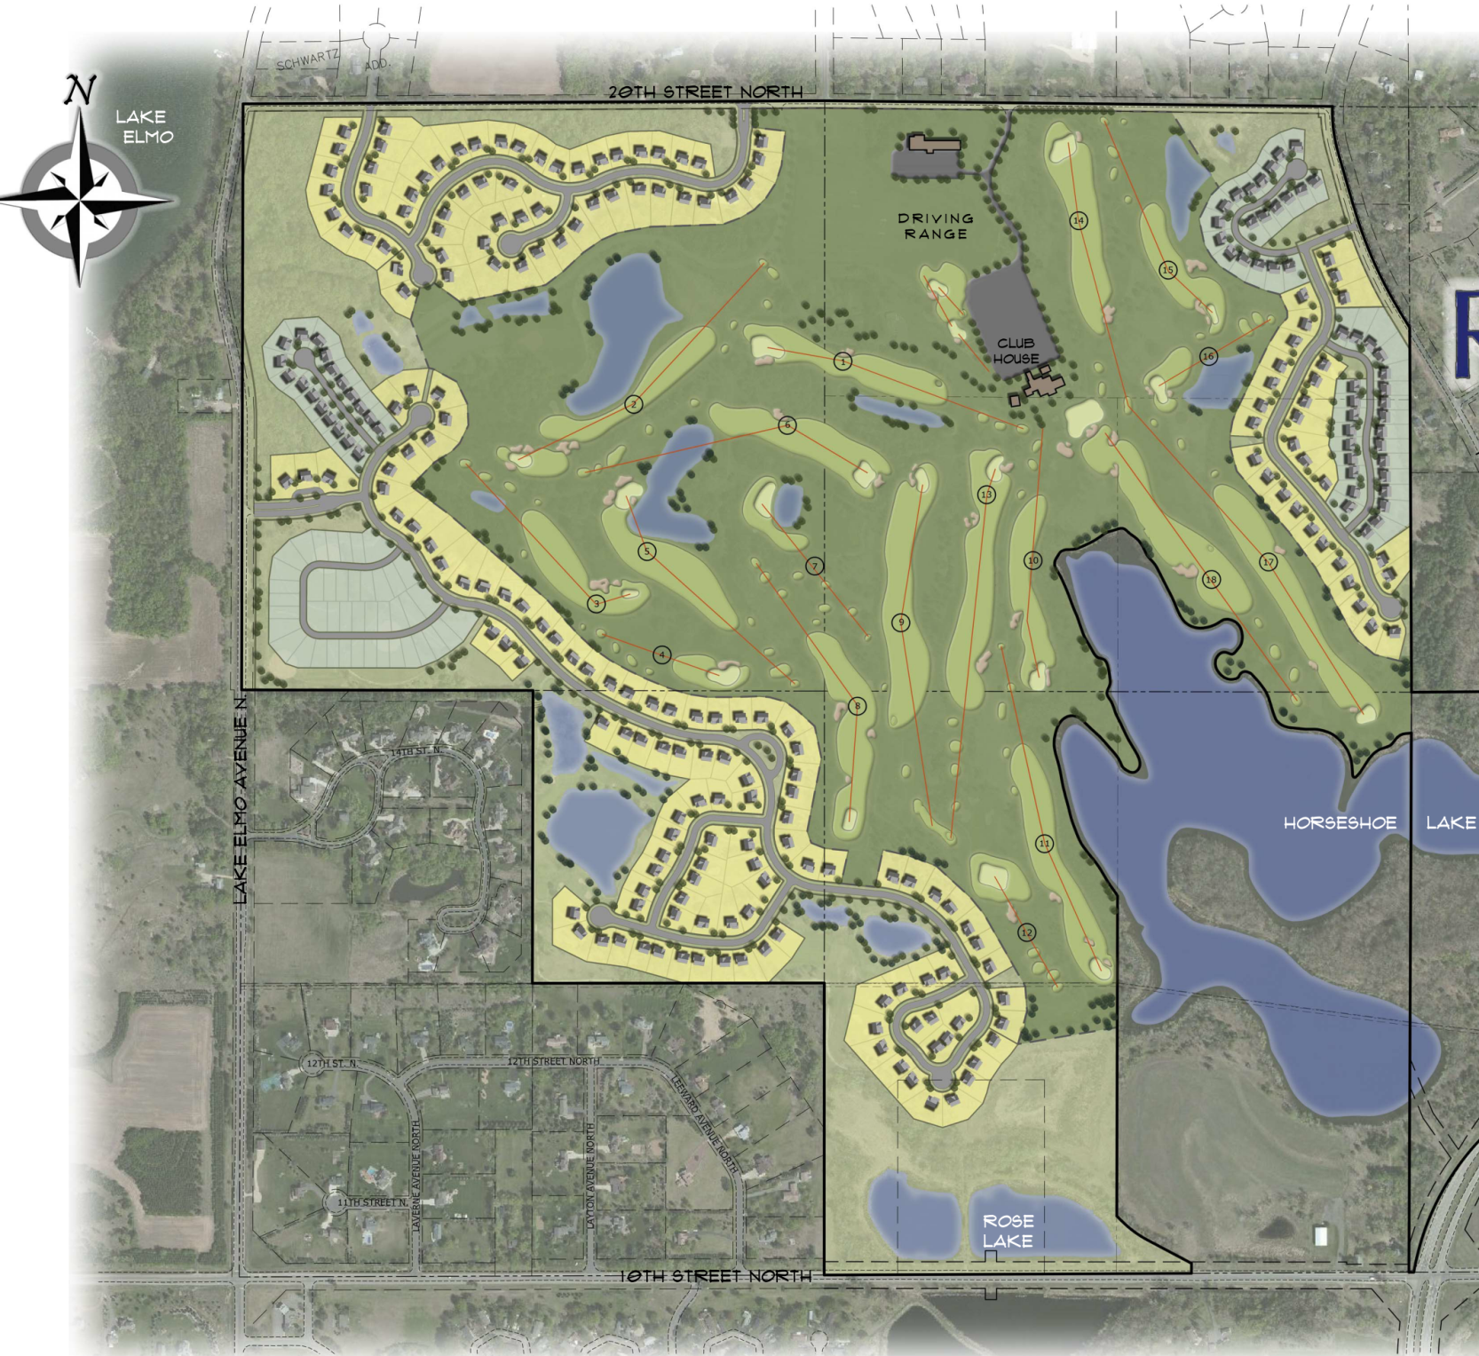

Slide 4
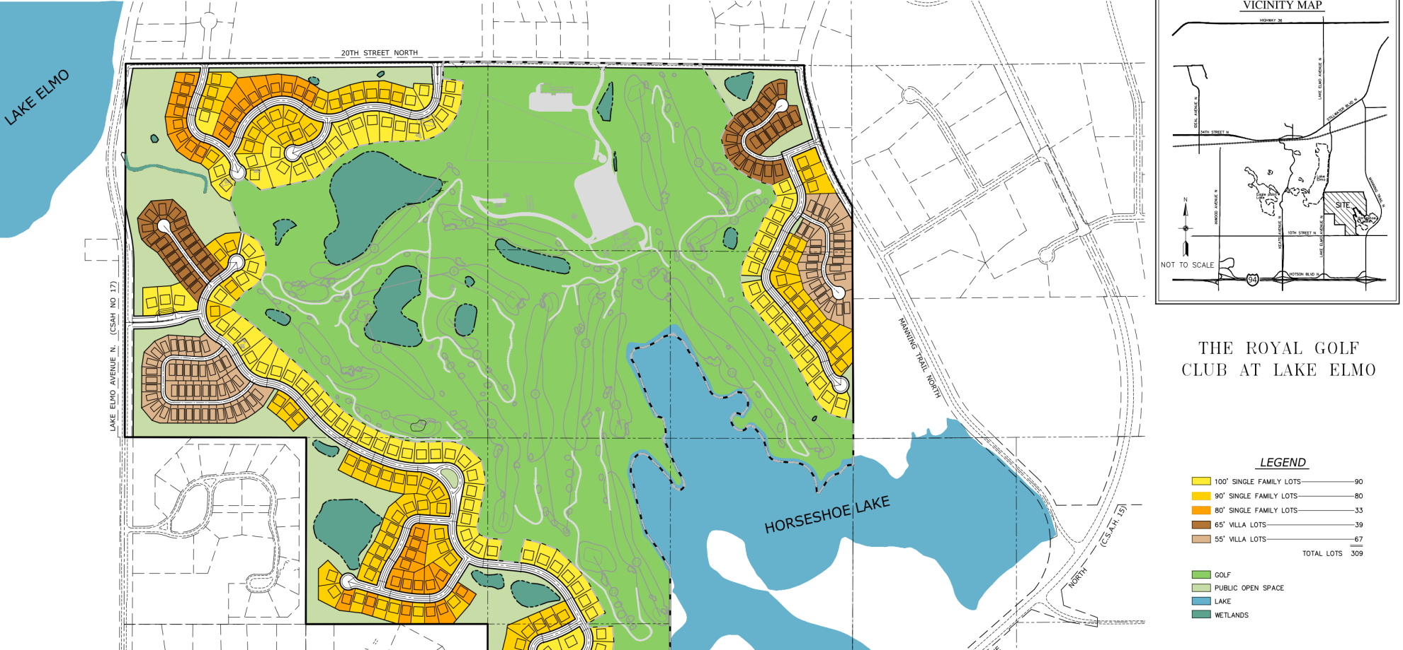

Lot Mix

Slide 5
Density
Submitted Plan contains 301 Units
Gross Residential Site Area is 205.66 acres
Net Residential Site Area is 132.93 acres
Gross Density is 1.16 D.U./acre
Net density is 2.26 D.U./ac

Slide 6
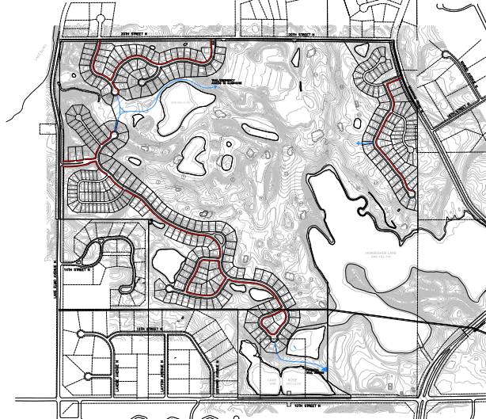
Internal Trails and Sidewalks

Slide 7
Parks and Open Space
Golf Course will be turned from private to public along with clubhouse
Approximately 74 acres of Private Open Space will be provided. Included with this will be youth golf course (Par 3), a swimming pool, and fitness center
Public Trails will be discussed
No public parkland is proposed; dedication will be via fees.

Slide 8
Sustainability
Golf Course
  All areas reseeded/slit-seeded with drought tolerant, disease resistant grasses requiring less watering, fewer herbicides and less run-off
  In the past, the course irrigation was done with 93% stormwater run-off. We expect this to improve.
  Clubhouse built with new, energy efficient, state of the art HVAC systems
  In conjunction with the University of Minnesota, the youth golf course will be used as a study area for new, improved types of grasses using less chemicals and water
Residential
  All homes will be required to use Anderson windows, 30 year architectural shingles, Trane energy efficient heating and cooling
  All residential stormwater will be conveyed through multiple pond systems, infiltration basins and other conveyance features before reaching any public water. No storm sewer will be directed toward Lake Elmo.
  All HOA covenants will be friendly to alternative forms of energy.

Slide 9
THANK YOU!

