Slide 1
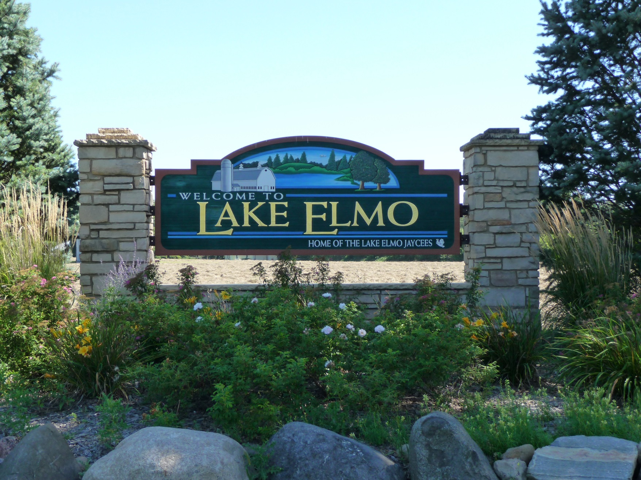
Lake Elmo Parks
Capitol Improvement Plan (CIP)

Slide 2
Funds for new park development
At the May 21st park meeting funds were reallocated so that two new parks could be planed for development in the coming years.
Money was moved from Tablyn ($45,000) and Reid (60,000) to accomplish this goal.
New park development funds:
2018 $105,000
2019 $150,000

Slide 3
Recommendation needed:
What are the park improvements that should be included in the 2019-2023 CIP? When should they be completed?
In what order should the new parks receive funding? The decision is pertaining to Inwood and Wildflower/Village Preserve parks.

Slide 4
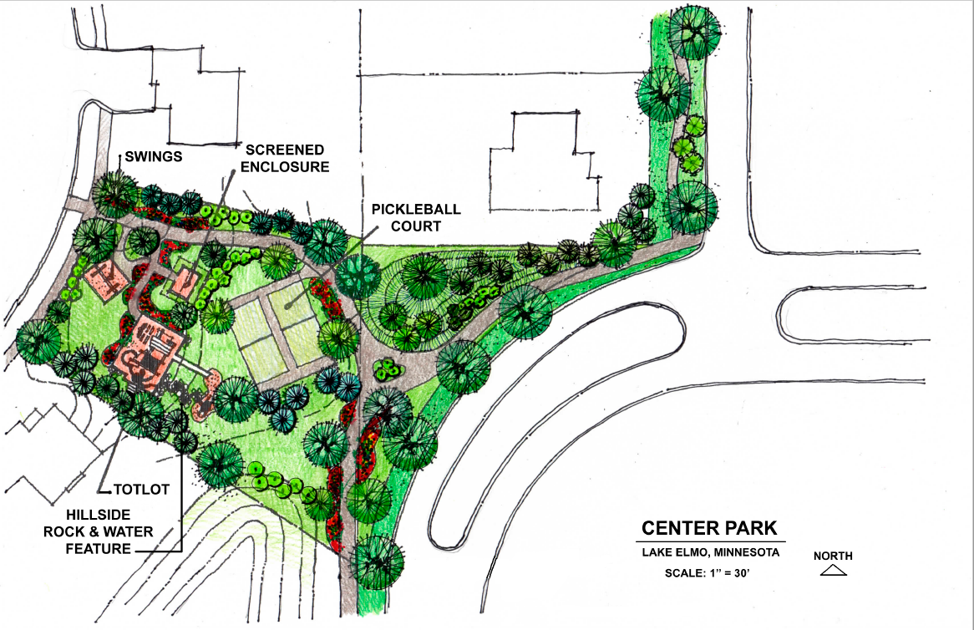
Wildflower/Village Preserve
Village Preserve
Wildflower
The developers gave land in lieu of money for these two developments
The total size is about .75 acres

Slide 5
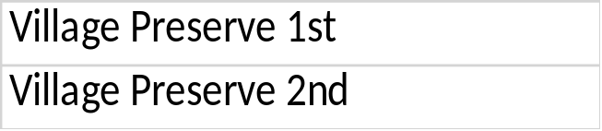
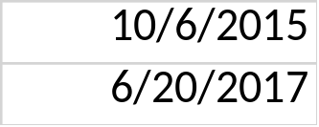
Wildflower/Village Preserve
Total #
Total # of
Total # of
Building
CO's
Of Homes
SF Homes
Townhomes
Permits Issued
Issued
Zoning
8/25/2015
46
46
0
40
31
LDR
9/9/2016
45
45
0
32
28
LDR
Total
91
91
0
72
59
Wildflower
60
60
0
36
30
PUD/MDR
Wildflower
20
20
0
4
2
PUD/MDR
Total
80
80
0
40
32
Total Combined
171
112
91

Slide 6
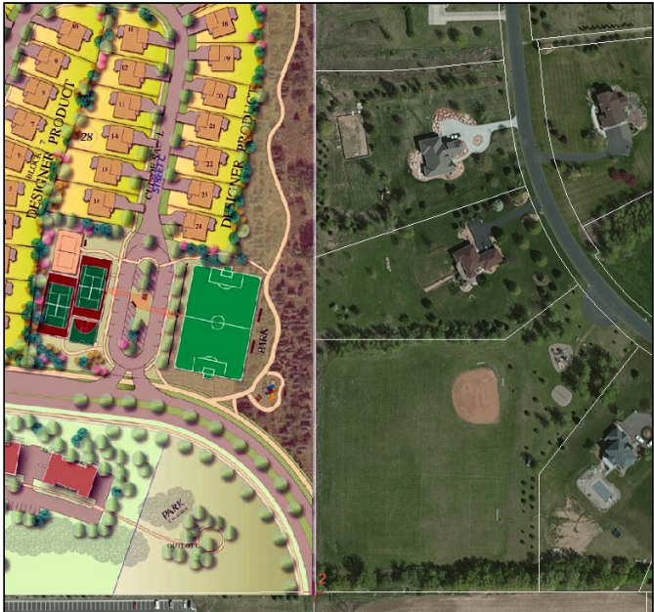
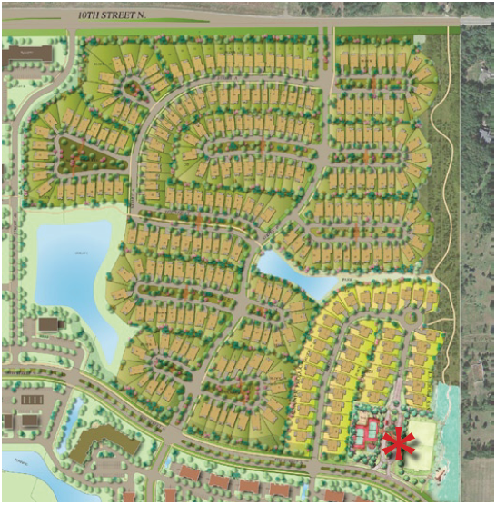
Inwood Park Concept
Stone Gate

Slide 7
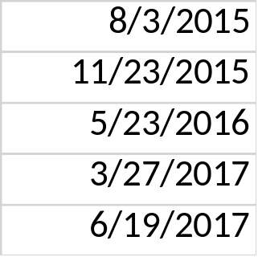
Inwood
Total #
Total # of
Total # of
Building
CO's
Of Homes
SF Homes
Townhomes
Permits Issued
Issued
Zoning
Inwood 1st
40
40
0
39
37
PUD/LDR
Inwood 2nd
21
21
0
21
21
PUD/LDR
Inwood 3rd
68
68
0
68
65
PUD/LDR
Inwood 4th
60
60
0
19
11
PUD/LDR
Inwood 5th
101
101
0
47
32
PUD/LDR
Total
290
290
0
194
166

Slide 8
Wildflower/Village Preserve is 65% developed with 53% of the homes occupied.
Total lots 171
Building Permits Issued 112
Certificate of Occupancy Issued 91
Inwood is 66% developed with 57% of the homes occupied.
Total lots 290
Building Permits Issued 194
Certificate of Occupancy Issued 166

Slide 9
Questions?

