Slide 1
9450 Hudson Blvd Preliminary PUD
Park Dedication
Parks Commission Meeting
May 16, 2022

Slide 2
INTRODUCTION/BACKGROUND
Applicant: SRD 2.0, LLC
Property Owner: DPS- Lake Elmo, LLC
Location: North of Hudson Blvd and West of Julia Ave
PID#: 34.029.21.34.0012
Site Area: 14.15 Acres
Proposal: 190 unit apartment building (northern half), preschool/childcare center up to 188 children (Southeast corner)
Notes:
The City has received a request from Inland Development Partners LLC for review of a Planned Unit Development (PUD) Pre-Application and Plat Pre-Application/Sketch Plan. The proposal is for a 130-unit
apartment building, a 42-unit senior housing building, and 136 townhouses (308 total units) on 31.8 acres located on the south side of the intersection of 39th Street and Stillwater Boulevard. The proposed project would require approval of a PUD, plat and a zoning map amendment (rezoning) to the land use designations guided by the Comprehensive Plan. The pre-application/sketch plan process is a staff level review. No development rights are granted at this stage.

Slide 3
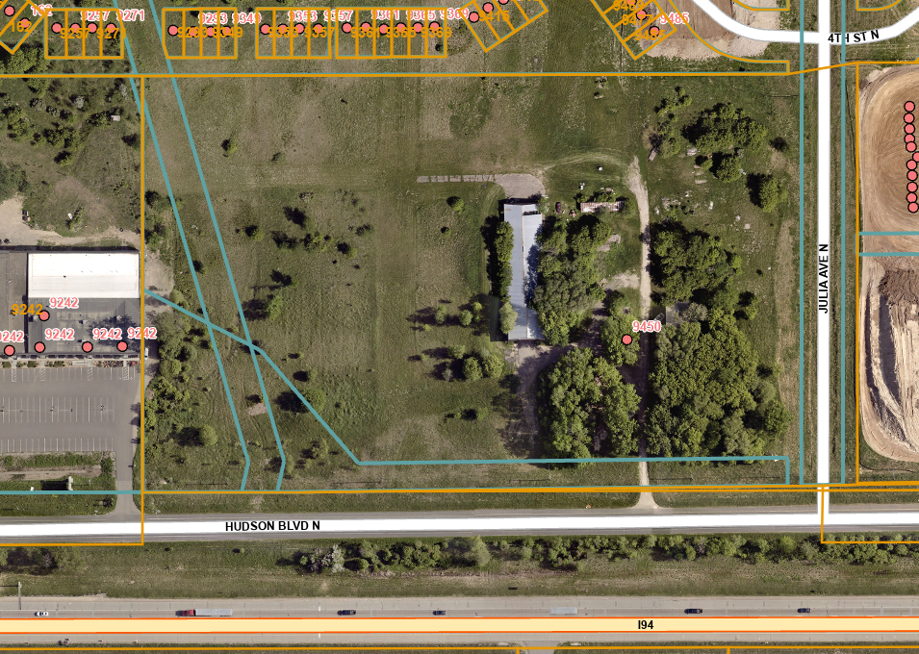
BACKGROUND CONTINUED
Comprehensive Plan: Mixed Use Commercial
Current Zoning: Rural Development Transitional
Proposed Zoning: Mixed Use Commercial/PUD
A preliminary PUD was previously submitted to the City in 2020. The Parks Commission recommended Cash in Lieu of Land. Application was withdrawn.

Slide 4
ISSUE BEFORE THE PARKS COMMISSION
The Parks Commission is being asked to review the PUD pre-application and provide feedback on the proposal to meet the City Code Park Land Dedication Requirements and the Comprehensive Plan guidance.
Notes:
The Commission is respectfully requested to review and provide feedback to the developer, and make a recommendation to the City Council for the Preliminary PUD as it pertains to park land or park fund dedication.

Slide 5
SIDEWALKS STANDARDS
Required: 6-foot wide public sidewalk on one side of any public street.
Proposed: Internal private driveways and roads with a series of sidewalks connecting the public street to the building

Slide 6
COMPREHENSIVE PLAN-TRAILS
Comprehensive Plan:
  A road separated trail along Julia Ave
  A on-road striped shoulder trail connection along Hudson Blvd.
Proposed:
  6-foot wide sidewalk along Julia Ave
The City should require the developer to install the planned trails , sidewalks and crosswalk with a pedestrian ramps where needed.

Slide 7
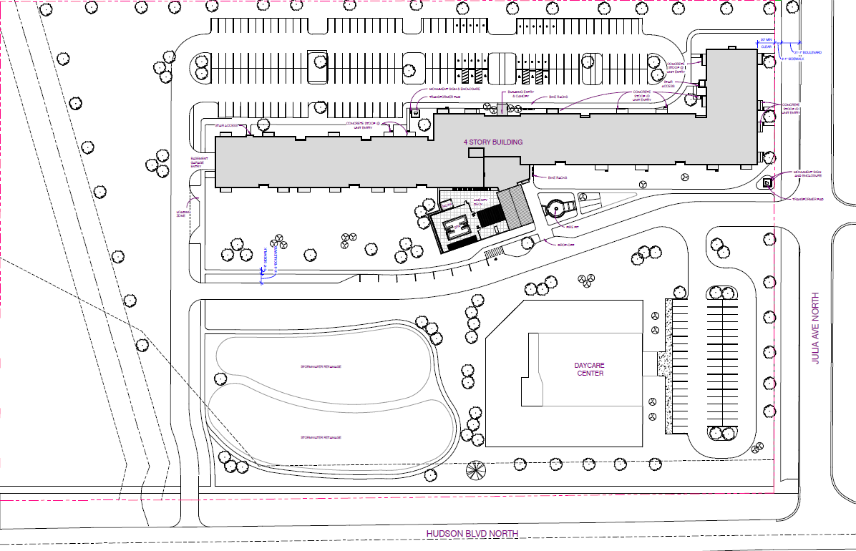

Slide 8
SUBDIVISION CODE
Park Land Dedication Requirements (Section 103.00.150)
  “Dedication of land for park and open space use. In all new residential subdivisions, a percentage of the gross area of all property subdivided shall be dedicated for parks, playgrounds, trails, public open space, or other public recreational use.”
  Developer is required to provide the City with either physical land, cash payment, or a combination of both. Physical land would require 10% of the land, which equals 1.42 acres.
Notes:
§103.00.150 Park Land Dedication Requirements. The City Code outlines the type of land that is considered
acceptable for park dedication.
• Park Dedication Requirement. The developer is required to provide the City with either physical land, cash
payment, or a combination of both.

Slide 9
SUBDIVISION CODE CONTINUED
Land Acceptability
  The City must approve the location and configuration of proposed dedicated park land and shall take into consideration the suitability of the land and for its intended purpose; future needs of the City for parks, playgrounds, trails, or open space; and recommendations of the City’s Parks Commission.
  Trails constructed by a subdivider within dedicated public open space having at least 30 feet of width are eligible for park credit. The amount of trail dedication credit shall not exceed 25% of the total dedication.
Notes:
Land acceptability. The City must approve the location and configuration of any park land which is
proposed for dedication and shall take into consideration the suitability of the land and for its intended
purpose; the future needs of the City for parks, playgrounds, trails, or open space; and the
recommendations of the City’s Parks Commission. The following properties shall not be accepted for park
land dedications:
(1) Land dedicated or obtained as easements for streets, sewer, electrical, gas, storm water drainage and
retention areas, or other similar utilities and improvements;
(2) Land which is unusable or of limited use; and/or
(3) Land within a protected wetland or within a flood plain area unless the Council determines that all of
the following criteria are satisfied:
(a) Would be in the best interests of the general public;
(b) Would be valuable resource for environmental preservation, educational, or habitat preservation
purposes;
(c) Has an exceptional aesthetic value; and
(d) Would not become financially burdensome to the City as a result of maintenance or preservation
requirements.

Slide 10
SUBDIVISION CODE CONTINUED
Excluded from park land dedications
Land dedicated or obtained as easements for streets, sewer, electrical, gas, storm water drainage and retention areas, or other similar utilities and improvements;
Land which is unusable or of limited use; and/or
Land within a protected wetland or within a flood plain area unless the Council determines that all of the following criteria are satisfied:
  Would be in the best interests of the general public;
  Would be valuable resource for environmental preservation, educational, or habitat preservation purposes;
  Has an exceptional aesthetic value; and
  Would not become financially burdensome to the City as a result of maintenance or preservation requirements.

Slide 11
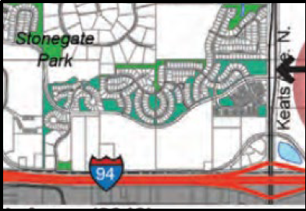
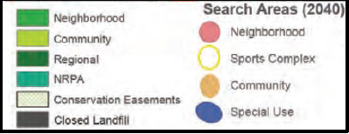
COMPREHENSIVE PLAN- PARKS
The 2040 Comprehensive Plan outlines Park Search Areas within the City.
The proposed development is not located within a defined Park Search Area.

Slide 12
NEARBY PARKS
The proposed development is within the following proximities to nearby parks:
Hammes Park: 0.13 mi
Notes:
The southern 1/4 of the property is planned for parks but much of the area is frequently inundated with
stormwater and so use of the property for parks purposes would have to be carefully designed.

Slide 13
COMMISSION OPTIONS
The Commission may recommend the following options:
                The City accept cash in lieu of land
                The City accept land in lieu of cash
                The City take a combination of both
Notes:
The Commission may recommend to that:
• The City accept cash in lieu of land.
• The City accept land in lieu of cash.
• The City take a combination of both.

Slide 14
STAFF RECCOMENDATION
“Motion to recommend approval of the Preliminary PUD with the acceptance of park dedication funds in lieu of physical land supported by the cited findings.”

