Slide 1
Schiltgen East Preliminary PUD and Plat
Parks Commission Meeting
july 18, 2022

Slide 2
INTRODUCTION/BACKGROUND
Location: South side of the intersection of 39th St N and Stillwater Blvd.
31.8 acres
This development was brought before the Parks Commission at the April 18, 2022 regarding to park dedication requirements during the pre-application phase. Recommended taking 3.2 acres of land for future park space.
The proposal brought forth at the April 18th meeting lacked a required secondary access to a public right of way.
Pre-Application
136 Townhomes
130 Unit Apartment Building
42 Unit Senior Housing Building
Preliminary PUD/Plat
240 Townhome Units
Notes:
The City has received a request from Inland Development Partners LLC for review Preliminary Planned Unit Development (PUD) and Plat. This development was brought before the Parks Commission at the April 18, 2022 meeting to provide feedback and make a recommendation regarding park dedication requirements. The Parks Commission recommended taking 3.2 acres of land for future park space at the April 18, 2022 meeting. The initial proposal during the Pre-application phase was for a 130-unit apartment building, a 42-unit senior housing building, and 136 townhouses (308 total units). The two multifamily buildings proposed during pre-application have now been replaced with 97 attached townhomes, decreasing the total units to 244. This project requires approval of a PUD, plat and a zoning map amendment (rezoning) to the land use designations guided by the Comprehensive Plan.

Slide 3
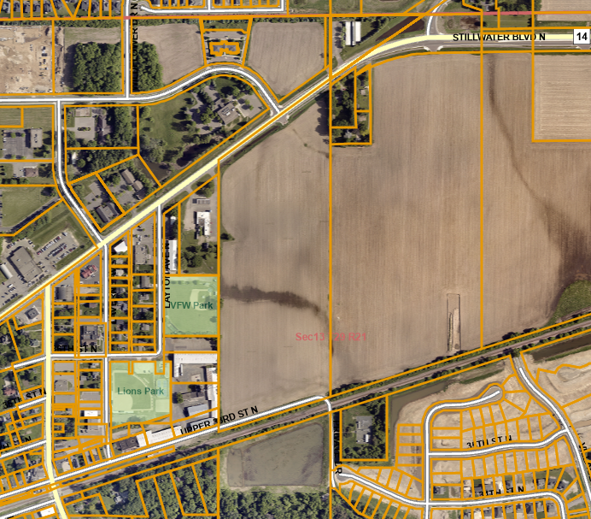
BACKGROUND CONTINUED
  The applicant is now proposing/requesting to construct a new road with 25 parking stalls through the north end of VFW Park as a secondary access.

Slide 4
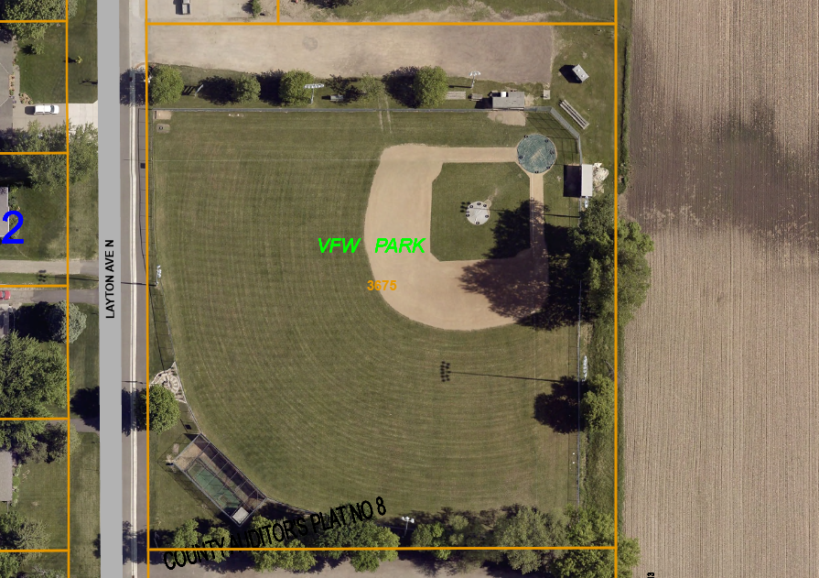

Slide 5
ISSUE BEFORE THE PARKS COMMISSION
Review the Preliminary PUD and Plat to provide feedback and a recommendation on the proposal to construct a new road with 25 parking spaces through the north end of VFW Park.
Notes:
The Parks Commission is being asked to review the PUD pre-application and plat sketch plan and provide feedback on the proposal to meet the City Code Park Land Dedication Requirements and the Comprehensive Plan guidance.

Slide 6
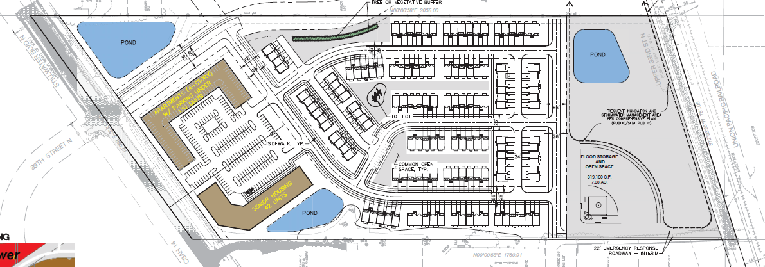
N

Slide 7
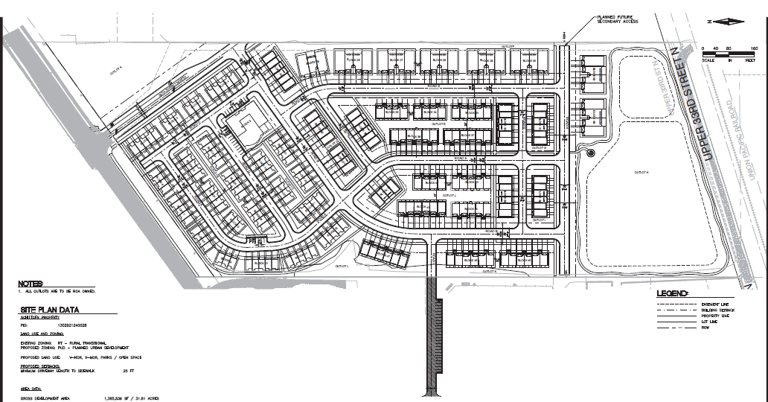
Village Parkway

Slide 8
PROPOSAL DETAILS/ANALYSIS
Secondary access through VFW Park is proposed as temporary until future development allows access to the planned Village Parkway.
Requesting an easement for road placement
Easement would be dedicated to the City once a new secondary access is established.

Slide 9
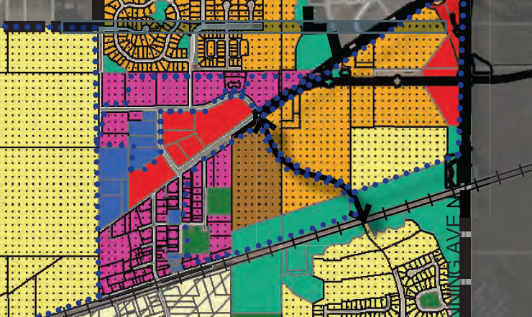

Slide 10
PROPOSAL DETAILS/ANALYSIS
  Parking spaces are proposed directly adjacent to the right field fence line of VFW ballpark.
  High probability that parked vehicles will be struck by foul balls
  Construction of parking spaces would require removal of mature trees.
  May require the relocation of spectator seating and overhead ballpark lighting.
  Relocation of parking spaces is preferred.

Slide 11
OPTIONS
Recommend approval to construct a new road with 25 parking spaces through the north end of VFW Park.
Recommend denying the request to construct a new road with 25 parking spaces through the north end of VFW Park.

Slide 12
STAFF COMMENTS
City Engineer
Recommends denial of the Preliminary Plat as presented. Plans should be revised to be in compliance with secondary access requirements and City Design Standards.
Planning
The proposal is for access that is inconsistent with the Comprehensive Plan. Recommends denial of preliminary plat and PUD.

Slide 13
RECCOMENDATION
Review the proposal and make a recommendation to construct a new road and 25 parking spaces through the north end of VFW Park.

